Slide 1
COMMONWEALTH OF MASSACHUSETTS
Deval L. Patrick, Governor
Richard K. Sullivan, Jr., Secretary
Mark Sylvia, Commissioner
Massachusetts Land Conference
March 22, 2014
Solar Fields and Greenfields – State Resources for Siting
Meg Lusardi, Director
Green Communities Division
Notes:
Talk about programs and tools to OPTIMIZE siting of solar

Slide 2
State Policy and Legislation Creates Momentum
Green Communities Act (GCA)
RPS Class I Carve Out - Solar
Long Term Contracts / Net Metering
Green Communities
All cost effective energy efficiency
Global Warming Solutions Act (GWSA)
Clean Energy and Climate Plan set GHG emission reduction limits at 25% below 1990 Baseline Levels by 2020; 80% reduction by 2050 → Renewables 4%
Governor Patrick’s Renewable Energy Goals
Install 250 megawatts of solar capacity by 2017 – met in April 2013→New goal of 1600 MW by 2020
Install 2000 megawatts of wind capacity by 2020
Notes:
Legislation/Goals put MA at forefront of clean energy policy and programs
Why Do? 1) Reduce Carbon footprint (GWSA) 2) Promote Economic Development – 2013 Mass CEC Clean Jobs report shows 11.8% inc in clean energy jobs from 2012 – 2013, and 11.2% year prior; ~ 80K clean energy workers and 5,500 clean energy firms 3) Energy Independence – WE spend $22B/yr on energy; 80% or $18B leaves MA, we import vast majority of our energy resources
Will talk about arrowed topics….
GWSA target – Renewables are 4% of 25% limit; only takes into account the increase in the RPS implemented under the GCA, .5% additional each year (originally grew at .5% each year, now at 1% each year)
Current solar installed – 464 MW

Slide 3
Solar is Working for the Commonwealth
Solar is well distributed throughout the Commonwealth, with installations in 348 of 351 MA cities and towns. Over 130 municipalities are hosting solar projects on town facilities.
Solarize Mass program has supported 9 MW of residential solar in 33 towns (another 15 towns are underway).
Massachusetts is well ranked nationally (SEIA 2013)
4th in solar capacity installed in 2013
6th in cumulative installed capacity
3rd in commercial installations; 5th in residential installations
2nd lowest weighted average commercial installation costs
4th in total solar jobs; 6th in per capita solar jobs
Over 1800 firms in MA work primarily in the renewable energy sector, employing over 21,000 workers. Nearly 60% of renewable energy workers support the solar sector (2013 MassCEC Jobs Report).

Slide 4
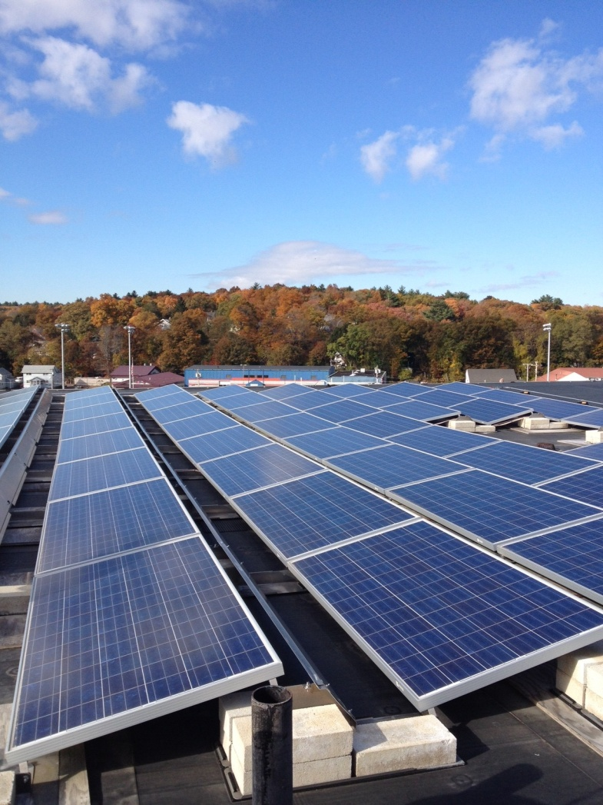
RPS Solar Carve-Out Phase II (SREC-II)
SREC-II program will
continue growth of solar PV
to meet Governor’s new goal
of 1600 MW by 2020
Rulemaking complete in
April 2014.
DOER has established a
complementary solar loan program
to support residential direct
Ownership market.
Notes:
I mentioned we met our first goal, now we have a new goal, how do we plan to get there?
1600 MW represents 3-4% of Massachusetts’ electric load; probably represents ~ 50K projects, and we have more than 2.5M roofs in MA

Slide 5
SRECII - Managed Growth Market Sectors and SREC Factors
Market Sector |  | SREC Factor
A | Generation Units with a capacity <=25 kW, Solar Canopies, Emergency Power Generation Units, Community Shared Solar Generation Units, low or moderate income housing units. | 1.0
B | Building Mounted Generation Units, ground mounted Generation Units with a capacity > 25 kW with 67% or more of the electric output on an annual basis used by an on-site load. | 0.9
C | Generation Units on Landfills or Brownfields, or Generation Units with a capacity of <= 650 kW with less than 67% of the electrical output on an annual basis used by an on-site load. | 0.8
Managed Growth | Unit that does not meet the criteria of Market Sector A, B, or C. | 0.7
Notes:
1 SREC = 1 MWh of production
SREC Factors differentiate market sectors and provide different incentive levels to different types of projects; SREC Factors represent the % of output produced that you obtain SRECs for.
Managed Growth sector helps control market growth. Qualification under this sector will be limited by Annual Capacity Blocks made available on a two year forward schedule by DOER. That this will be the process is in the regulation, but what the actual limits will be announced every August.
Looking for sustained growth over a long period versus spurring growth like under SREC I; larger projects costs less and do not need as much incentive ($/w); Developers are definitely moving towards “un-managed” growth
If Market Sectors A,B and C take off, then there will be NO need for D
Compliance Obligation and Minimum Standard set in regulation for 2014 and 2015. Annual calculations thereafter based on actual and projected installed supply; constrained by Yearly Installed Capacity Targets, which help determine Annual Capacity Blocks for Managed Growth sector.
Sectors A,B, and C can grow as much as possible in any given year, but Managed Growth is capped on an Annual Basis ; 2014 (after SREC II in place) 26 MW; 2015 at 80 MW.
Targeted Growth is ~150MW/yr with Annual Compliance Obligation formula. Note that Managed Growth has been at about 50% of market to date, the 2015 limit reduces that to ~60%. BUT, limits will be reduced if A, B, and C take off
Managed Growth is filled on a first come first serve basis, process very similar to applying for Net Metering – must have a signed Interconnection Service Agreement, all non-ministerial permits, and be installed in 9 months thereafter (can get extensions)
ACP for 2014 and 2015 set at $375; declines on an annual basis thereafter
650 kW is 2-3 acres

Slide 6
Green Communities Division - Solar Programs & Resources for Municipalities
Four Regional Coordinators located at Mass DEP offices
Model Bylaws
Green Communities Criteria 1 Bylaw
New Model Bylaw encompassing all solar
Handbooks
Questions & Answers: Ground-Mounted Solar Photovoltaic Systems
The Guide to Developing Solar Photovoltaics at Massachusetts Landfill
Documents located under “Opportunities and Publications” on our website: www.mass.gov/energy/greencommunities
Common message in bylaws/documents: encourage development on previously disturbed lands, discourage cutting of trees
Notes:
Tools and TA we provide for optimally siting solar
Common message for Large-scale ground-mounted solar.

Slide 7
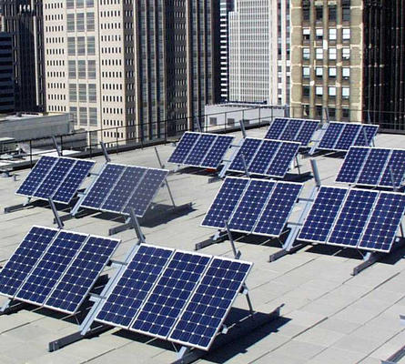
Model Zoning and Guidance for Solar Energy System Regulation
Responds to identified need to help communities establish solar energy regulations
Addresses small, medium and large-scale roof and ground-mounted systems
Reflects statutory limits on municipal ability to regulate solar energy systems
Chapt 40A – Solar systems may not be prohibited or unreasonably regulated; “reasonable” not defined
Notes:
This Guidance, along with the companion Model Zoning for the Regulation of Solar Energy System, was prepared to assist cities and towns throughout Massachusetts in establishing reasonable standards to facilitate development of small-, medium- and large-scale ground-mounted and roof-mounted solar energy systems. DOER acknowledges that this Guidance represents our own understanding of state law and has made every effort to carefully research this issue. While DOER believes our interpretation is reasonable, we anticipate that local municipal counsel may offer a different interpretation and that communities will need to consider these alternatives moving forward. It is highly recommended that any local regulatory language developed from this Guidance be reviewed by municipal counsel prior to adoption.
GUIDANCE: 1) discusses various statues and our understanding of the them 2) encourages robust outreach and education, and an audit of existing zoning
MODEL ZONING LANGUAGE: provides suggested language for municipalities to consider

Slide 8
Model Zoning and Guidance for Solar Energy System Regulation
Model bylaw provides a framework for local zoning – zoning is controlled at the local level
Green commentary sections highlight questions local decision makers should consider to tailor the model to local circumstances
Example:
Commentary: As drafted, this model zoning does not require medium-scale ground mounted solar energy systems to be fenced, but this is something communities will want to consider. Regardless, many project proponents will find fencing prudent.
Review customized bylaw with legal counsel

Slide 9
Model Zoning and Guidance for Solar Energy System Regulation
Definitions:
Solar Energy System: A device or structural design feature, a substantial purpose of which is to provide daylight for interior lighting or provide for the collection, storage and distribution of solar energy for space heating or cooling, electricity generation, or water heating.
Solar Energy System, Large-Scale: An Active Solar Energy System that occupies more than 40,000 square feet of surface area (equivalent to a rated nameplate capacity of about 250kW DC or greater).
Solar Energy System, Medium-Scale: An Active Solar Energy System that occupies more than 1,750 but less than 40,000 square feet of surface area (equivalent to a rated nameplate capacity of about 10 - 250 kW DC).
Solar Energy System, Small-Scale: An Active Solar Energy System that occupies 1,750 square feet of surface area or less (equivalent to a rated nameplate capacity of about 10 kW DC or less).
Notes:
Large- Scale – consistent with GC AOR model bylaw

Slide 10
Notes:
SPR – no discretionary review allowed
Is this “reasonable”? Probably depends on who you talk to. But without case law, we believe it is.
40A sec 3 from early 80’s, not clear that it contemplated a market that included large-scale groun-mounted systems, so ucnlear if it was meant to protect this type of development
Consistent with establishment of Solar under Crit 1 for GC designation, designated location, so it is implied that you would do something else in other locations throughout the municipality.

Slide 11
Model Zoning and Guidance for Solar Energy System Regulation – Siting Preferences
Where a solar facility is sited, as well as placement on the site, is important, particularly for large-scale ground mounted facilities.
DOER strongly discourages locations that result in significant loss of land and natural resources, including farm and forest land, and encourages rooftop siting, as well as locations in industrial and commercial districts, or on vacant, disturbed land.
Significant tree cutting is problematic because of the important water management, cooling, & climate benefits trees provide.
Notes:
DOER emphasis

Slide 12
Model Zoning and Guidance for Solar Energy System Regulation – Siting Preferences
Siting Preferences – Agricultural
Rooftops
Non-productive, non-arable agricultural land
Dual use of land to preserve productive farmland by continuing crop production underneath high-mounted & well spaced panels
Use of the least productive land first to minimize the loss of productive food/crop land.
Agricultural Exemption – See Gerry!
Notes:
DOER emphasis

Slide 13
Contact Information
Meg Lusardi - Director
meg.lusardi@state.ma.us
www.mass.gov/energy/greencommunities
www.mass.gov/doer
Email updates via listserv – Sign up by sending an email to:
join-ene-greencommunities@listserv.state.ma.us

