Slide 1
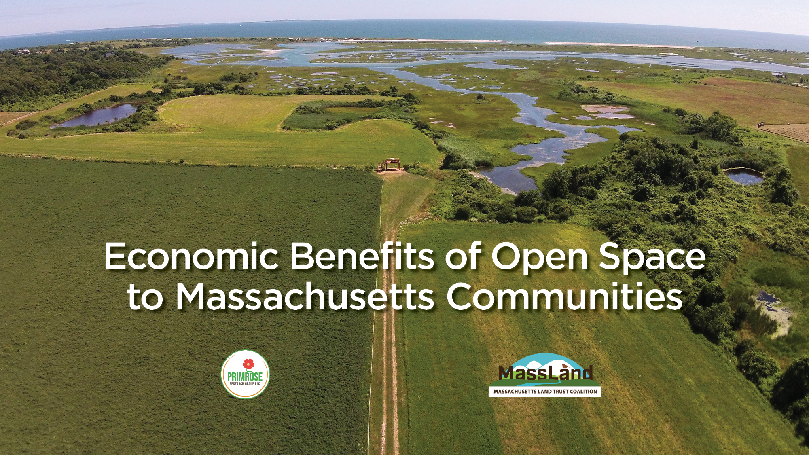

Slide 2
Notes:
The purpose of this presentation is to give an overview of the economic benefits that conserved lands provide to communities across Massachusetts. It is based on a paper prepared for the Massachusetts Land Trust Coalition, where full citations for all referenced studies can be found.
Land conservation benefits residents, local businesses, and municipalities. This presentation will detail the benefits by beneficiary.

Slide 3
Community Concern | How Land Conservation Helps
Resident energy costs for heating/cooling Heatwaves | Natural temperature moderation
Chronic illness, obesity, heart and lung disease, mental health | Enables recreation and improves human health
Air quality index warnings | Improves air quality
Flooding | Prevents development in vulnerable areas Stores and slows runoff from storms
Drinking water quality | Naturally filters and cleans water Enhances infiltration and replenishment of ground water resources
Stormwater management | Stores and slows runoff from storms
Jobs | Strengthens economic development Supports industries that rely on working landscapes (e.g., forestry and agriculture)
Equity | Supports environmental justice
Climate change | Moderates temperatures Helps accommodate rising sea levels and flooding
Notes:
This slide introduces the concept of how land conservation benefits communities by addressing local concerns. The table is intended to be customized for the specific concerns of your community. It is not intended to universally apply to all concerns land conservation can help address across all communities in the state.
Land conservation may help address community concerns. Here in NAME PLACE, BLANK, BlANK, and BLANK are top concerns. This presentation will detail how land conservation can help with these concerns.

Slide 4
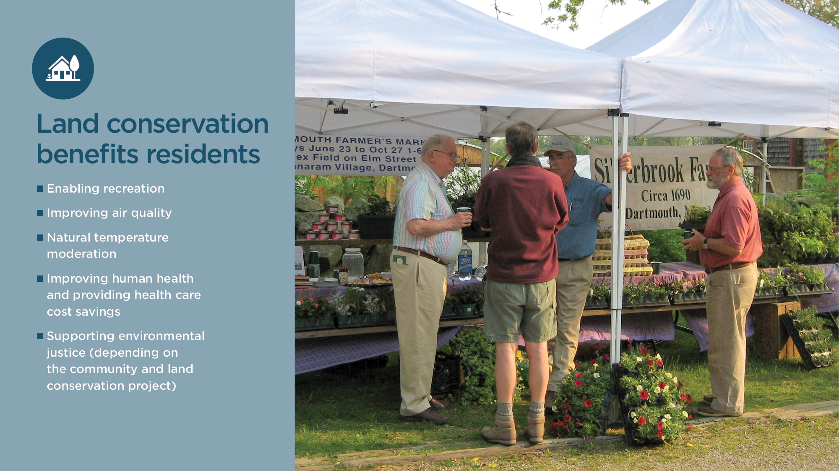
Notes:
Quality of life plays a critical role in municipal economic development. Employees in today’s economy consider more than salary when choosing where to work and reside. For example, focus groups conducted by Carnegie Mellon University have found that young creative workers, particularly those in high-technology fields, consider lifestyle factors, such as environmental and recreational quality, more heavily than the job itself when choosing where to live.
Florida, R., Cities and the Creative Class (New York: Routledge, 2005).
This is especially true in Massachusetts as the pandemic has changed the way people work and businesses operate. According to the Massachusetts Business Roundtable and The Center for State Policy Analysis “Prior to the pandemic, Massachusetts cities and towns were focused on attracting companies to anchor development sites and spur job creation. Now, however, municipalities need to consider strategies to attract talent to live within the community—and entice companies to follow. Talent is drawn to communities with vibrant environments such as restaurants, cultural hubs, ample green space, and reliable broadband. While municipalities can still leverage state tax incentives to attract companies, investments within the community will lure talent locally and, thereby, make it more attractive for companies to hire locally.”
Massachusetts Business Roundtable and The Center for State Policy Analysis. A Talend Agenda to Drive Massachusetts’ Competitiveness. Fall 2021.
Conserved land contributes to local economic development by making communities more attractive to new residents and also providing low-cost opportunities for recreation and health, including improving air quality and moderating temperature, that increase the quality of life for residents.
See white paper page 4 for more details

Slide 5
Notes:
Local recreational access is important because most recreational activities are conducted within five miles of home.
Executive Office of Energy and Environmental Affairs. Massachusetts Statewide Comprehensive Outdoor Recreation Plan 2017. Submitted to the National Park Service. December 2017.
People are willing to pay for recreational access to trails, parks, and even private facilities. This value exists even if individuals do not have to pay to access these amenities (e.g., pay an entry fee). The benefit accrues to the user in one of two ways: by providing cost savings to individuals who were willing to pay to recreate but did not have to, or by providing travel cost savings to individuals who do not have to travel further from home to access a substitute site. Following the U.S. Army Corps of Engineers’ Unit Day Value methodology, one can estimate recreation benefits by specific activity, assigning each activity a dollar value. Oregon State University’s Recreation Use Values Database contains values for more than 20 activities and is based on over 420 economic studies that estimated the use value of recreation activities in the United States and Canada from 1958 to 2015.
Oregon State University, Recreation Use Values Database, accessed January 13, 2022, http://recvaluation.forestry. oregonstate.edu/database.
See white paper page 4 for more details

Slide 6
Notes:
Air pollution is a significant and expensive problem associated with growth that injures human health and damages structures. Human cardiovascular and respiratory systems are affected, with broad consequences for health care costs and productivity.
Kampa, M. and E. Castanas, “Human Health Effects of Air Pollution,” Environmental Pollution 151 (2007): 362–367; Currie, J., “Pollution and Infant Health,” Child Development Perspectives 7 (2013): 237–242.
In addition, acid rain, smog, and ozone increase the need to clean and repair buildings and other infrastructure.
Butlin, R. “Effects of Air Pollutants on Buildings and Materials,” Proceedings of the Royal Society of Edinburgh. Section B. Biological Sciences 97 (1990): 255–272; U.S. Environmental Protection Agency, The Plain English Guide to the Clean Air Act, EPA-456/K-07-001, Office of Air Quality Planning and Statistics, 2007.
The vegetation in conserved lands plays a role in improving air quality, helping nearby areas avoid the costs associated with pollution.
Nowak, D., S. Hirabayashi, A. Bodine, and R. Hoehn, “Modeled PM2.5 Removal by Trees in Ten U.S. Cities and Associated Health Effects,” Environmental Pollution 178 (2013): 395–402.
Trees and shrubs have the ability to remove pollutants from the air. Leaves absorb gases such as nitrogen dioxide, sulfur dioxide, carbon monoxide, and ozone. By adhering to plant surfaces, particulate matter (PM), which includes small particles of dust, metals, chemicals, and acids, can also be removed. Breathing air pollutants, including fine particles and ozone, can lead to premature death, nonfatal heart attacks, aggravated asthma, and lost days of work and school.
U.S. Environmental Protection Agency, “Benefits Mapping and Analysis Program: How BenMAP-CE Estimates the Health and Economic Effects of Air Pollution,” accessed January 14, 2022, https://www.epa.gov/benmap
Data are available by county in Appendix A. For example,
The (insert project name) provides air quality benefits by removing harmful air pollution and improving human health. For example, across Barnstable County the air pollution removal value provided by 114,000 acres of tree canopy is estimated to be $17.7 million annually.
See white paper page 6 for more details

Slide 7
Notes:
Studies have shown that trees around residences keep homes cooler in the summer and warmer in the winter which reduces cooling and heating costs and improves human health and comfort – thereby mitigating what is known as the Urban Heat Island (UHI) Effect. Less attention has been given to temperature elevations in low density residential areas, but trees significantly reduce temperatures even in low-density residential areas.
Trees are an effective means of offsetting the energy-intensive urban heat island effect. Worcester’s urban forest has been greatly degraded by large disturbance events, culminating in a recent Asian Longhorned Beetle infestation. To exterminate the Asian Longhorned Beetle, from 2008 to 2010 30,000 mature trees were removed decreasing urban tree cover by 21 percent. The loss in urban tree canopy increased peak temperatures by an additional 1 to 6 degrees Celsius and extended the summer warm period by up to 15 days. This leads to increased energy bills for home cooling.
Elmes, A., J. Rogan, C. Williams, S. Ratick, D. Nowak, and D. Martin. 2017. Effects of urban tree canopy loss on land surface temperature magnitude and timing. ISPRS Journal of Photogrammetry and Remote Sensing. 128
To give a sense of the order of magnitude of these costs, as of 2008 Worcester’s 17,113 street trees provided nearly $1 million in energy savings benefits.
Freilicher, M., B. Kane, H. Ryan, and D. Bloniarz. 2008. A Report on the Status of Street Trees in Worcester, Massachusetts Trees in Peril: Responding to the Asian Longhorned Beetle.
Extreme heat also causes a range of health problems including heat exhaustion, heat stroke, even death. In New England, an estimated 2,302 deaths are attributable to heat annually.
Weinberger, K. et al., 2020. Estimating the Number of Excess Deaths Attributable to Heat in 297 United States Counties. Environmental Epidemiology 4, no. 3. June 2020, https:// journals.lww.com/environepidem/fulltext/2020/06000/ estimating_the_number_of_excess_deaths.1.aspx.
Many of these premature deaths are preventable by simply increasing tree canopy cover.
Kondo, M. et. al. 2020. Heat Impact Assessments of Philadelphia’s 2025 Tree Canopy Cover Goals. Lancet Plant Health. 4. April 2020.
This is especially important for households that lack access to air conditioning.
See white paper page 7 for more details

Slide 8
Notes:
Conserved lands provide numerous health benefits. Research indicates that people with access to the outdoors show long term health improvement. For example,
Nature reduces symptoms of attention-deficit disorder and post-traumatic stress disorder, and improves mental health.
Spending just 20 minutes connecting with nature can help lower stress hormone levels.
Access to parks and recreational resources can reduce child obesity.
Proximity to more green space is associated with reduced mortality and increased longevity. For example, women living with a higher amount of greenness around their homes had a 12 percent lower rate of death from non-accidental causes compared to women living with the least amount of greenness. Another study found a reduced COVID-19 mortality rate with higher greenspace access.
Kuo, F. and A. Faber Taylor. 2004. A Potential Natural Treatment for Attention-Deficit/Hyperactivity Disorder: Evidence from a National Study. American Journal of Public Health 94, no. 9 September 2004.
Anderson, C., M. Monroy, and D. Keltner. 2018. Awe in Nature Heals: Evidence from Military Veterans, At-Risk Youth, and College Students. Emotion 18, no. 8.
Alcock, I., M. White, B. Wheeler, L. Fleming, and M. Depledge. 2014. Longitudinal Effects on Mental Health of Moving to Greener and Less Green Urban Areas. Environmental Science and Technology 48, no. 2 (2014): 1247–1255; Astell-Burt, T. R. Mitchell, and T. Hartig. 2014. The Association Between Green Space and Mental Health Varies Across the Lifecourse. A Longitudinal Study. Journal Epidemiology and Community Health. 68, no. 6 June 2014; Kuo, M. 2015. How Might Contact with Nature Promote Human Health? Promising Mechanisms and a Possible Central Pathway. Frontiers in Psychology 6 2015: 1–8; Marselle, M., K. Irvine, and S. Warber, 2014. Examining Group Walks in Nature and Multiple Aspects of Well Being: A Large-Scale Study. Ecopsychology 6, no. 3 2014: 134–147; Sturm, R. and D. Cohen. 2014. Proximity to Urban Parks and Mental Health. Journal of Mental Health Policy and Economics 17, no. 1 2014: 19–24.
Harvard Medical School, Harvard Health Publishing, Mind & Mood: A 20-Minute Nature Break Relieves Stress. Accessed January 19, 2022, https://www.health.harvard.edu/ mind-and-mood/a-20-minute-nature-break-relievesstress.
Wolch, J. et al., Childhood Obesity and Proximity to Urban Parks and Recreational Resources: A Longitudinal Cohort Study, Health & Place 17, no. 1 (January 2011), https://www.sciencedirect.com/ science/article/abs/pii/S1353829210001528?via%3Dihub; Veugelers, P., F. Sithole, and S. Zhang. 2008. Neighborhood Characteristics in Relation to Diet, Physical Activity and Overweight of Canadian Children. International Journal of Pediatric Obesity 3 2008: 152–159.
James, P., J. Hart, R. Banay, and F. Laden. 2016. Exposure to Greenness and Mortality in a Nationwide Prospective Cohort Study of Women. Environmental Health Perspectives 124, no. 9 2016: 1344–1352; Ji, J. et al., “Residential Greenness and Mortality in Oldest-Old Women and Men in China: A Longitudinal Cohort Study,” Lancet Planetary Health 3, no.1 (January 2019), https://www.thelancet.com/ journals/lanplh/article/PIIS2542-5196(18)30264-X/ fulltext.
Russette, H. et al. 2021. Greenspace Exposure and COVID-19 Mortality in the United States: January-July 2020. Environmental Research. Volume 198 July 2021.
Centers for Disease Control and Prevention, “How Much Physical Activity Do Adults Need?”
See white paper page 5 for more details

Slide 9
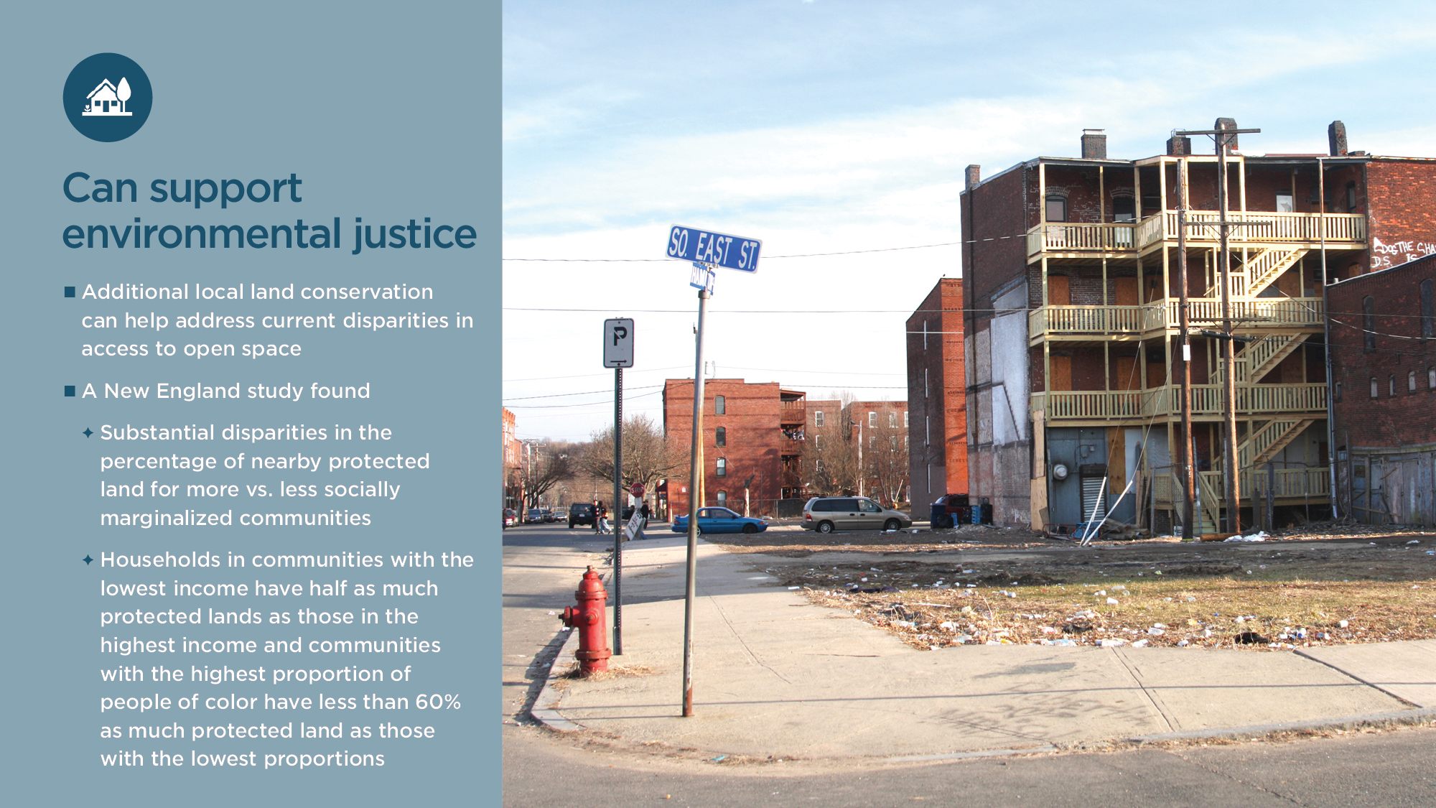
Notes:
Additional local land conservation can be a tool to address current disparities in access to nearby open space. A plethora of literature has shown that there are significant disparities in access to open space.
Schell, C., K. Dyson, T. Fuentes, S. Des Roches, N. Harris, D. Miller, M. Lambert. 2020. The ecological and evolutionary consequences of systemic racism in urban environments. Science, 369(6510); Jennings, V., C. Johnson Gaither, and R. Gragg. 2012. Promoting environmental justice through urban green space access: A synopsis. Environmental Justice, 5(1), 1-7; Trust for Public Land. 2020. The Heat is On: A Trust for Public Land Special Report; Chapman, R., L. Foderaro, L. Hwang, B. Lee, S. Muqueeth, J. Sargent, and B. Shane, 2021. Parks and an equitable recovery. Trust for Public Land, May 27, 2021; Rigolon, A., M. Browning, and V. Jennings. 2018. Inequities in the quality of urban park systems: An environmental justice investigation of cities in the United States. Landscape and Urban Planning, 178, 156-169. Flores, D., G. Falco, N. Roberts, and F. Valenzuela III. 2018. Recreation equity: Is the Forest Service serving its diverse publics? Journal of Forestry, 116(3), 266-272; Winter, P., W. Crano, T. Basáñez, and C. Lamb, 2020. Equity in Access to Outdoor Recreation—Informing a Sustainable Future. Sustainability, 12(1), 124; Taylor, D. 2000. Meeting the challenge of wild land recreation management: Demographic shifts and social inequality. Journal of Leisure Research, 32(1), 171-179; Roberts, N., and D. Rodriguez. 2008. Use of multiple methods: An examination of constraints effecting ethnic minority visitor use of national parks and management implications. Ethnic Studies Review, 31(2), 35-70; Erickson, B., C. Johnson, and B. Kivel. 2009. Rocky Mountain National Park: History and culture as factors in African-American park visitation. Journal of Leisure Research, 41(4), 529-545; García, R., and E. Baltodano. 2005. Free the Beach-Public Access, Equal Justice, and the California Coast. Stan. JCR & CL, 2, 143; Sister, C., J. Wolch and J. Wilson. 2010. Got green? Addressing environmental justice in park provision. GeoJournal, 75(3), 229-248; Finney, C. 2014. Black faces, white spaces: Reimagining the relationship of African Americans to the great outdoors: UNC Press Books.
A recent study of New England found substantial disparities in the percentage of nearby protected land for more vs. less socially marginalized communities. Households in census tracts within the lowest income quartile have just half as much nearby protected land as those in the highest income quartile and communities with the highest proportions of people of color have less than 60 percent as much protected land as those with the lowest proportions. They found that disparities by income persist within urban, exurban, and rural census tracts and within all states in the region. Lack of access to transportation can exacerbate access challenges and emphasize the importance of local protected open space.
Improving environmental justice also requires attention to the processes of priority setting and decision-making within municipalities to ensure inclusion of all stakeholders and balancing of multiple priorities. Future land protection efforts can satisfy multiple community priorities. The study found that prioritization based on clean drinking water also had positive potential to decrease racial or income disparities in land protection. The Incorporating Environmental Justice Criteria in Land Conservation map shows census tracts in New England with a high degree of social marginalization and low amount of open space. Environmental justice areas have both high social marginalization and little land protection.
See white paper page 8 for more details

Slide 10
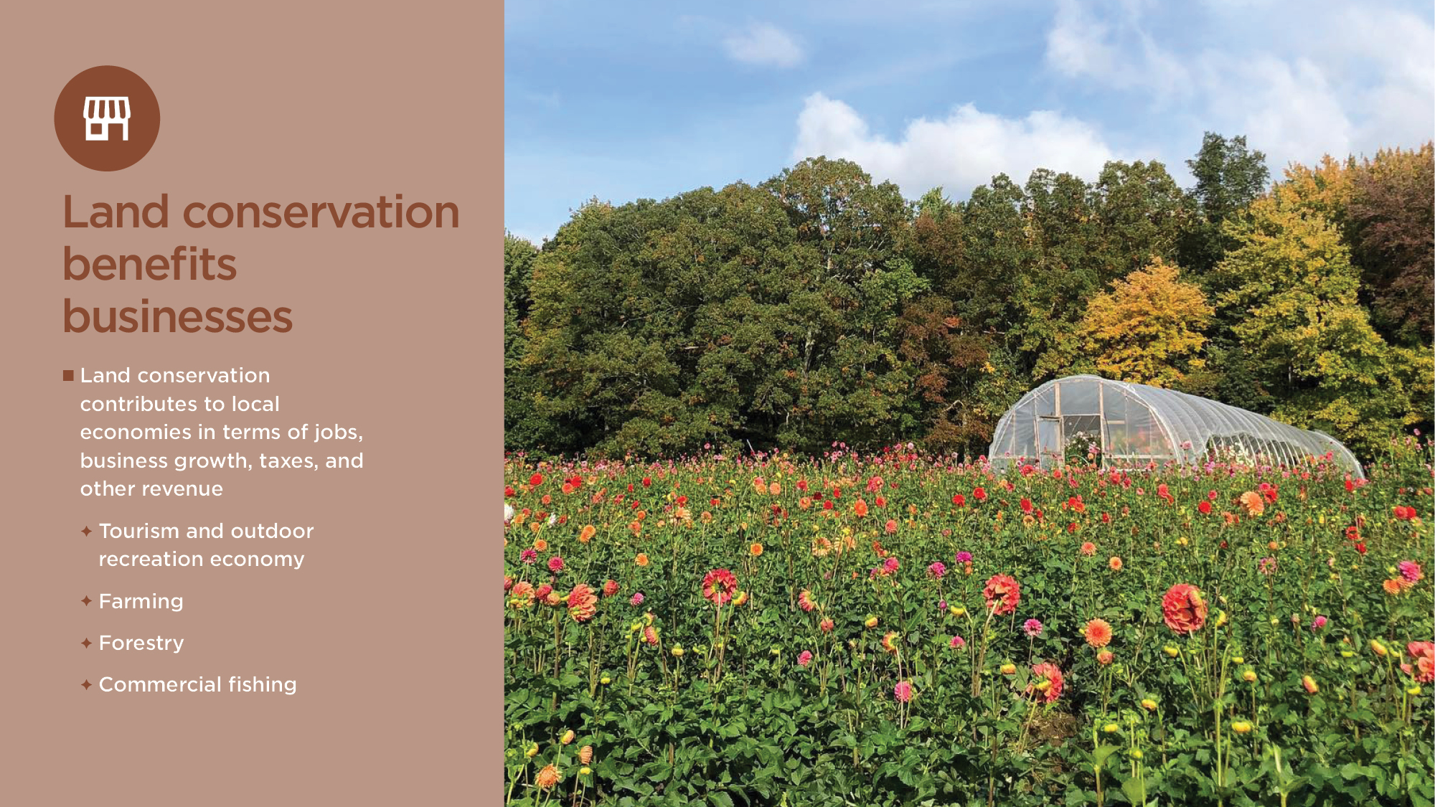
Notes:
Land conservation contributes to local economies by increasing jobs, business growth, tax revenues, and other revenues. Outdoor recreation drives many economic benefits, including support for tourism-related businesses and recruiting new residents who may be business owners, entrepreneurs, or workers, supporting growth in earnings per job across a community. Protecting working landscapes and improving water quality for fish habitat contribute to the farming, forestry, and commercial fishing industries. Together these industries employ hundreds of thousands of workers and generate billions in value add in communities across Massachusetts.
See white paper page 10 for more details

Slide 11
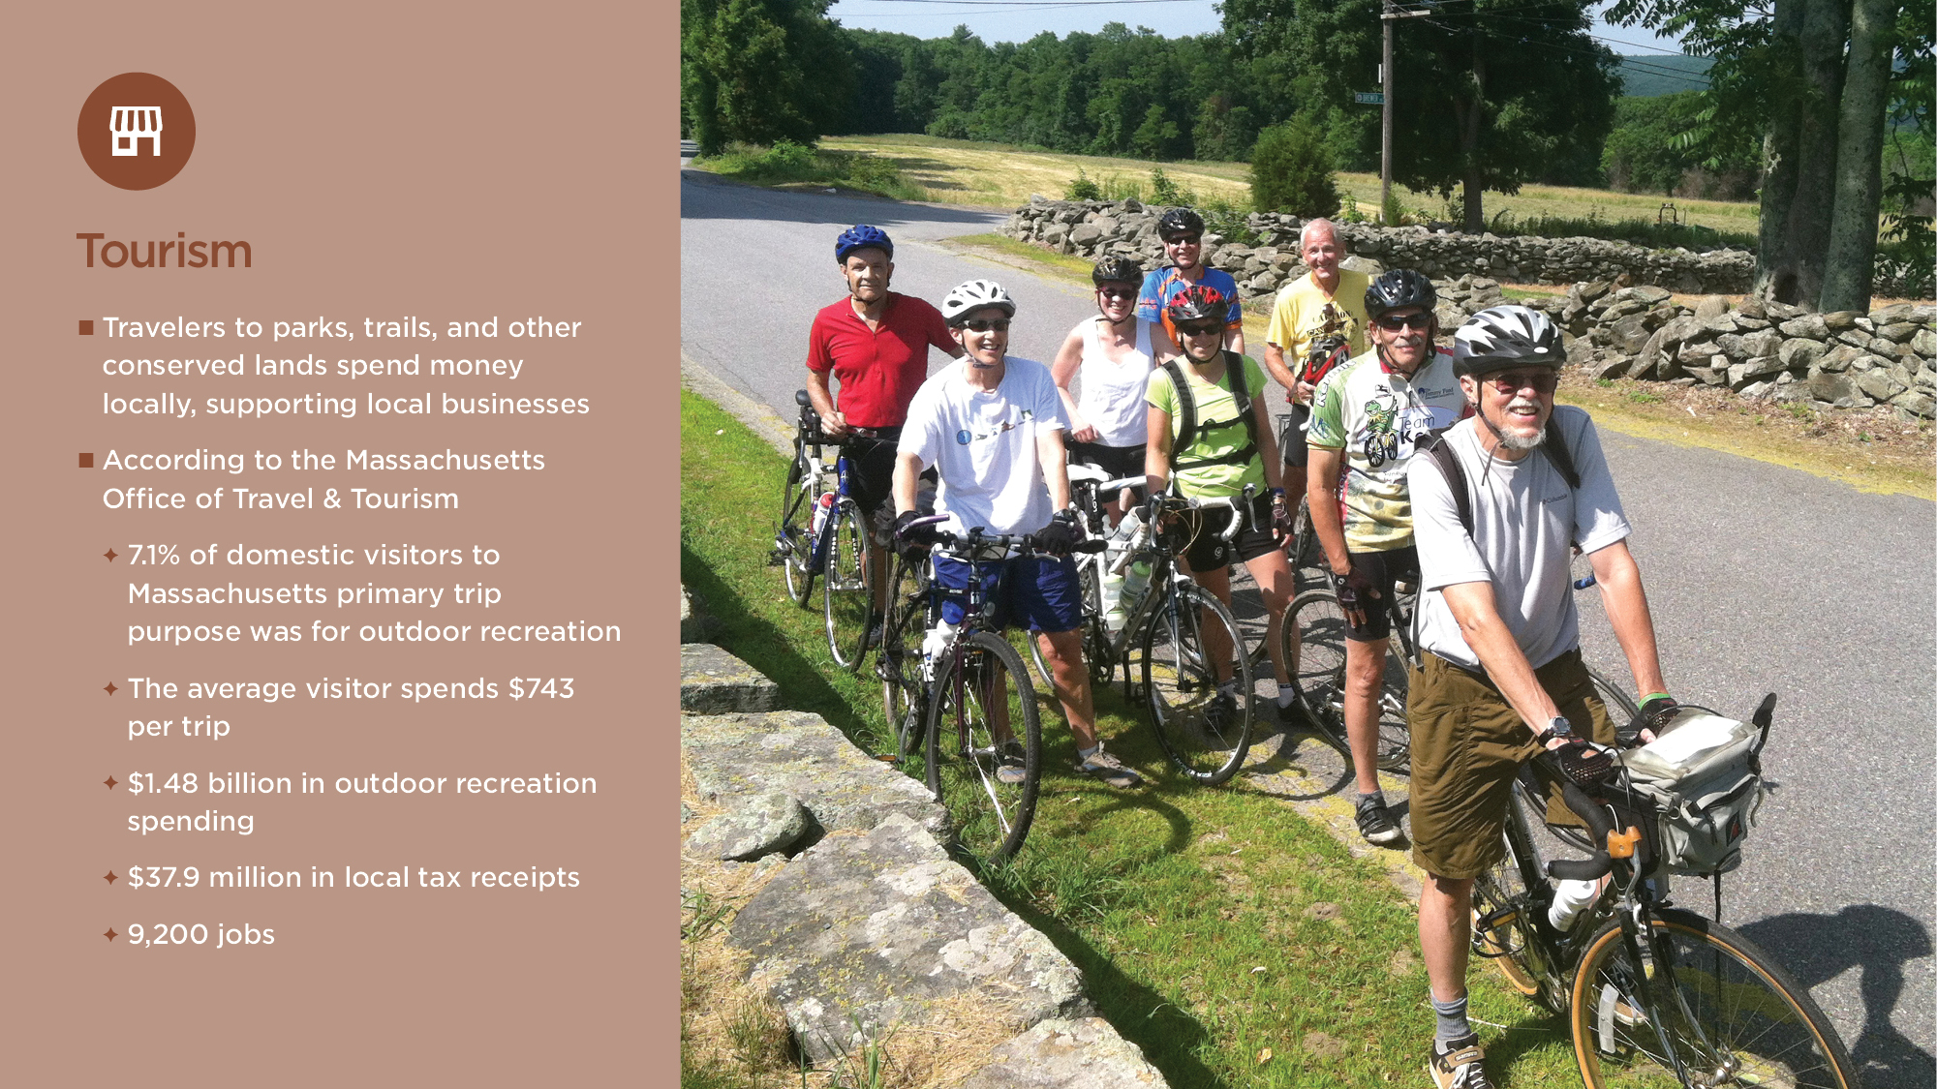
Notes:
Land conservation supports a thriving tourism and outdoor recreation economy. The outdoor recreation tourism economy includes spending by visitors. Travelers to conserved lands with public access, such as parks and trails, spend money locally supporting local income and jobs. In fiscal year 2020, 7.1 percent of domestic visitors came to Massachusetts with the primary trip purpose of outdoor recreation. They spent an average of $743 per trip on things like lodging and restaurants, for total outdoor recreation spending of $1.48 billion, resulting in $37.9 million in local sales, lodging and other tax receipts. The outdoor recreation industry also supports 9,200 jobs in Massachusetts.
Data are available by county in Appendix B. For example,
In 2019, Barnstable County outdoor recreation visitors spent $81 million. This spending supported 700 jobs and directly contributed $5 million local tax revenues including $1.03 million in room occupancy tax collections.
Massachusetts Office of Travel & Tourism. 2020 Annual Report. Published April 2021.
See white paper page 10 for more details

Slide 12
Notes:
The overall outdoor recreation economy includes spending by both residents and visitors. According to the Bureau of Economic Analysis outdoor recreation accounted for $7.69 billion in value added, representing 1.3 percent of the GDP, and 90,600 jobs.
U.S. Bureau of Economic Analysis. Outdoor Recreation Value Added, Employment, and Compensation as a Percent of Total, 2020.
See white paper page 10 for more details

Slide 13
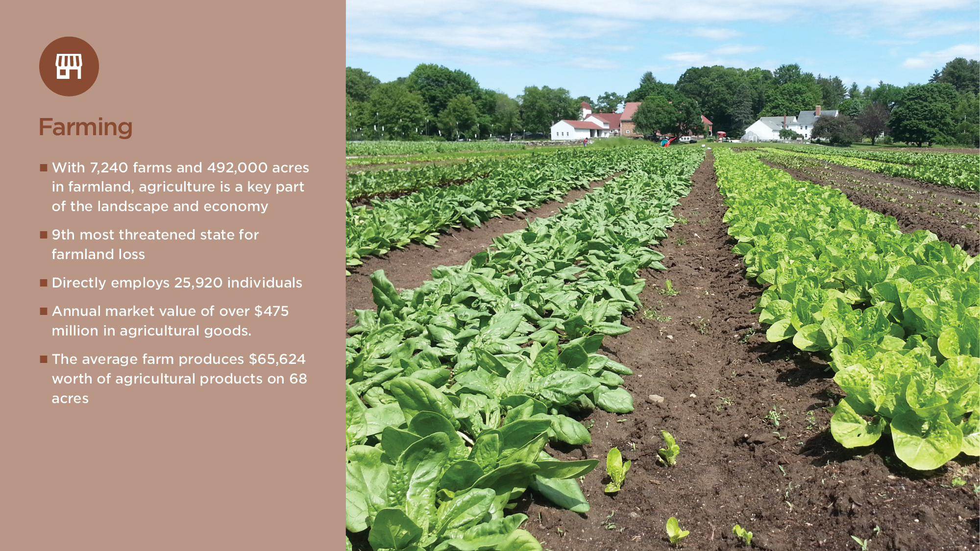
Notes:
According to American Farmland Trust, Massachusetts is the 9th most threatened state for farmland loss in the country. From 2001 to 2016, 6,750 acres of state significant farmland was converted to urban and highly developed land uses.
Freegood, J., M. Hunter, J. Dempsey, and A. Sorensen. 2020. Farms Under Threat: The State of the States. American Farmland Trust.
Land conservation has an important role to play in sustaining the agriculture industry. With 7,240 farms and 492,000 acres in farmland, agriculture is a key part of the Massachusetts landscape and economy. The agricultural industry in the state directly employs 25,920 individuals and produces an annual market value of over $475 million in agricultural goods. The average Massachusetts farm produces $65,624 worth of agricultural products on 68 acres.
U.S. Department of Agriculture. 2017 Census of Agriculture.
Data are available by county in Appendix C. For example,
Losing (insert farm name) of X acres would reduce the viability of farming in the community resulting in lost jobs and hurting local businesses. In Barnstable County, there are currently 321 farms, encompassing 6,564 acres, with a total market value of $23.1 million. The average farm is 20 acres with $72,000 in agricultural products sold annually.
See white paper page 12 for more details

Slide 14
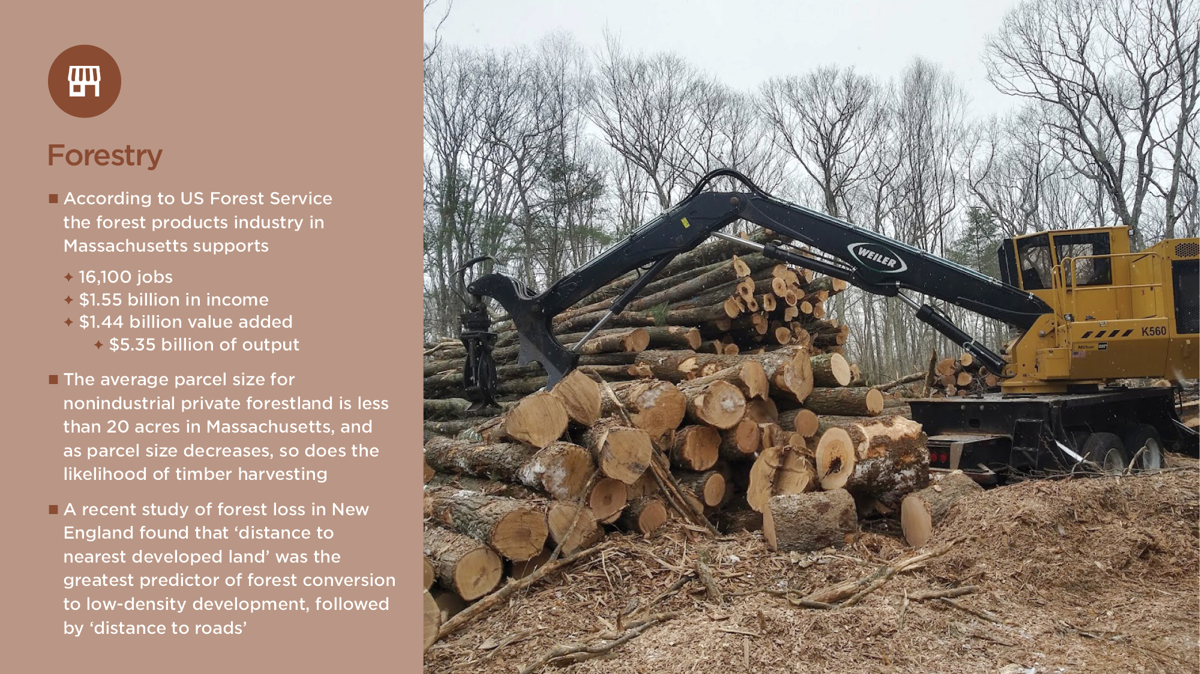
Notes:
The main threats to the productive capacity of Massachusetts forests are development/conversion of forest to non-forest (including forest clearing to build ground mounted solar arrays), climate change, fire and natural disasters, herbivore browsing, pests and disease, and economic factors (e.g., additional costs associated with increasing distance to pulpwood processors).
Cardwell, M. 2021. Massachusetts State Forest Action Plan 2020. Executive Office of Energy & Environmental Affairs, Department of Conservation & Recreation, Massachusetts Bureau of Forest Fire Control & Forestry.
A recent study of forest loss in New England found that ‘distance to nearest developed land’ was the greatest predictor of forest conversion to low-density development, followed by ‘distance to roads’.
Thompson J., J. Plisinski, P. Olofsson, C. Holden, and M. Duveneck. 2017. Forest loss in New England: a projection of recent trends. PLoS One, 12(12). https://doi.org/10.1371/journal.pone.0189636.
In Massachusetts, the average parcel size for nonindustrial private forestland is less than 20 acres and as parcel size decreases, so does the likelihood of timber harvesting. Social factors for landowners, as well as minimum sizes for profitability for loggers, contribute to this trend.
Kittredge, D., A. D’Amato, P. Catanzaro, J. Fish, and B. Butler. 2008. Estimating ownerships and parcels of nonindustrial private forestland in Massachusetts. Northern Journal of Applied Forestry, 25(2):93-98.
Preservation of the _xx-acre JONES property will help avoid fragmentation of a block of xxx acres of forestland.
The forest products industry employs 16,100 workers directly, with labor income of $1.55 billion. For a total value added of $1.44 billion and output of $5.35 billion. Multipliers capture the indirect and induced economic activity generated by the re-spending of income or sales revenues in a regional economy. When multipliers are considered, the forest projects industry provides 37,800 jobs indirectly, with $3.10 billion in labor income, $3.81 billion in value-add, and $9.23 billion in output.
Leefers, L., J. Poudel, D. Neumann, and Public Sector Consultants. 2020. Forest Products Industries’ Economic Contributions in the Northeast and Midwest. Lansing: Public Sector Consultants.
See white paper page 11 for more details

Slide 15
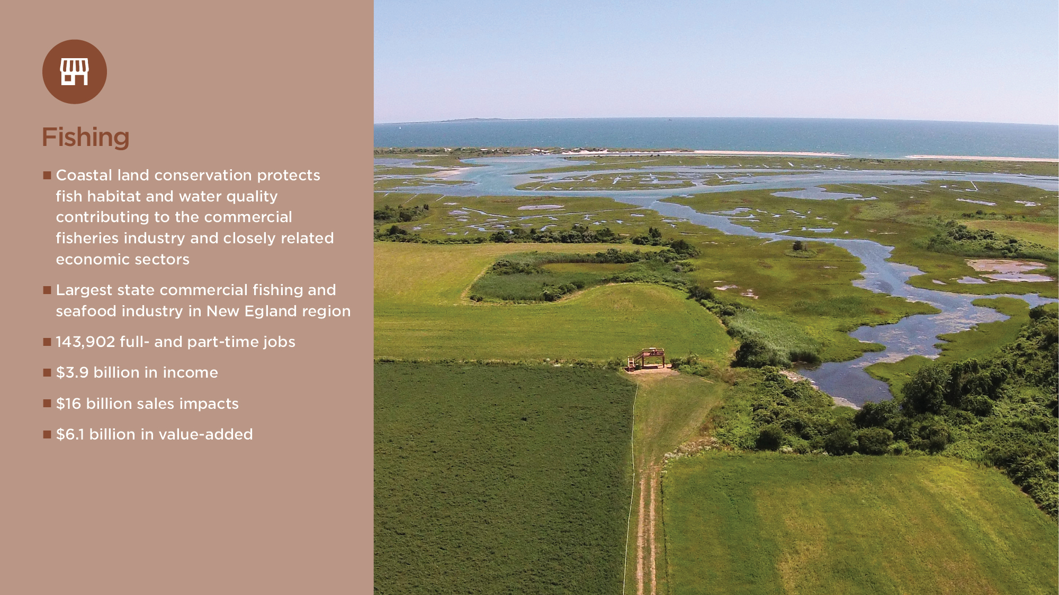
Notes:
Coastal land conservation protects fish habitat and water quality contributing to the commercial fisheries industry and closely related economic sectors. The water quality in the state’s estuaries near coastal areas is directly affected by the water purification, flood control and stormwater protection provided by adjacent natural lands. The commercial fishing and seafood industry in Massachusetts is the third largest in the U.S. In 2018, it generated the largest fishing and seafood industry employment impacts in the New England region with 143,902 full- and part-time jobs. Massachusetts also generated the largest sales impacts ($16 billion), value-added impacts ($6.1 billion), and income impacts ($3.9 billion) of the fishing and seafood industry in New England.
National Marine Fisheries Service. 2021. Fisheries Economics of the United States, 2018. Economics and Sociocultural Status and Trends Series. U.S. Dept. of Commerce, National Oceanic and Atmospheric Administration.
See white paper page 13 for more details

Slide 16
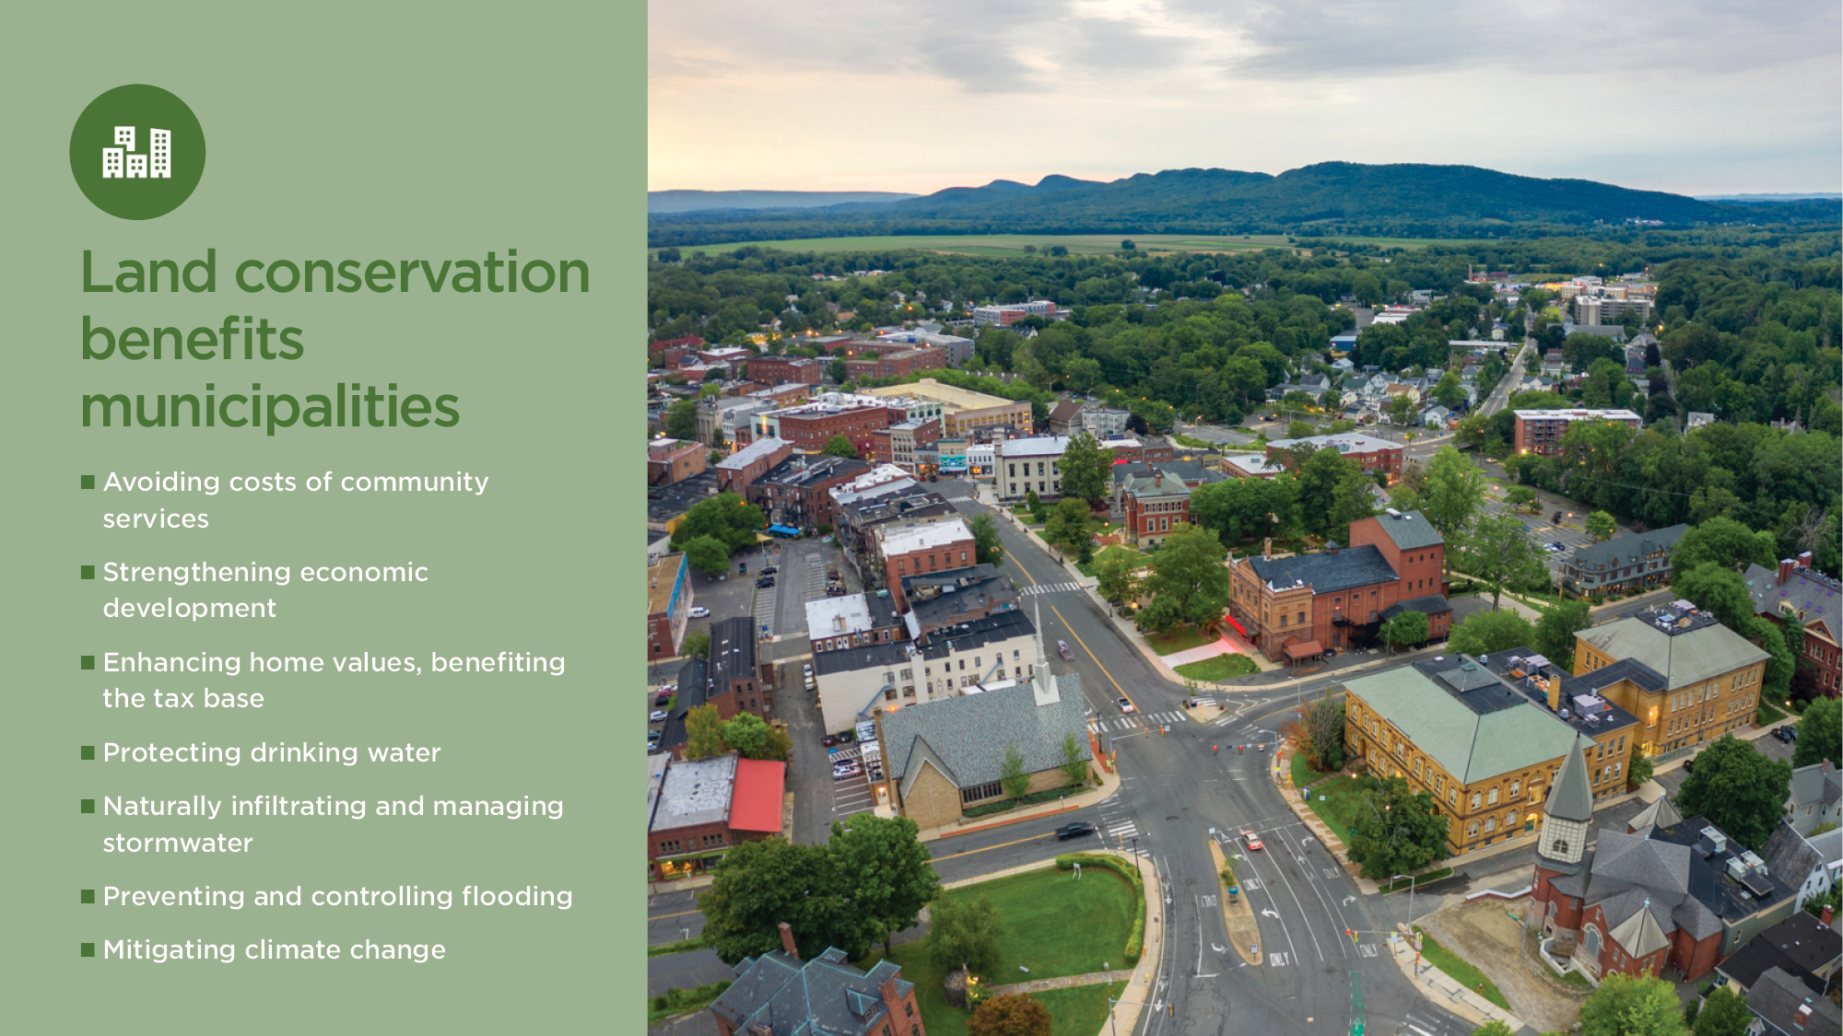
Notes:
Land conservation can potentially improve the municipal bottom line. Studies have shown that property tax revenue losses are often offset by other impacts of conserving the parcel for reasons that include:
Avoiding increased costs of public services that would have been required if the conserved property had been developed, such as increased school, public works, and public safety services.
Positively impacting local employment outcomes and economic growth thereby improving the tax base.
Enhancing nearby property values by creating an amenity value which boosts surrounding home values, increasing tax revenue collected as assessments are adjusted.
In addition, development of open space in Massachusetts leads to increases in impervious surface, increases in water runoff, increases in nitrogen and phosphorus loading, and lost filtration capacity. This often translates to increased costs for municipalities to provide clean drinking water, manage stormwater, and protect infrastructure from flooding.
See white paper page 14 for more details

Slide 17
Notes:
Land conservation has not been found to result in big increases in property tax rates. A comprehensive study of land conservation, including both ownership and easement-based protection, in New England found that land protection from 1990 to 2015 did not have a substantial impact on property tax rates.
In Massachusetts, the study found that on average, new protection results in small property tax rate increases of $0.58 to $0.88 per $100,000 of taxable property value for the average annual new area protected of 54 acres. This translates to an annual tax bill increase of $2.10 to $3.18 for a typical home with a tax bill of $4,828. They found no evidence that the impacts last over time or affect municipal expenditures.
However, for towns that are growing slowly, have lower household incomes, or municipal land acquisition, they study estimated greater impacts, ranging from a $5 to $30 tax bill increase for each $100,000 of value.
Kalinin, A., K. Sims, S. Meyer, and J. Thompson. Does land conservation raise property taxes? Evidence from New England cities and towns. Working Paper. January 2022. Available at: https://sites.google.com/view/alexey-kalinin/research?authuser=0.
See white paper page 14 for more details

Slide 18
Notes:
New development brings not only more revenue, but also more expenses, particularly for residential development. Undeveloped land can be beneficial to communities because it brings in more revenue than it would use in services if developed.
A recent University of Massachusetts study of Great Barrington, Whately, Upton, and Haverhill showed lower expense to revenue ratios for open space and commercial land than residential land. This means, for example, that for every dollar of revenue brought in from open space in Great Barrington, $0.35 is spent providing services for that land while residential development requires $1.12.
Murray, H., and C. Paul, 2019. Fiscal Impacts of Land Use in Massachusetts: Up-to date Cost of Community Services Analyses for 4 Massachusetts Communities. University of Massachusetts Amherst Extension.
The ratios calculated in this study are similar to previous cost of community services research. The graphic is from American Farmland Trust across 151 communities nationwide (including 13 Massachusetts communities). It found residential development is a net fiscal loss for communities That is, for every $1 in property tax revenues residential development requires $1.16 in services. While working and open lands require $0.37 in services.
Farmland Information Center. 2016. Cost of Community Services Studies. Partnership between the U.S. Department of Agriculture Natural Resources Conservation Service and American Farmland Trust.
See white paper page 15 for more details

Slide 19
Notes:
Strong local economies have a stronger tax base. Conserved lands help communities cultivate a competitive advantage by enhancing quality of life and attracting talent, employers, and investment. The availability of quality open space and recreation resources helps to attract businesses. Many workers choose a job based on an area’s quality of life, which is increased by the availability of open spaces. Furthermore, small-business decision makers rated park, recreation, and open space amenities as being the most important factor in measuring quality of life. This shows how important the investment of parks and open space is to the future economic well-being of Massachusetts’ communities.
Executive Office of Energy and Environmental Affairs. Massachusetts Statewide Comprehensive Outdoor Recreation Plan 2017. Submitted to the National Park Service. December 2017.
Saving land can also help local economies. A recent study of all major towns and cities in New England found that land conservation moderately increased local employment numbers and the labor force, without reducing new housing permits. This was found to be especially true in rural areas.
Sims, K., J. Thompson, S. Meyer, C. Nolte, and J. Plisinski. 2019. Assessing the local economic impacts of land protection. Conservation Biology. Volume 33. No. 5. 1035-1044.
See white paper page 16 for more details

Slide 20
Notes:
Conserved lands have a positive impact on nearby home values and associated property tax revenues.
In Amherst, according to the American Planning Association, cluster housing with dedicated open space was found to appreciate at an annual rate of 22 percent, compared to a similar conventional subdivision's rate of 19.5 percent.
Executive Office of Energy and Environmental Affairs. Massachusetts Statewide Comprehensive Outdoor Recreation Plan 2017. Submitted to the National Park Service. December 2017.
Vacant land that shares a border with a conserved parcel, through either fee simple or conservation restriction (easement), increases in value by 46 percent. This benefit declines with distance, although the rate of decline is less with conservation restrictions (easements). In addition, the study found separate, positive price effects from new land conservation of 3 percent for property that is within view.
Chamblee, J., P. Colwell, C. Dehring, and C. Depken, 2011. The effect of conservation activity on surrounding land prices. Land Economics 87, 453–472. https://doi.org/10.3368/le.87.3.453
Open-space acquisitions increase home values across a municipality. In the study, the average house price increased 0.6 percent because of the open-space acquisitions.
Vandegrift, D., and M. Lahr, 2011. Open space, house prices, and the tax base. Annals of Regional Science 46, 83–100. https://doi.org/10.1007/s00168-009-0336-1
Another national study that found positive impacts of open space expenditures on municipal home values investigated whether this increase in home price was due to the supply of developable land being more restricted due to land conservation. It found that across 710 municipalities from 1997 to 2013, open space spending did not affect new development, as measured by annual number of new housing units permitted.
Lang, C., 2018. Assessing the efficiency of local open space provision. Journal of Public Economics 158, 12–24. https://doi.org/10.1016/j.jpubeco.2017.12.007.
See white paper page 16 for more details

Slide 21
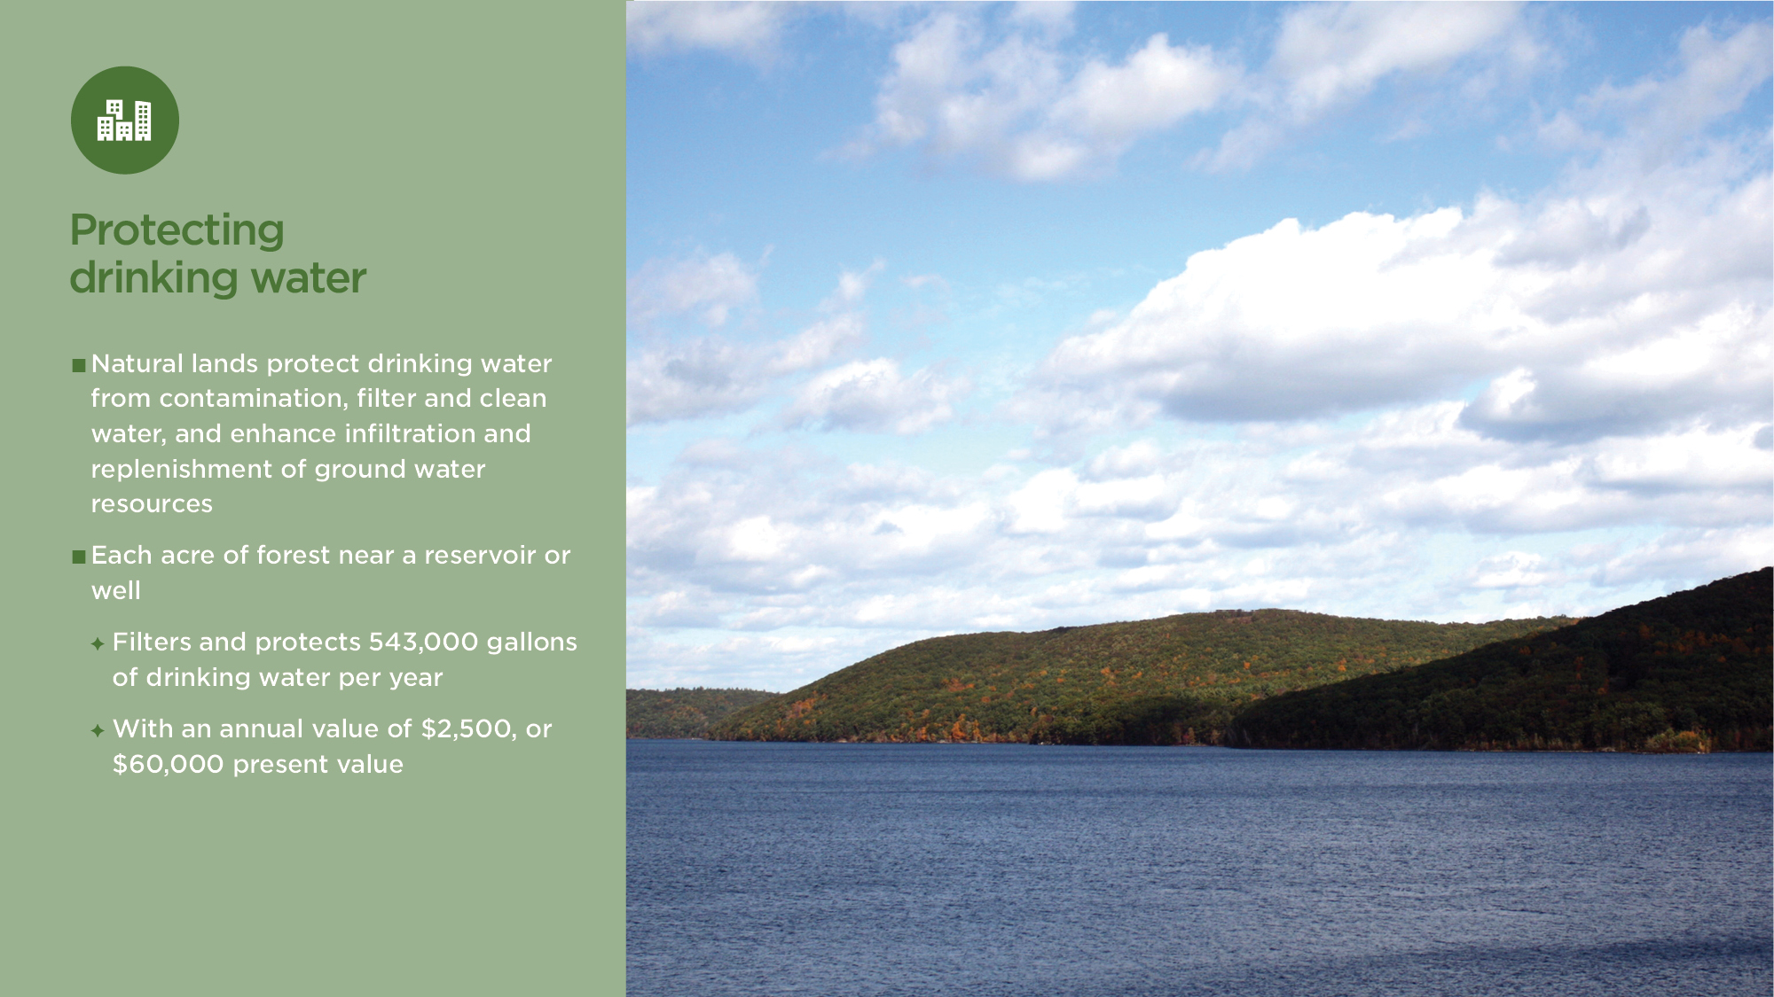
Notes:
Natural lands protect drinking water from contamination, naturally filters and cleans water, and enhances infiltration and replenishment of ground water resources. Each acre of forest near a reservoir or well filters and protects 543,000 gallons of drinking water per year, with an annual value of $2,500, or $60,000 present value.
Executive Office of Energy and Environmental Affairs. 2015. Looking to the Future – Massachusetts Land and Park Conservation and Their Future.
See white paper page 17 for more details

Slide 22
Notes:
The largest threat to Massachusetts waterways is from stormwater pollution. Conserved lands support water quality because their pervious surfaces capture and absorb precipitation, slow runoff, infiltrate and recharge groundwater, and filter out pollutants. Meanwhile, vegetation on conserved lands provides a considerable surface area that intercepts and stores rainwater. In effect, these green spaces function like storage reservoirs, reducing peak flows of runoff during rain events.
Land conservation is a proactive approach to avoiding stormwater management costs. Converting natural vegetated areas in Massachusetts to impervious cover will decrease water quality by increasing phosphorus and nitrogen levels. Decreased water quality will require implementing costly Best Management Practices (BMPs), such as infiltration trenches and enhanced biofiltration, to meet regulatory requirements. The range in potential control costs per acre of conversion to impervious cover is $48,000 to $79,000.
Personal communication with Mark Voorhees, Environmental Engineer, Environmental Protection Agency, January 31, 2022.
Data are available by county in Appendix A. For example,
The (insert project name) provides important water quality benefits. Protecting an acre of natural land provides stormwater management values ranging from $48,000 to $79,000. These cost savings add up for communities. For example, across Barnstable County the avoided stormwater runoff value provided by 114,000 acres of tree canopy is $9.06 million annually.
See white paper page 17 for more details

Slide 23
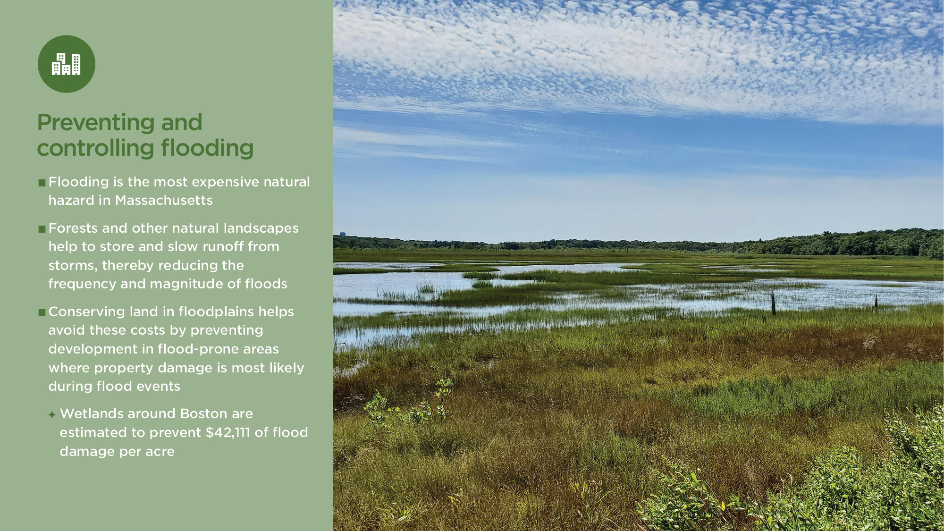
Notes:
Flooding is the most expensive natural hazard in Massachusetts, with $400 million in total losses from 2000 to 2019.
Hazards and Vulnerability Research Institute. 2021. How Hazardous is Your State? accessed January 18, 2022 https://public.tableau.com/app/profile/hvri/viz/Haz_Dash_New/FinalCompleteDashboard.
Forests and other natural landscapes help to store and slow runoff from storms, thereby reducing the frequency and magnitude of floods. Conserving land in floodplains helps avoid these costs by preventing development in flood-prone areas where property damage is most likely during flood events. Wetlands and natural areas near rivers and streams also prevent costly property damage by absorbing and storing potentially devastating floodwaters.
Wetlands around Boston are estimated to prevent $42,111 of flood damage per acre.
Myers, N. 1996. “Environmental services of biodiversity.” Proceedings of the National Academy of Sciences, USA. 93: 2764-2769.
See white paper page 18 for more details

Slide 24
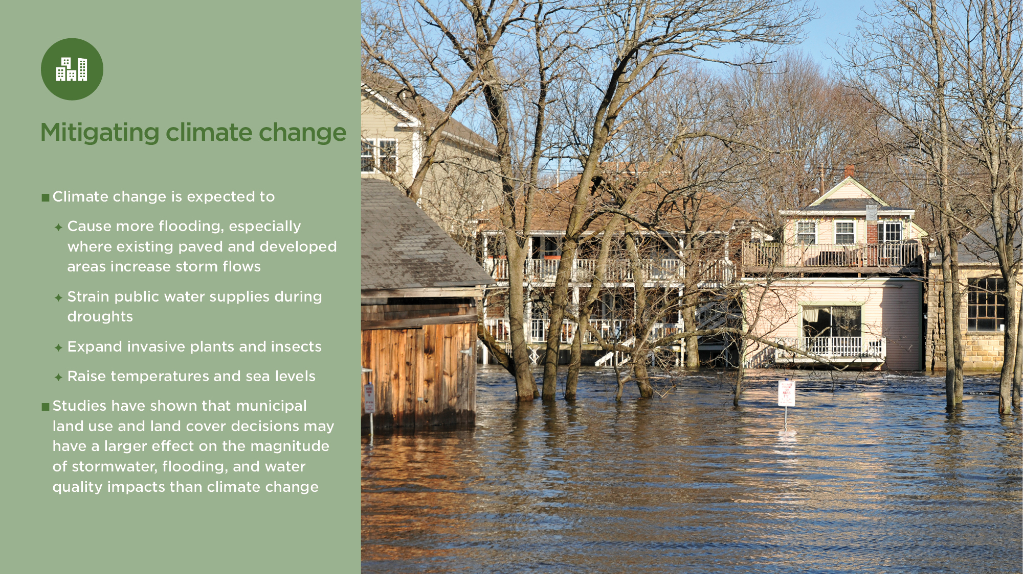
Notes:
Climate change is expected to have important impacts to communities across the state. Intense rainstorms are likely to occur more frequently causing more flooding, especially where existing paved and developed areas increase storm flows. Summer drought conditions will strain public water supplies. Invasive plants and insects will also expand in this changing landscape. Mosquito borne diseases may become more prevalent.
Studies have shown that municipal land use/land cover decisions may have a larger effect on the magnitude of stormwater, flooding, and water quality impacts than climate change. For example, a town that conserves and actively manages forestland, with some development, can be expected to experience less stormwater and flooding issues than a similarly situated town that develops more of its natural forests – due to a greater amount of impervious area and less natural groundwater infiltration and flood storage.
Thomas, J., K. Fallon Lambert, D. Foster, M. Blumstein, E. Broadbent, and A. Almeyda Zambrano. 2014. Changes to the Land: Four Scenarios for the Future of the Massachusetts Landscape. Harvard Forest, Harvard University.
A study investigating both runoff and water quality, found as runoff increases, pollutants such as suspended solids, nitrogen, and phosphorus also increase. Without land conservation costly BMPs may have to be employed to reduce runoff and treat pollutants such as nutrients and sediment through biological, chemical, and physical processes.
Alamdari, N., P. Claggett, D. Sample, Z. Easton, M. Nayeb Yazdi. 2022. Evaluating the joint effects of climate and land use change on runoff and pollutant loading in a rapidly developing watershed. Journal of Cleaner Production, 2022; 330: 129953 DOI: 10.1016/j.jclepro.2021.129953.
See white paper page 19 for more details

Slide 25
Notes:
Land conservation investments have the potential economically benefit to communities by providing benefits that outweigh the initial costs of the projects.
On the cost side, sometimes but not always, a municipal investment is requested to acquire. A municipal investment is sometimes requested to acquire a specific parcel of conservation land. Sometimes conserving a piece of land will remove it from property tax rolls, but in the case of a conservation restriction or agricultural preservation restriction over land that remains in private hands, the property will still be subject to property taxation.
On the benefits side, there are many categories of value that directly benefit residents, local businesses, and the municipality itself. These economic benefits can accumulate to offset municipal costs to the point of breaking even or even exceeding the municipal investment. The types and magnitudes of the benefits that accrue locally depend on the characteristics of the community and the subject property.

Slide 26
Notes:
The purpose of this slide is to:
Thank the audience
Provide your contact information
Provide link to report will all the supporting information

Slide 27
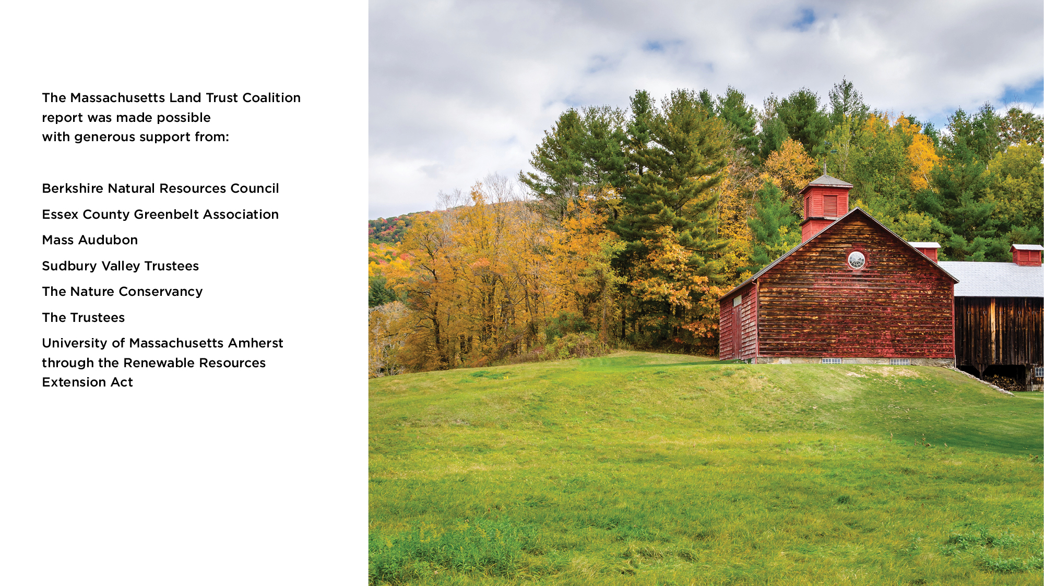
Notes:
The purpose of this slide is to thank the supporters of the report.

