Slide 1

Treatment of Invasive Plants in Field Habitat Management
Control Strategies
Suggested Techniques
Precautions
Case study
Restoration & Shifting Plant Communities
Notes:
I will be summarizing strategies used to control invasive plants in fields and meadows and will be presenting a study on a wet meadow invasive plant management project

Slide 2
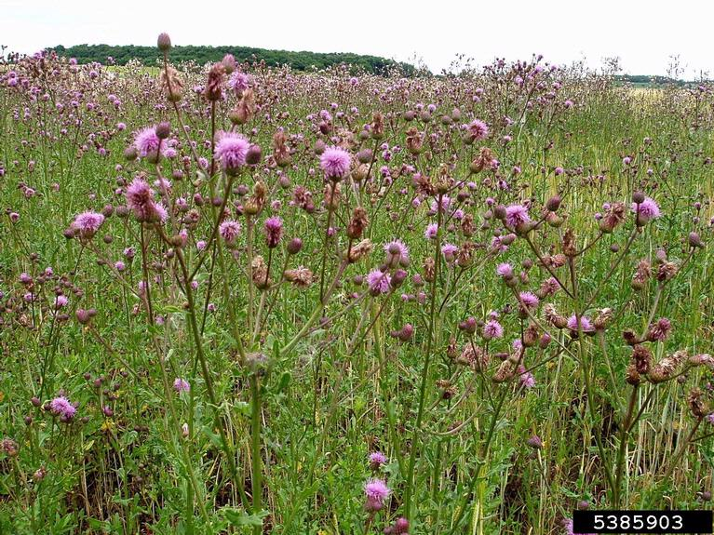
↑ Land use history = ↑ Invasive species abundance
Notes:
field habitats usually have an abundance of invasive species which 9 out of 10 times can be attributed to land use history. The longer a parcel is disturbed manipulated and planted the greater chance there is for invasion and establishment of these species.

Slide 3
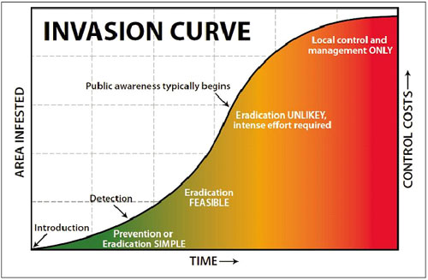
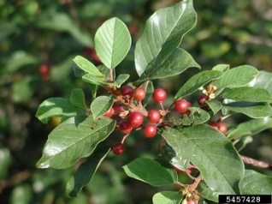
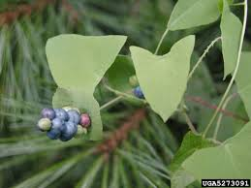
Control: Sequence
Notes:
SET a REALISTIC GOAL
Size of infestation influences feasibility of success and amount of $$ required for control
Prevention is the cheapest and easiest (prevention may not be an option in a field, where invasives are common)
Control of EDRR of is also in expensive and is relatively easy, requires
Define EDRR and some of the challenges.

Slide 4
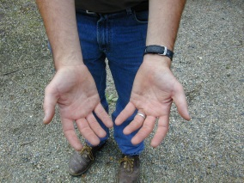
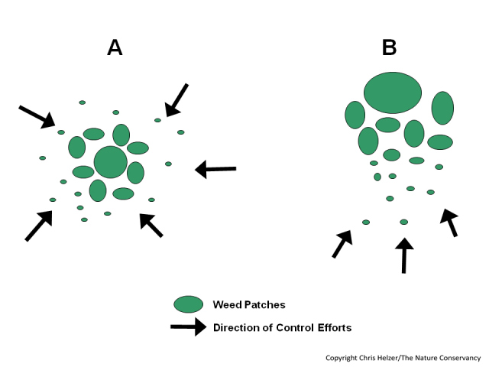
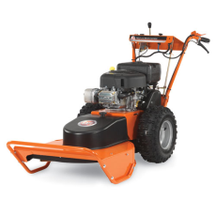
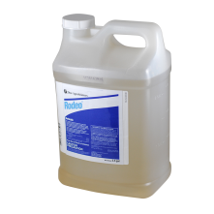
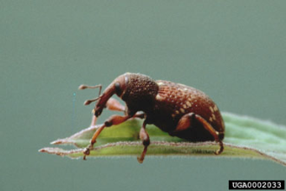
Control Strategies
Manual
Mechanical
Chemical
Biological
$$$$
Large Patch Small Patch
IPM
$
Notes:
Different approaches are appropriate for different sized infestations. It’s generally unrealistic to hand pull several acres of knapweed just as it’s unrealistic to release Galerucella beetles for a very small isolated patch of purple loosestrife. Select the right strategy for the right size patch.
Generally several strategies are needed for effective control (IMP).
Implement by working from the area of “least” infestation to the greatest while trying to reduce/stop seed production.

Slide 5
Control Strategy
1. Goals for project
2. Methods
3. Resources
4. Survey, Mapping, Documentation (Year 1)
5. Flag sensitive areas, and native and rare species
6. Control Methods and Implementation (Years 1-2)
  Manual, Mechanical
  Chemical
  Biological
  Other: Grazing, Fire, Flame weeding, smothering
  7. Follow up Control and Monitoring (long-term)
  8. Restoration

Slide 6

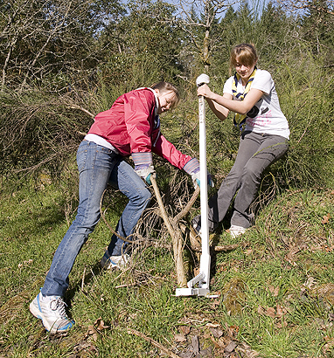
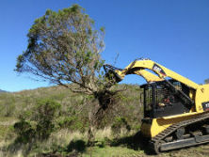
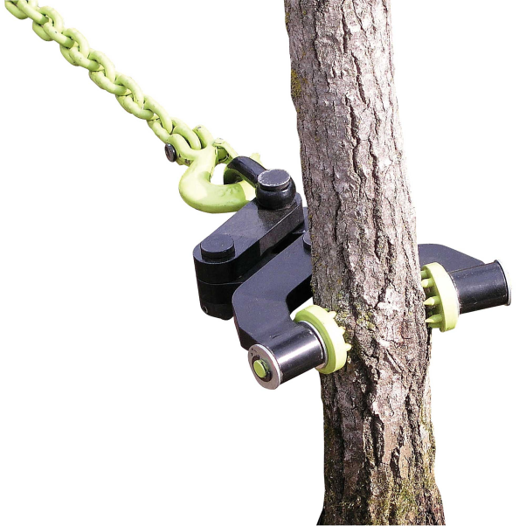
Control Techniques
  SPRING – EARLY SUMMER
    Remove small-medium woodies or herbaceous plants
      Hand pulling or wrenching
        Volunteers!
      Mechanical uprooting
      Mound mulch/cover herbs.
Puller Bear
Machine attachments
Brush Grubber
Notes:
Friends of Assabet; SVT volunteers.
NPT team of 20 =1/2 acre of fairly dense understory shrubs in 2-3 hrs. Ground is moist, weather is not hot, manual pulling can be done anytime of year. Species dependent—longer root species are not as easy for manual pulling—Asian bittersweet has long roots, Mugwort and Japanese knotweed have rhizomes that make it difficult to control by manual pull-On the other hand, Japanese Stiltgrass and Japanese barberry have shallow roots that make them easier to pull manually
Cost?
Touch on brush disposal

Slide 7
Manual/Mechanical Control Summary
PROS
Can be very cost effective
Requires little permitting and is very resource efficient
Introduces no chemicals into the environment
Volunteers can help initially
CONS
Labor intensive
Maintaining volunteer enthusiasm
Time intensive
Not usually feasible for large scale infestations
Disturbance of soil

Slide 8
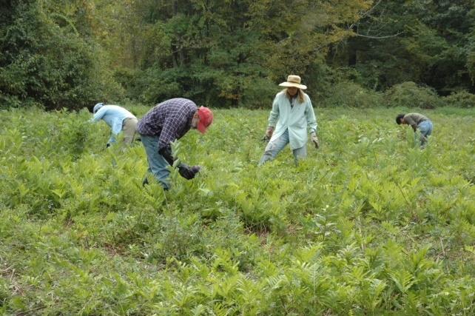
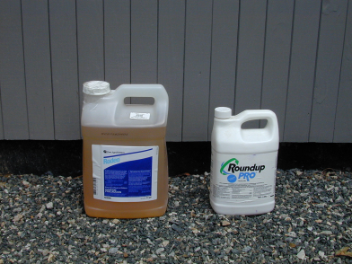
Chemical Treatments
Using herbicides is one of the more effective and resource efficient ways to treat invasive species infestations
Most invasive plants can be treated using only two herbicides – glyphosate (the active ingredient in Round-up and Rodeo) and triclopyr (the active ingredient in Brush-B-Gone and Garlon)

Slide 9
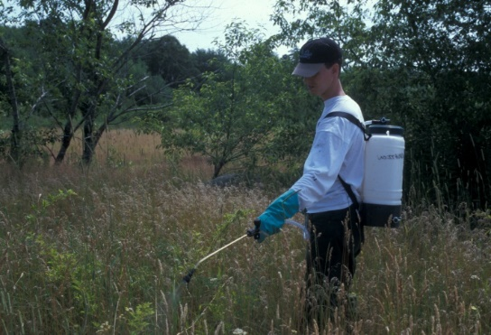
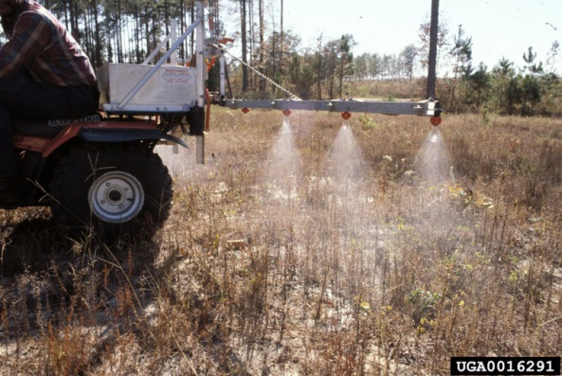
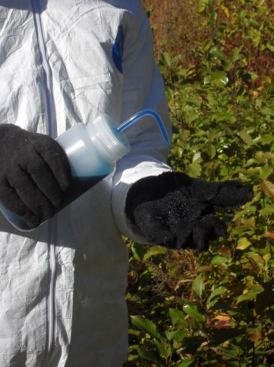
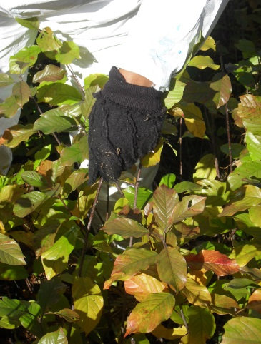
Control Techniques
  MID SUMMER – LATER FALL
    Treat woodies and herbs, < 5 ft.
      Foliar triclopyr - height of summer
      Foliar application of glyphosate late summer - fall
      Mechanical mowing, cutting or uprooting
Notes:
Foliar= less chemical and over 90%-100% effective, cut stump only 60% effective.
2-3 % solutions applied selectively by applicator, some collateral but spray can be targeted and veg. can be mowed earlier in the year to keep it low to the ground.
If favoring grass species in areas of dense invasives, selective herbicide (triclopyr) can be used and in some cases using an atv mounted boom sprayer is more effective and efficient.
Sensitive areas around rare plant species or habitats- swipe application- just as effective but very time consuming and

Slide 10
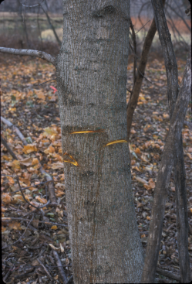
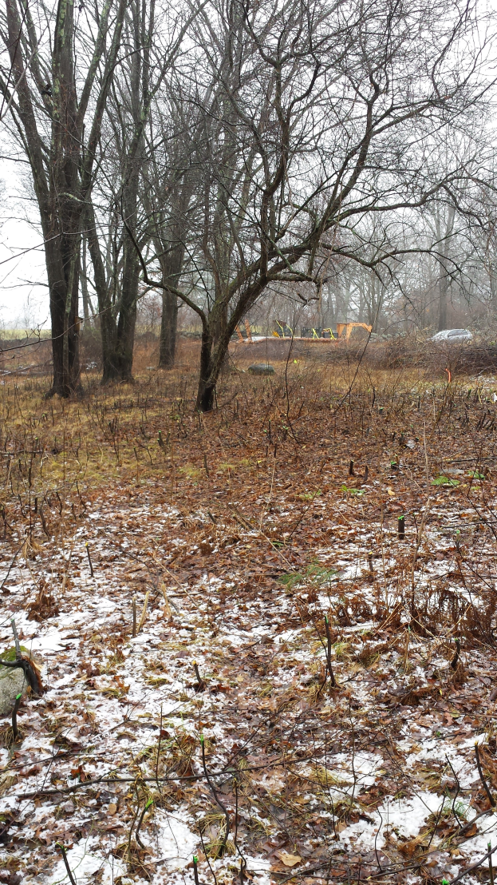
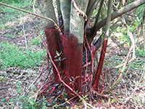
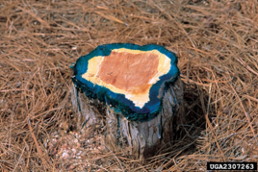
Control Techniques
  LATE FALL - WINTER
    Remove large woodies
      Cut-paint or hack glyphosate treatments
      Basal bark and dormant stem triclopyr treatments
      Mechanical
Notes:
Winter work= less non-target impact of herbs.
Glyphosate used on a 25-50% solution for C.P. Can be purchased in aquatic safe formulas for sensitive sites, very low toxicity. Brush must be cut or hacked. Brush handling can be costly and difficult.
Basal bark 20-30% solution in 100% oil for larger stems, dormant stem 2% solution plus 2-3 gallons oil in water for small stems. Only for upland site.
Oils = petroleum on non-petroleum based, non petroleum = Arborchem’s NPD- not to be sprayed into water.
Mechanical. Only suppresses vegetation, great for prepping for future foliar applications, improving access, and suppressing seed production.
Balance between disturbance and 100% control. Bush hogging can create a dense littler layer that prevents seed germination and limits open ground for wildlife

Slide 11
Precautions
You need to be licensed to apply herbicides
  To apply “general use” herbicides you need, at a minimum, a Commercial Applicators License (sometimes called the CORE license) ($75, $100)
  To apply “restricted use” herbicides you need a Commercial Applicators License PLUS a Commercial Certification ($75,$125, 2x $100)

Slide 12
Chemical Control Summary
PROS
Can be very effective with cut-paint and foliar spray
Typically less labor and time intensive
Less earth disturbance
CONS
License required
Permitting is sometimes required
Work with potentially hazardous chemicals (PPE recommended)

Slide 13
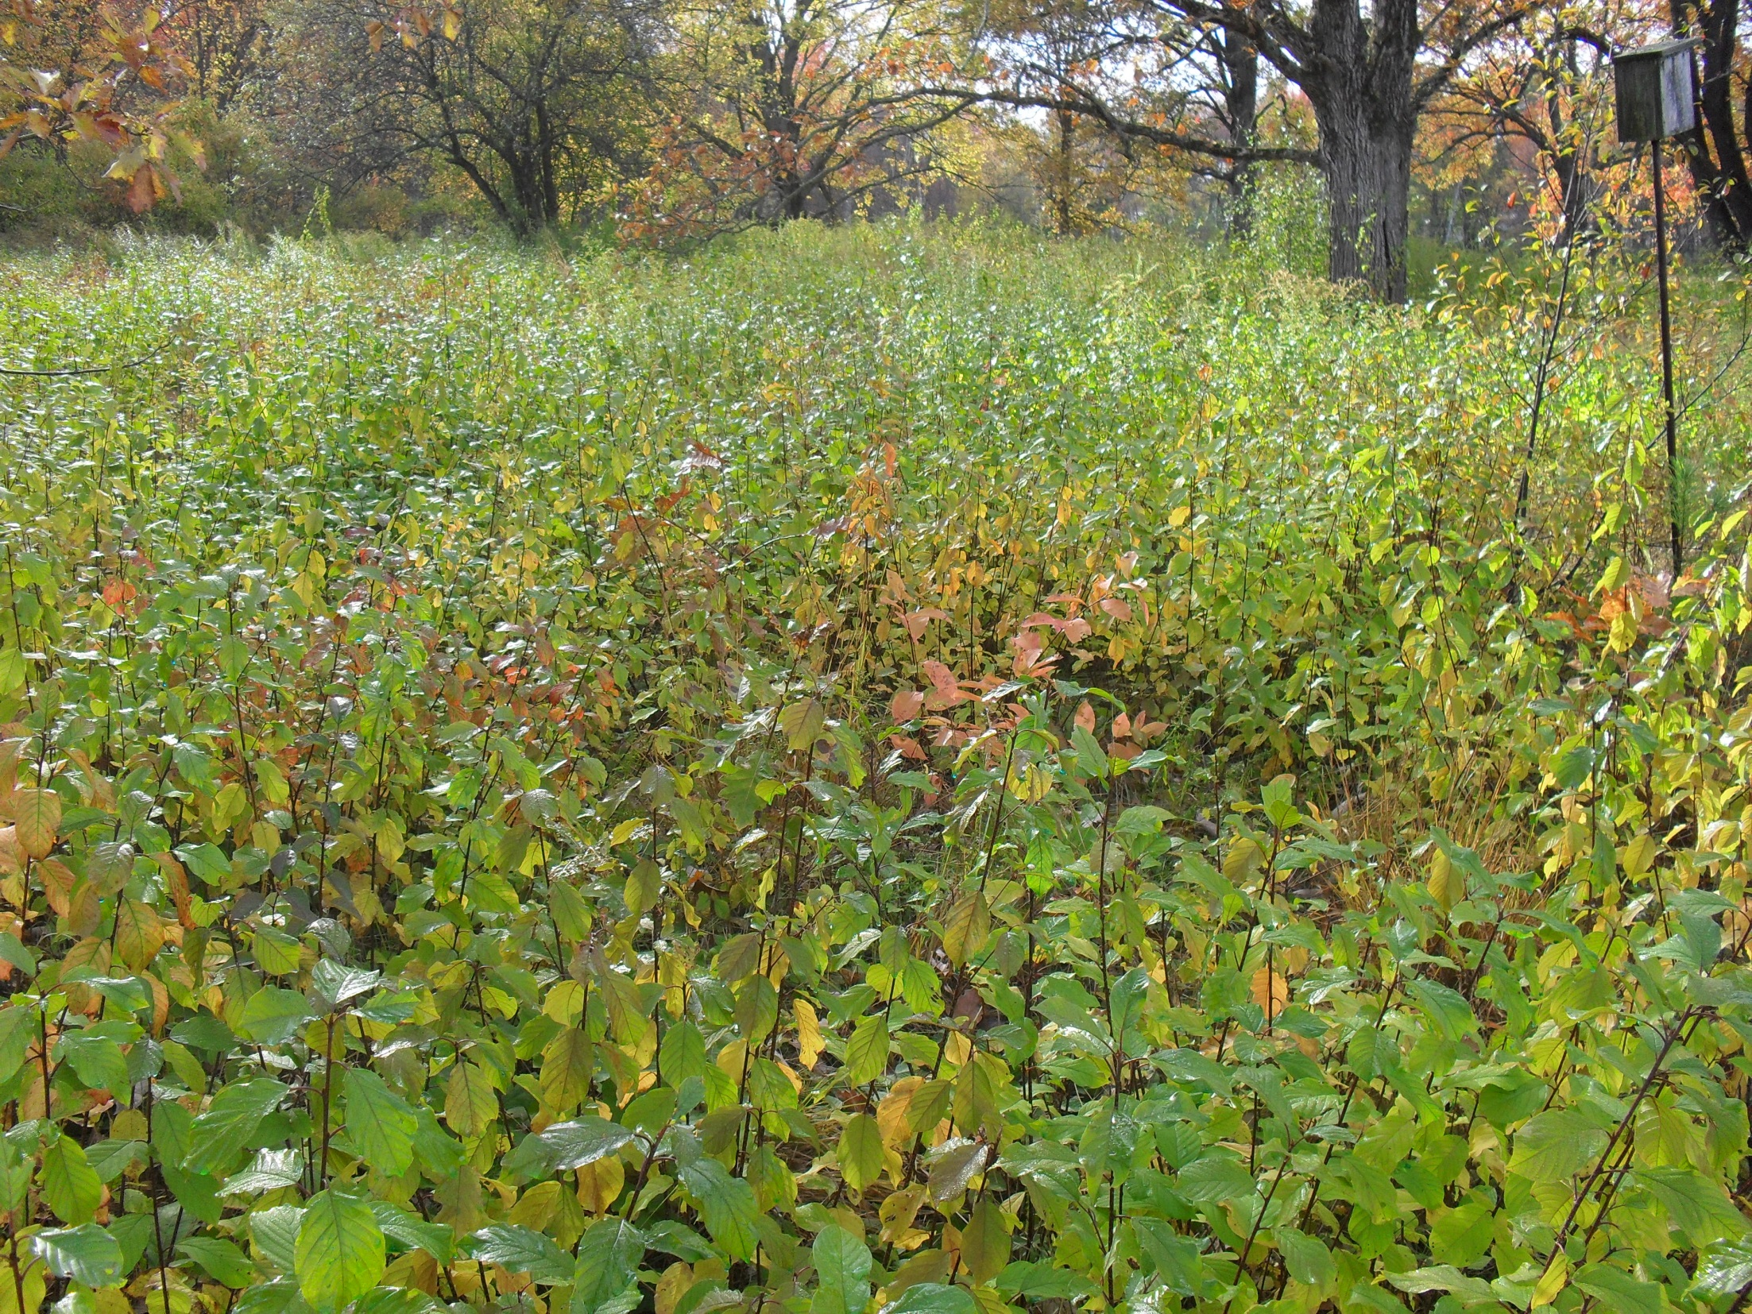
Notes:
Calf Pasture before treatment

Slide 14
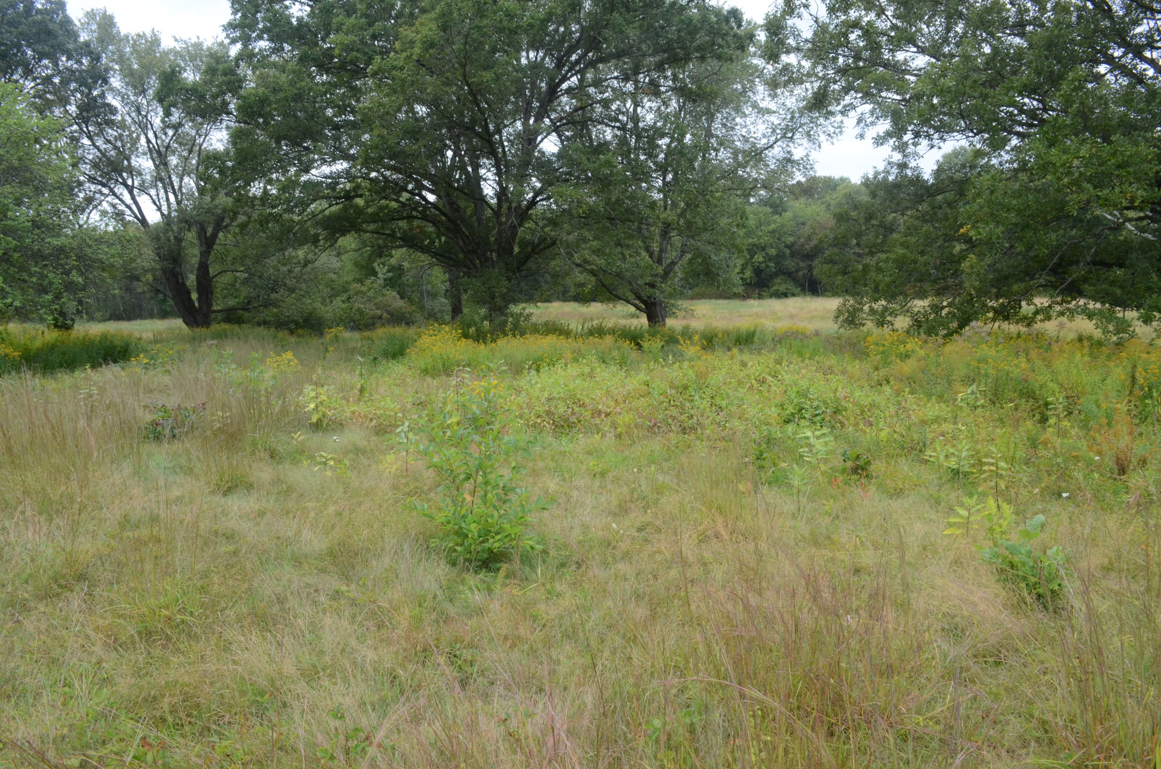
Notes:
After treatment-mostly hand-swiping of buckthorn

Slide 15
Wetlands Permitting
Check with your local Conservation Agent regarding local bylaws
Contact DEP specialist

Slide 16
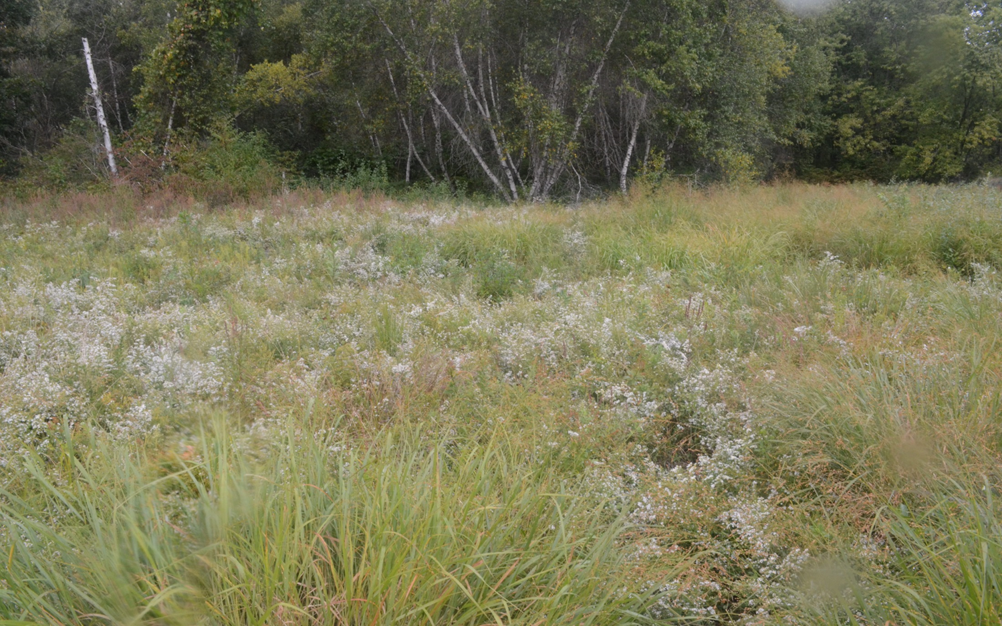
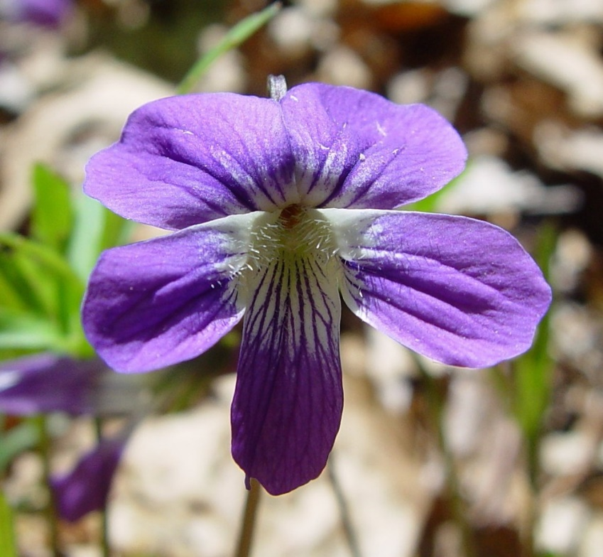
Rare species habitat Management in a wet meadow habitat
Frederick C. Sechler, Jr.
Native Plant Trust
May 1, 2020
Notes:
Native Plant Trust has been involved for a while on a rare plant species habitat management project in Concord, MA

Slide 17

Viola brittoniana management-Wet meadow
● 10 acres of floodplain and 9 acres of river open meadow
● Largest known population in NE for the rare Viola brittoniana
● Occupies approximately 2.5 acres of the overall site and presently contains approx. 2,666 plants
● Site is annually mowed, kept in early succession
● Threats include succession and Invasive plants such as Frangula alnus (glossy buckthorn)
● Funding from the Town, via the MANHESP
● Goal is to restore habitat and increase V. brittoniana population
Notes:
Native Plant Trust was contracted by the town to conduct management for the benefit of a rare violet, Viola brittoniana. This population of Viola brittoniana is threatened by the continued presence and spread of glossy buckthorn. This is by far the largest population of this rare species currently known in New England, with considerably more individuals than any other site. Its loss or dramatic decline would cause a major reduction in the total number of Viola brittoniana plants in the region, and may have genetic consequences. We have a good understanding of the ecology and habitat requirements of this species in our area resulting from Dr. Zielinski’s two decades of study and our own observations of its growth in cultivation at the New England Garden of Rare and Endangered Plants at Garden in the Woods, in addition to experience managing other populations-

Slide 18

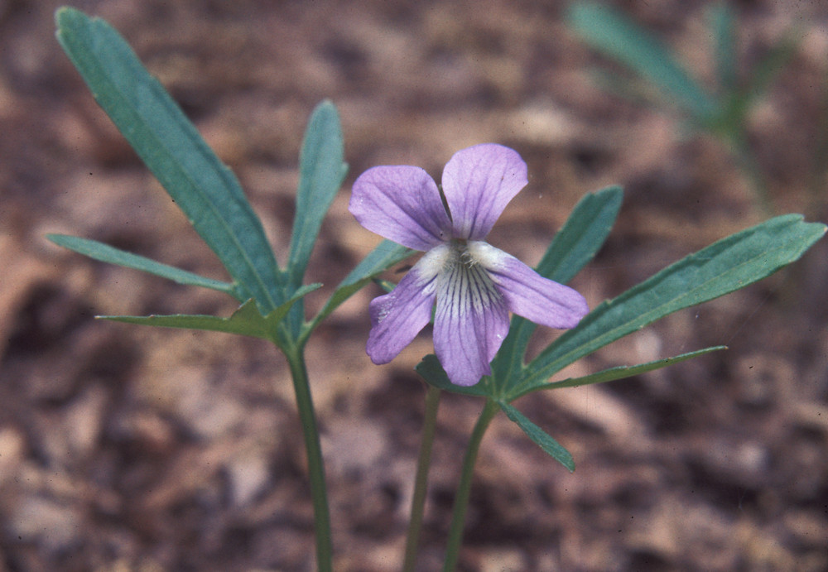
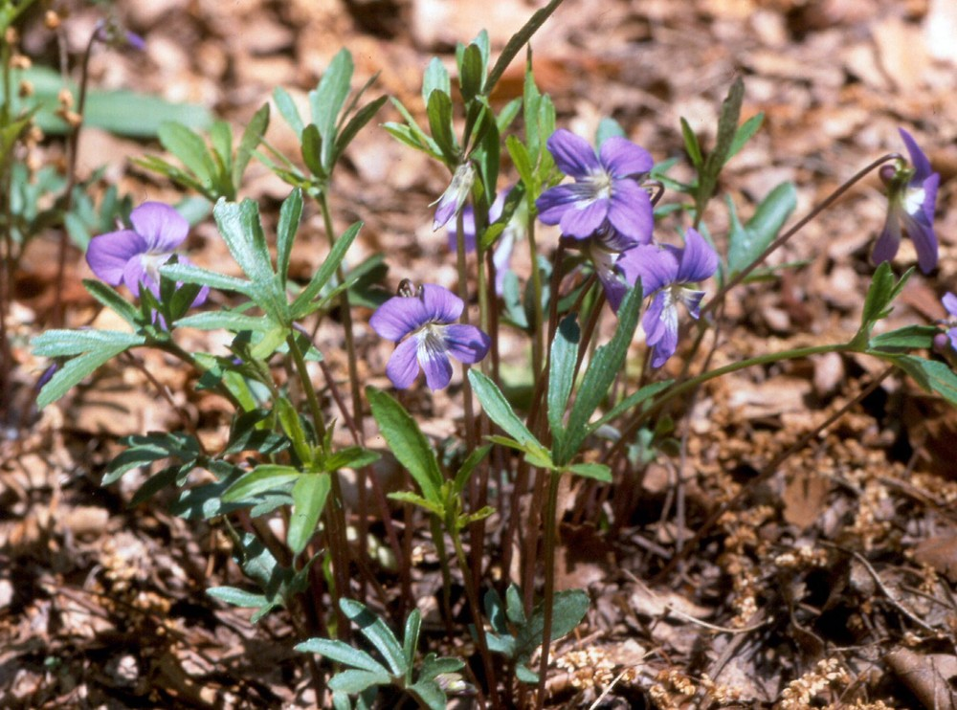
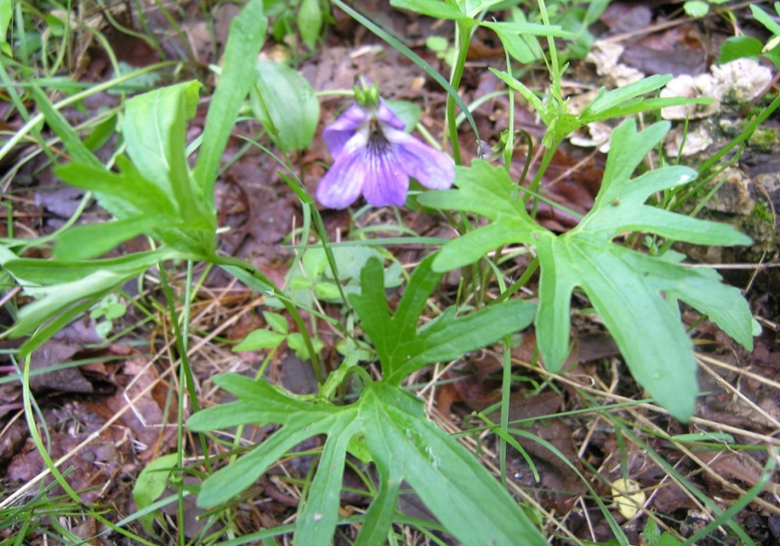
Viola brittoniana -Species profile
Habitat: found mostly between the upper part of the annually flooded zone and the 100-year flood line of freshwater rivers-in wet meadows, and can occur in drier mowed areas and along woodland trails
Notes:
This rare violet has distinctive leaves with narrow lobes and deep sinuses- Fields, meadows, trail edges, and forest clearings adjacent to rivers and coastal marshes, also peaty river shores

Slide 19

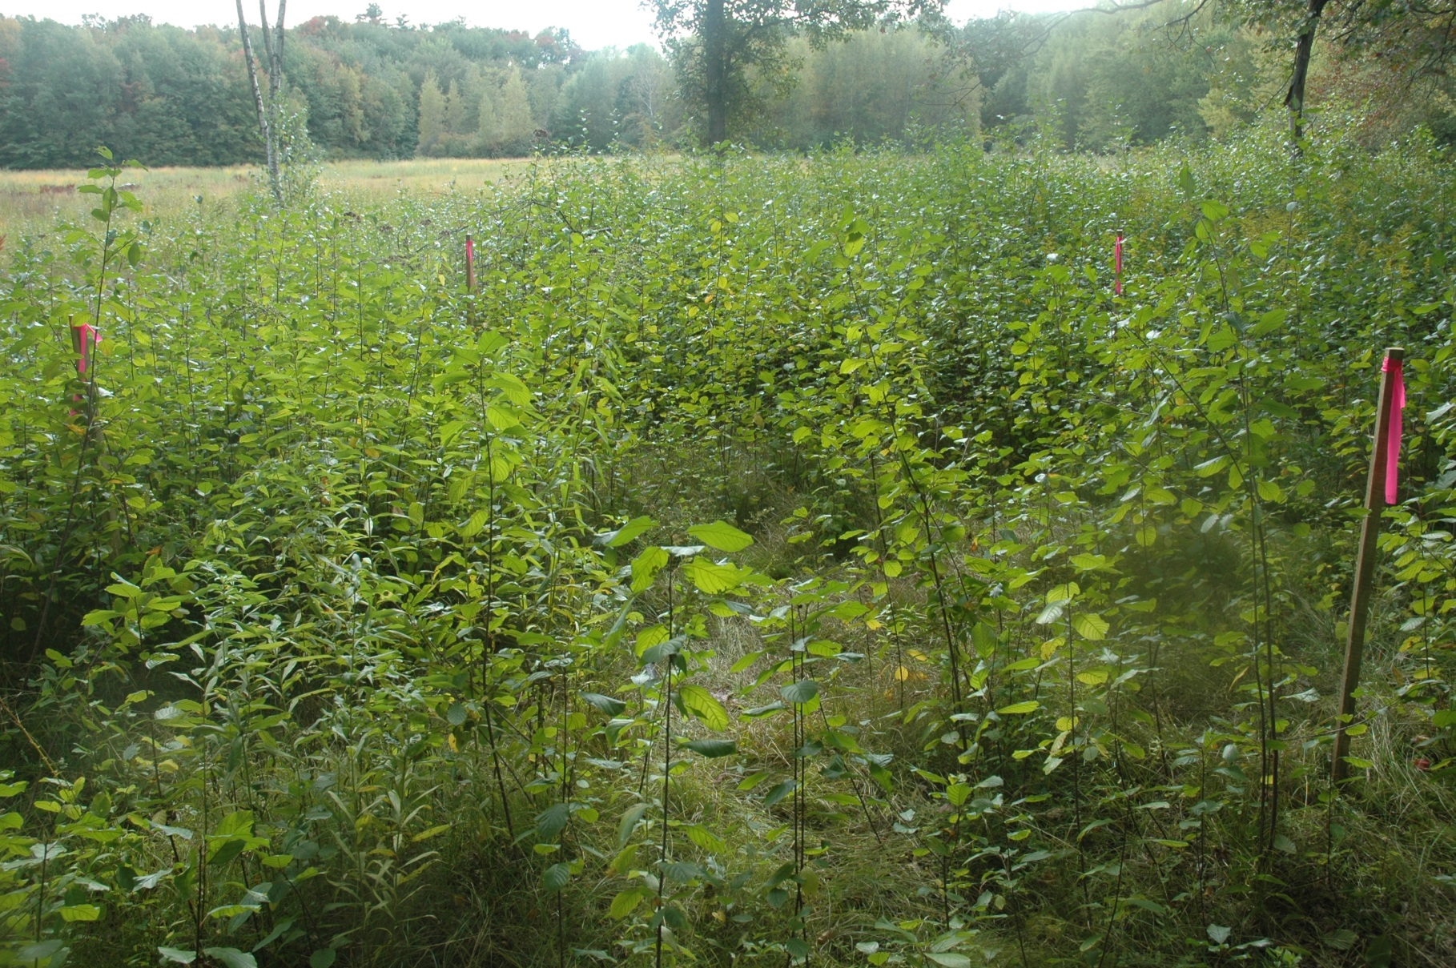
Viola brittoniana management-Pre-management in 2009
Notes:
Management for this species has been going on since 2010-This photos shows pre-management-tons of buckthorn in much of the area around the open meadow-The shrub border surrounding the mowed portion of Calf Pasture contained many large fruit producing buckthorn Frangula individuals. The simple removal of Frangula from the pasture itself meant little in the long term without the removal of the source infestation. The removal of the Frangula would benefit the Viola by preventing further colonization of the open pasture habitat and reduce the competition for light, space, and nutrients.

Slide 20
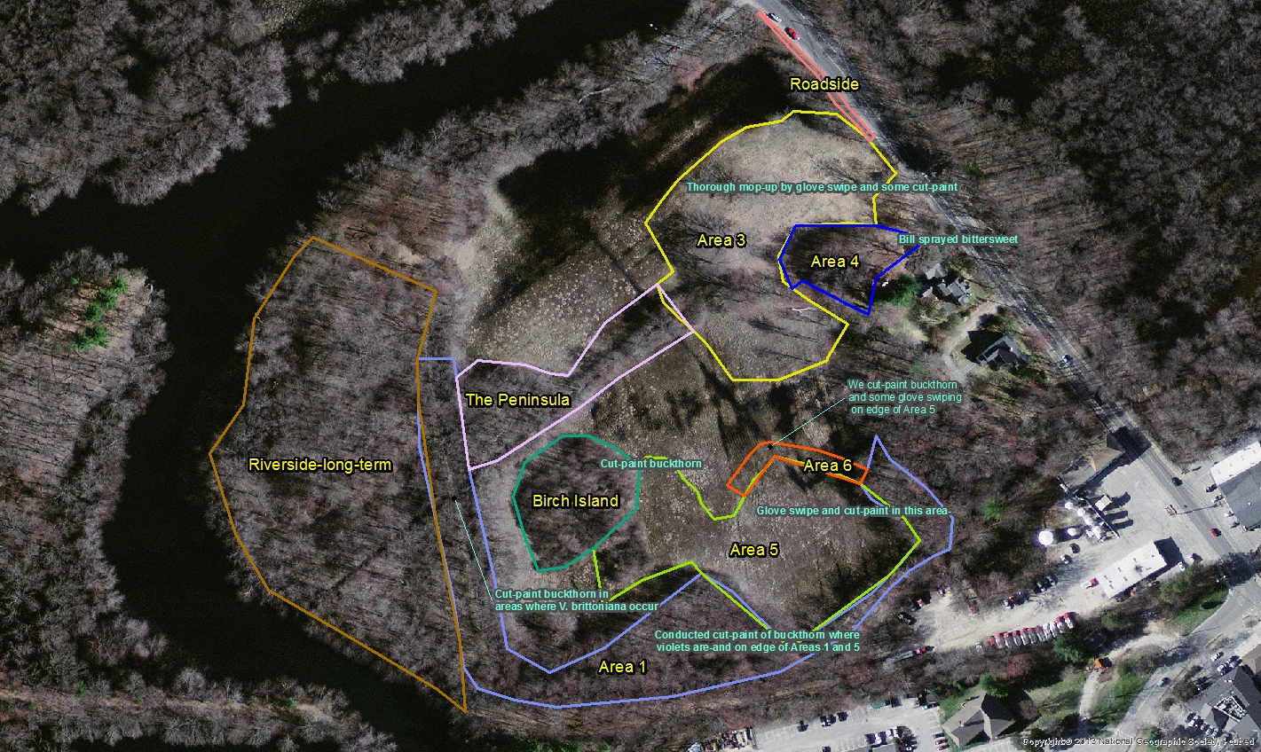
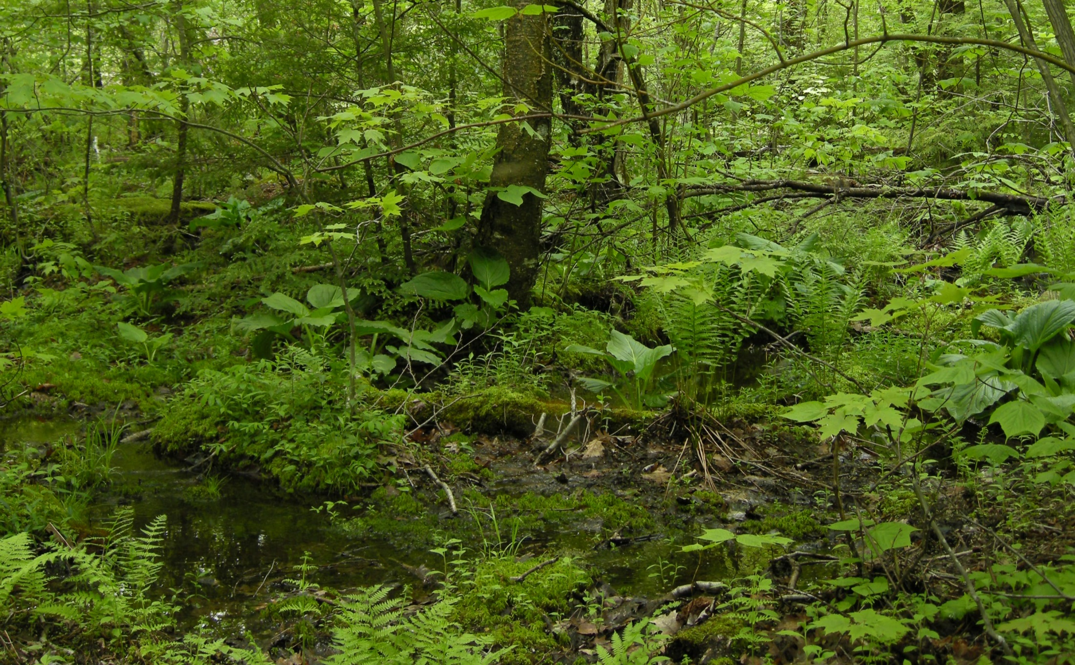
Viola brittoniana management-Site preparation
Notes:
So, in 2010, NEWFS was contracted by the town/MA Natural Heritage to conduct management to restore populations of V. brittoniana. Monitoring of violets in measured plots had been conducted by Dr. Sally Zielinski, who has been monitoring V. brittoniana populations since 1990-to get a count of violets before management was conducted. The treatments started in Area 3, but expanded to Area 1, Area 4, and eventually Area 5, where new subpopulations of V. brittoniana were found. In Area 1, treatment of glossy buckthorn, multiflora rose, burning bush, etc. was conducted at subpopulations of V. brittoniana population along the creek side trail (within 2 meters of the trail), using hand-swipe and cut and paint methods of applying glyphosate. Hand pulling of invasive plants in this area was also conducted when feasible. A small population of V. brittoniana has been found in this area. Despite progress here, there is still a good amount of buckthorn, and other invasive plants that remain in this area.
Triclopyr was used to treat Asian bittersweet, and other invasive plants in Areas 2 and 4. The area was sprayed with Triclopyr in summer of 2017 in order to eliminate the encroachment of bittersweet and other invasive plants into the areas where V. brittoniana occur. Triclopyr (3, 5, 6-Trichloro-2-pyridinyloxyacetic acid) is an organic compound used as a systemic, foliar herbicide and fungicide. It was applied with a backpack sprayer in areas where no violets were present, and using the hand-wicking technique where contact with violets was possible via herbicide drift (Figure 3). Through this treatment, a significant amount of potential habitat will be opened up and a future and current serious issue will hopefully be addressed. Onoclea sensibilis (sensitive fern), a native plant with aggressive tendencies, was also treated within Area 2.
Area 3 has been treated with glyphosate multiple times in the past few years, and in 2017, hand-swipe method of treatment was applied to glossy false buckthorn and Asian bittersweet in order to 'maintain' and 'clean up' the area. V. brittoniana is abundant in this area. This area was treated for several hours. However, the amount of glossy false buckthorn saplings in this area is still abundant, and will require more treatment in 2018. It is possible that mowing in Area 3 annually in autumn can greatly increase the glossy false buckthorn saplings that will need to be treated.
Area 5 had a heavy, mainly low-growing buckthorn infestation and required the most hours of treatment with glyphosate. The hand-swipe method was used for smaller invasive plants, and the cut and paint methods for larger shrubs. Only a fraction of the work needed was completed in this area in 2017, so a large amount of work will be needed in 2018.

Slide 21
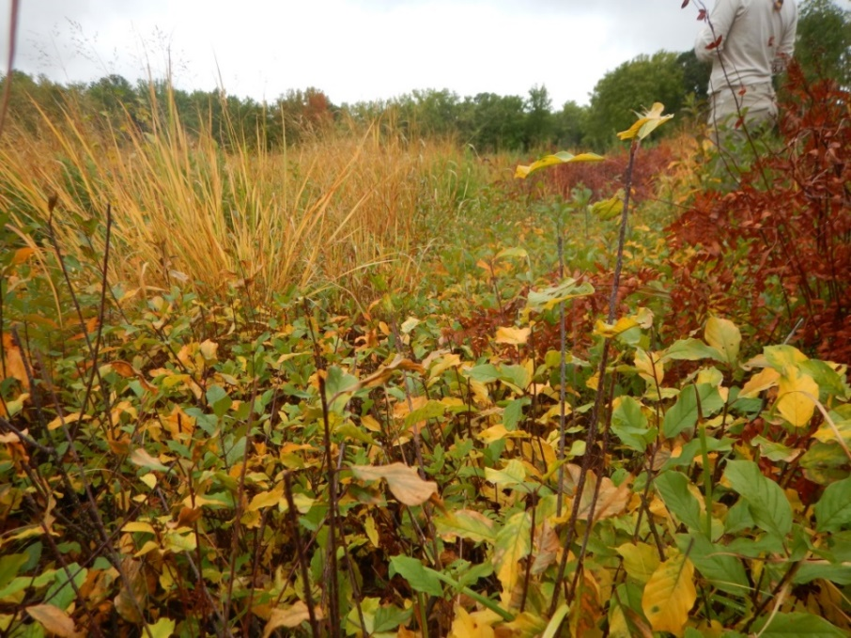
Viola brittoniana management-Methods
Annual monitoring of Viola brittoniana in long-term established plots
Invasive plant control of glossy buckthorn and other invasive plants in wet meadow, and forested floodplain
Treated with rodeo by cut-paint and hand-swipe methods
Treated Asian bittersweet with triclopyr spray method
Notes:
The cut-and-paint treatments started in Area 3, but expanded to Area 1, Area 4, and eventually Area 5, where new subpopulations of V. brittoniana were found. In Area 1, treatment of glossy buckthorn, multiflora rose, burning bush, etc. was conducted at subpopulations of V. brittoniana population along the creek side trail (within 2 meters of the trail), using hand-swipe and cut and paint methods of applying glyphosate. Hand pulling of invasive plants in this area was also conducted when feasible. A small population of V. brittoniana has been found in this area. Despite progress here, there is still a good amount of buckthorn, and other invasive plants that remain in this area.
Triclopyr was used to treat Asian bittersweet, and other invasive plants in Areas 2 and 4. The area was sprayed with Triclopyr in summer of 2017 in order to eliminate the encroachment of bittersweet and other invasive plants into the areas where V. brittoniana occur. Triclopyr (3, 5, 6-Trichloro-2-pyridinyloxyacetic acid) is an organic compound used as a systemic, foliar herbicide and fungicide. It was applied with a backpack sprayer in areas where no violets were present, and using the hand-wicking technique where contact with violets was possible via herbicide drift (Figure 3). Through this treatment, a significant amount of potential habitat will be opened up and a future and current serious issue will hopefully be addressed. Onoclea sensibilis (sensitive fern), a native plant with aggressive tendencies, was also treated within Area 2.
Area 3 has been treated with glyphosate multiple times in the past few years, and in 2017, hand-swipe method of treatment was applied to glossy false buckthorn and Asian bittersweet in order to 'maintain' and 'clean up' the area. V. brittoniana is abundant in this area. Area 5 had a heavy, mainly low-growing buckthorn infestation and required the most hours of treatment with glyphosate. The hand-swipe method was used for smaller invasive plants, and the cut and paint methods for larger shrubs.

Slide 22
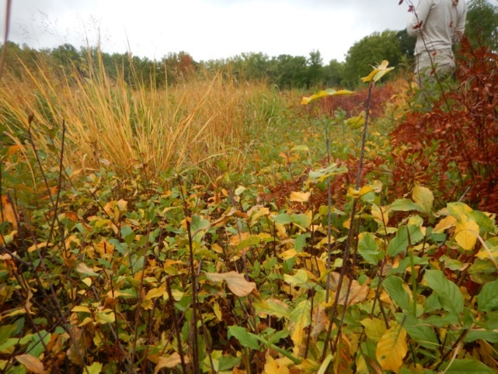
Viola brittoniana management-challenges
Control of glossy false buckthorn has proved to be challenging, since this species resprouts vigorously in response to herbicide and mowing
Resprouts of buckthorn have been visually observed after mowing and cut-painting individuals
Manual pulling is not feasible due to the proximity of violets next to buckthorn
Recruitment of source of buckthorn has not yet been eradicated--dispersal

Slide 23
Viola brittoniana management--2019-2020 management objectives
Native Plant Trust (NPT) set up three 10 m X 10 m plots in 2019
NPT conducted counts of V. brittoniana individuals and hybrids, and also counted Frangula alnus (glossy buckthorn) stems within each plot
Later, in summer of 2019, NPT conducted hand-swipe of buckthorn within the three plots
Goal is to evaluate the effectiveness of the hand-swiping of buckthorn within each plot, determine survivorship of buckthorn, and monitor for changes of V. brittoniana numbers
In 2020, NPT will count V. brittoniana and buckthorn stems again in the three plots in order to gather data to determine if hand-swiping method is an effective tool in controlling buckthorn

Slide 24
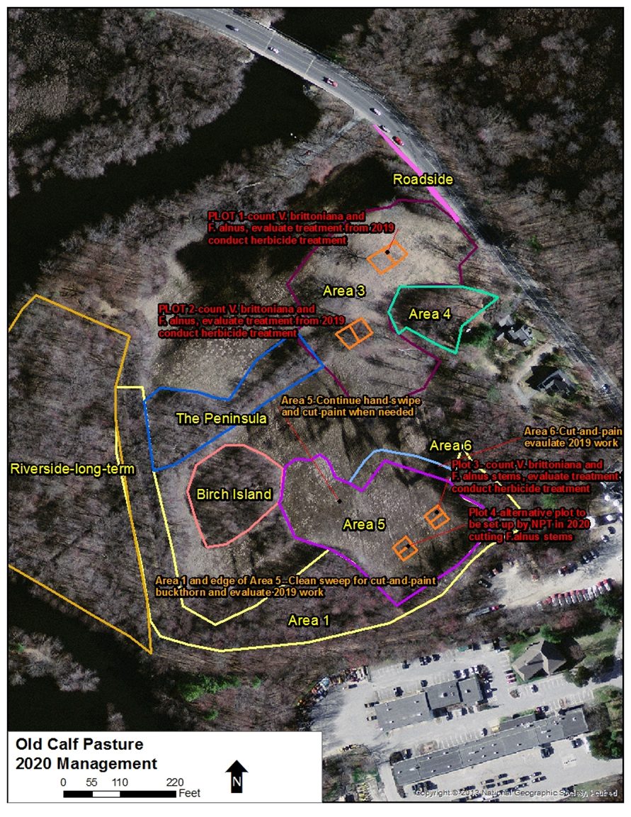

Slide 25
www.NativePlantTrust.org

