Slide 1
Identify Conservation Targets Identify Threats Consider Management Options and Plan Accordingly
Considerations
No field can be all things to all grassland species
Landscape Context, Size, Environmental Conditions, Land Use Wildlife
Notes:
There are many aspects to consider when planning field management. One is landscape context. Where does your field situate in the surrounding landscape. An adjacent grassland may inform you to manage your field as a grassland, to get more acreage. A field surrounded by forests adds diversity to the landscape. With fields, size matters. For fields over 10 acres, you can consider habitat for different grassland nesting birds. Think about what environmental conditions you are starting with. Are there wetlands nearby? How present are invasive species? What is the land use? Is it an old overgrown field, or is it an active hayfield? Finally, what wildlife are presently using the field? Or are they any species you are hoping to manage for?

Slide 2
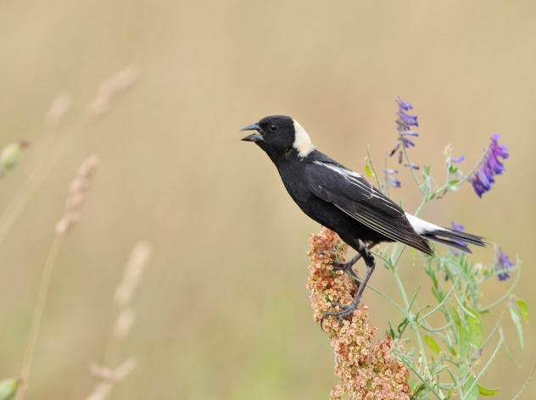
Big Patches

Slide 3
Grassland Nesting Birds
Species | Area Required | Vegetation Needed
Bobolink | 10+ ac. | Grass taller than 3 ft.
Eastern meadowlark | 15+ ac. | Grass and forbs taller than 3 ft.
Savannah sparrow | 20+ ac. | Areas of short and tall vegetation
Grasshopper sparrow | 30+ ac. | Short and sparse grass
Northern harrier | 30+ ac. | Wet meadows
Upland sandpiper | 100+ ac. | Short and sparse grass
Steven Kersting,
Creative Commons
John Carrel,
Creative Commons
Becky Matsubara,
Creative Commons
Gregory Smith,
Creative Commons
Do not mow between April 15th and August 1st
Notes:
If you have a field of at least 10 acres, you have the opportunity to manage habitat for grassland nesting birds. Many of which are rare in Massachusetts because large grasslands are rare. These birds are area sensitive, meaning they will not typically nest in areas less than a certain acreage. For example, bobolinks typically need at least 10 ac. while upland sandpipers need at least 100. Each species has its own requirements for vegetation too. Bobolinks and eastern meadowlarks prefer tall vegetation. A couple more notes is to avoid disturbing the nesting habitat between April 15th and August 1st.

Slide 4
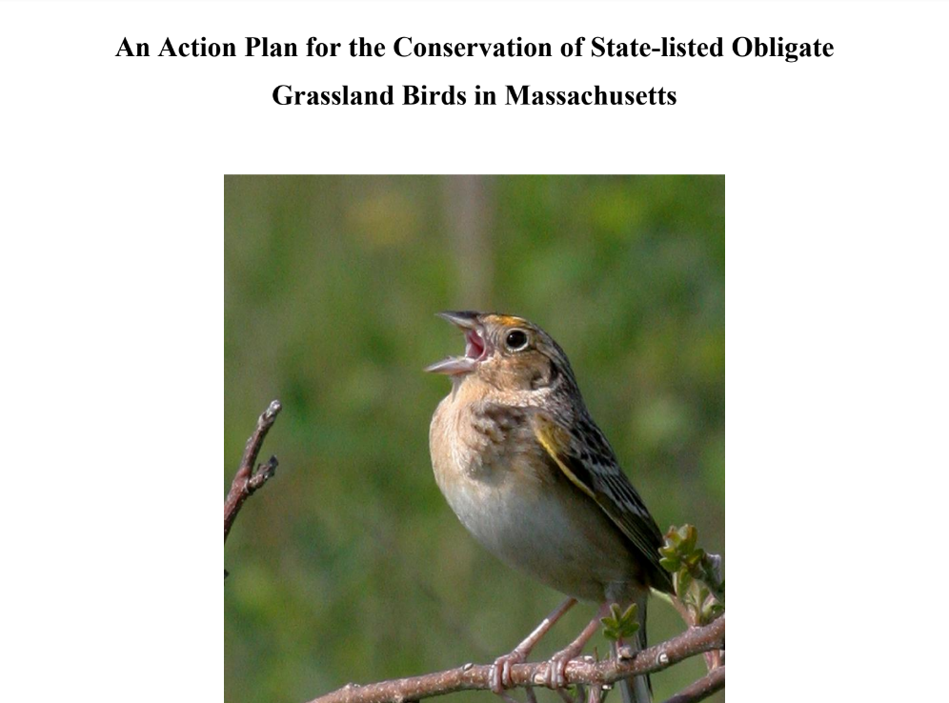
Notes:
These are a couple resources to read more about managing for grassland nesting birds. One is from Mass Audubon and the other is a collaborative work from multiple groups in the state. We’ll share both of these following the presentation.

Slide 5
Benefits of Small Fields
Too small for grassland nesting birds
Small mammals
and their predators
Nesting turtles
Stopover site for migrating birds
Rare plants
Pollinators and other insects
Notes:
Not every field is large enough for grassland nesting birds, but small fields still provide many other ecological benefits. Other wildlife such as meadow voles or meadow jumping mice use these areas. Their predators, snakes, raptors, foxes, and others also benefit from the field too. Some turtle species nest upland from a nearby wetland. A small field can act as a stopover site for grassland nesting birds, as migrating birds often stop in places similar to their nesting habitat. The field could also be a site for rare plants.
A field has the opportunity to be habitat for pollinators and other insects.

Slide 6
Wet Meadows
Notes:
Value of wet meadows habitat to add diversity

Slide 7
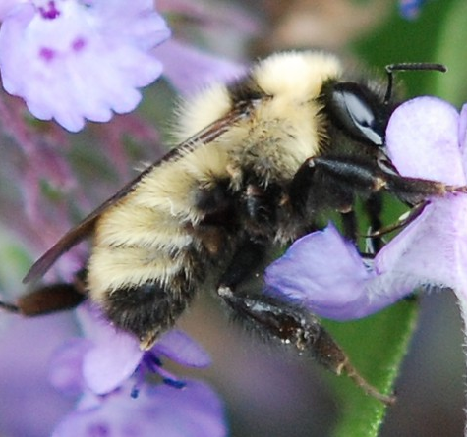
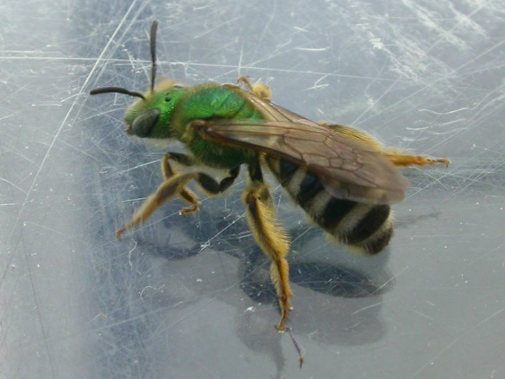
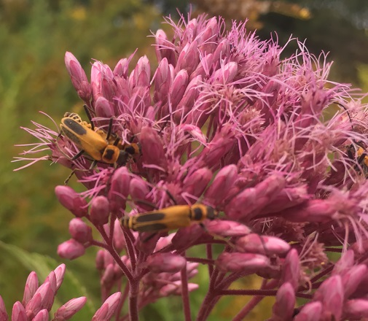
Pollinators
Over 75% of flowering plants need animals for pollination
The role of pollinating wild plants falls on native pollinators
Many pollinators are in decline, some at higher rates than others
John Baker,
Creative Commons
Notes:
Pollinators are an excellent group of critters to manage for, as their services are vital for ecological health. Pollination sustains most of an ecosystems plants, which provide food and shelter for wildlife. There’s a lot of buzz around the word pollinator, so I just want to take a moment to discuss which critters I’m talking about. The role of pollinating wild plants of the environment falls on native pollinators, which includes species of bumblebees, sweat bees, butterflies, beetles, and more. This does not include honeybees, which are vital in large scale agriculture, but not for New England’s environment. Many pollinators are in decline, so managing a field as pollinator habitat is a worthy cause. However, not all pollinators are declining at the same rate, creating habitat for more at-risk species will help preserve biodiversity than native pollinators that are not as threatened.

Slide 8
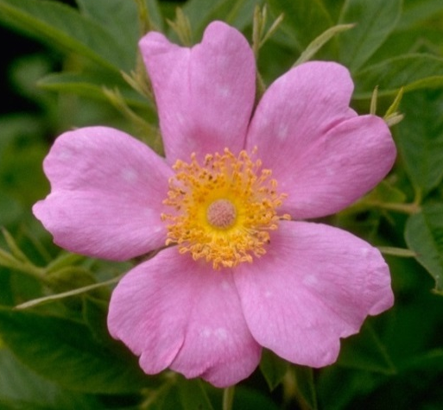
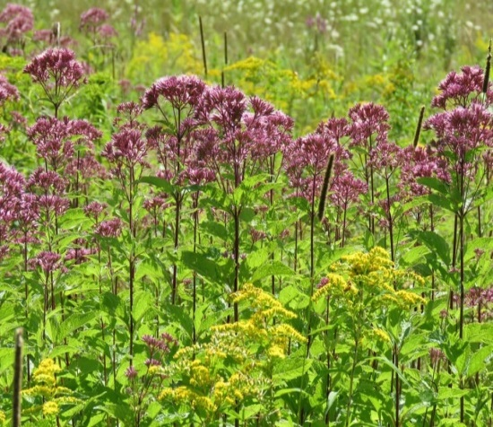
Habitat for At-risk Pollinators
Plant specifically for them
Provide sources of nectar and pollen
Bloom throughout the season
Early and late season blooms are especially important
Craig Smith
Freddie Gillespie
Christa R.,
Creative Commons
John Baker,
Creative Commons
Notes:
If you are thinking about pollinator habitat. Think of species that are more at-risk. For example, MA has twelve species of bumblebees. In eastern MA, there are two species that have declined more than others, B. fervidus and B. vagans. You can help these species by planting the plants they need. This includes flowers that provide nectar and pollen, and collectively bloom from March to October. Having those early and late season plants is helpful for queens coming out and going back into winter hibernation. We’ll also share a plant list following the presentation based on research happening in MA.
Also, creating habitat for these at-risk pollinators also helps others pollinators too.

Slide 9
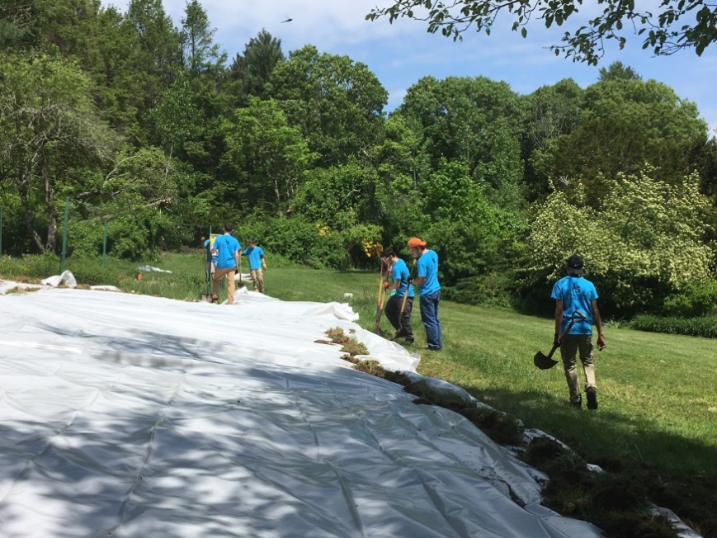
Solarization
Create a blank canvas for planting
Lay clear plastic for at least 6 weeks in full sun during summer
Notes:
A great way to prepare a site for planting is solarization. This process involves laying clear plastic in full sun during summer, and leaving it for at least six weeks. The plastic traps in heat from the sun to kill the existing vegetation, creating a blank canvas for any planting.

Slide 10
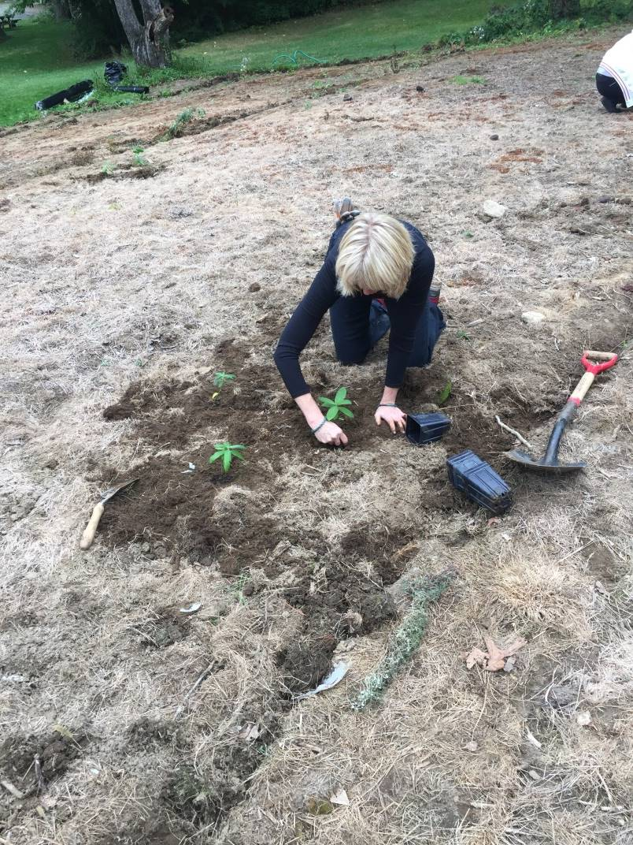
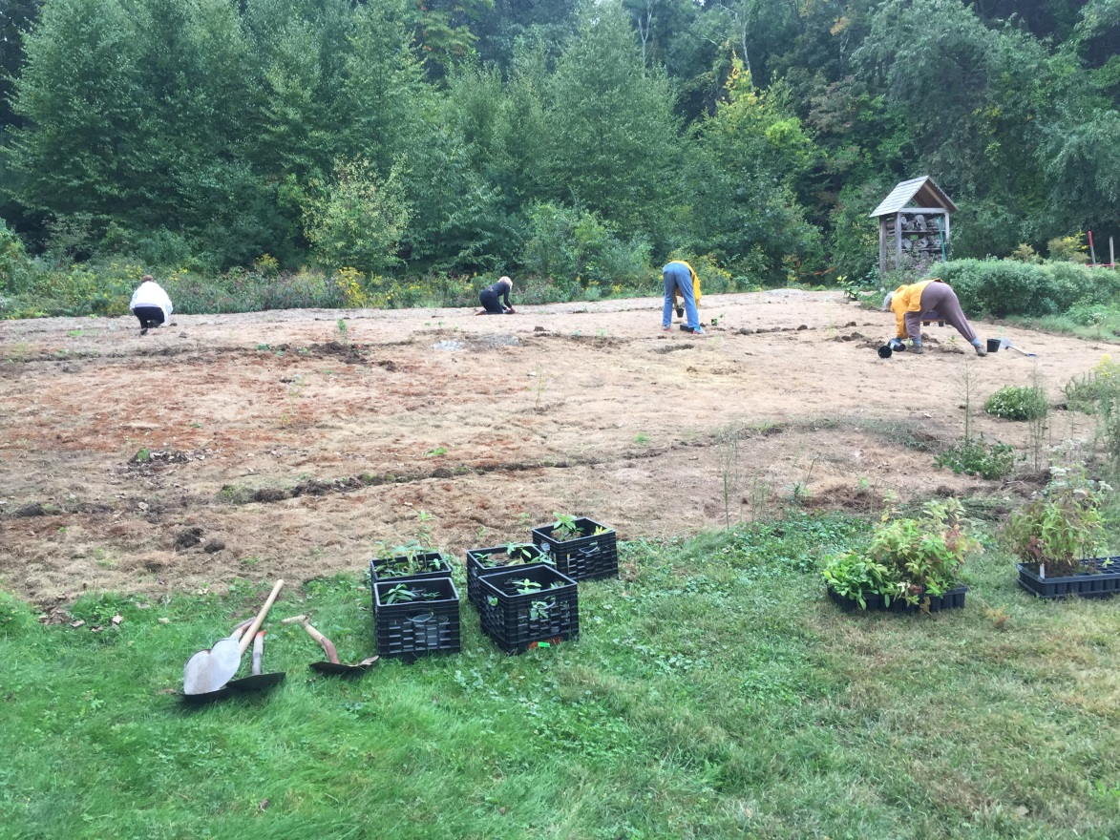
Planting
Install plugs and lay seed
Notes:
It’s important to plant soon after removing the solarizing sheets, before any invasive or unwanted plants establish. A native seed mix is a cost effective way to grow a pollinator area, but it may not include the plants needed for at-risk pollinators. Purchasing plugs (or small plants) of what you are missing is a way to fill the gaps.

Slide 11
Tips for Managing Small Fields with Limited Resources
Use rotational mowing cycle
Reduce speed to at most 8mph
Don’t mow outward-in
Adding a flush bar to mower
Mower height to at least 8 in.
Mow in late fall to promote late season forbs like asters and goldenrods
Notes:
You may not have the resources for a full field restoration project. Here are some practices you can follow if all you have is a mower. Avoid mowing the whole field at once. That creates a large disturbance for critters using the field. Instead, leave some area to be mowed later. This could either be field edges or a whole section.

Slide 12
Find Habitats of Rare Wildlife
Notes:
One way to prioritize is to see if any rare species occur in or near your field. You can search online on OLIVER and select the Natural Heritage layers. This is a field that SVT manages, with some priority habitat between it and a river. To find out exactly what species an area is denoting, send an email to Natural Heritage with the PH number and prove that you the landowner looking to improve habitat.
Just because priority is not mapped, does not mean it’s not there. Ask a local botanist or naturalist to for a survey.

