Slide 1
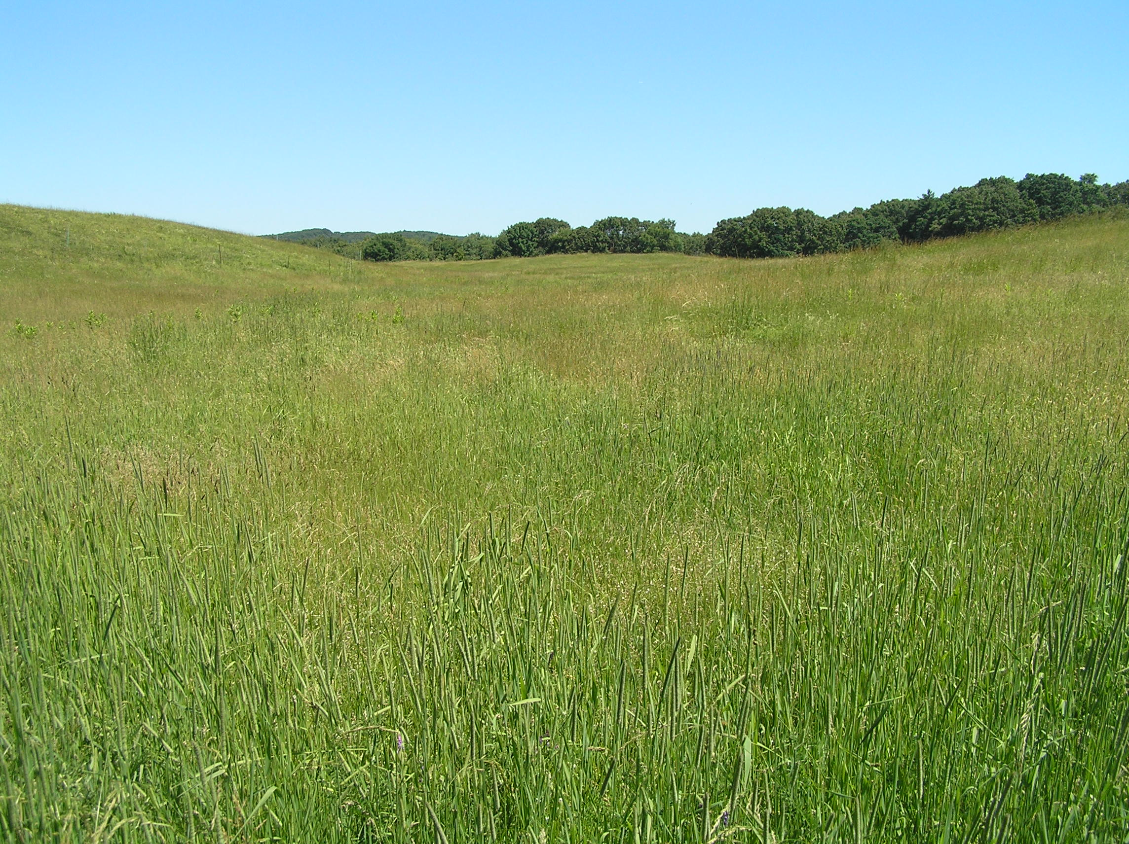
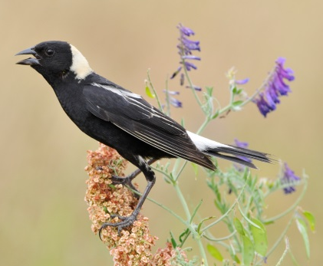
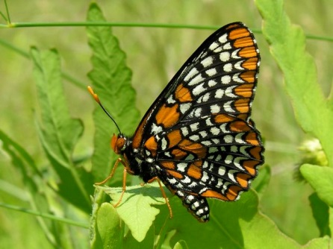
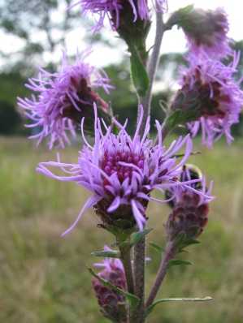


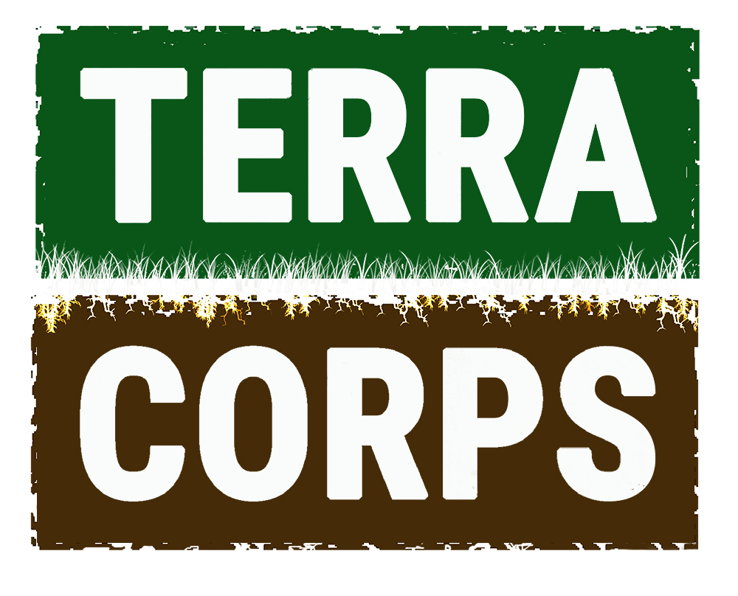
Open Field Management:
Managing Fields for Wildlife Habitat

Slide 2
Presentation Outline
Context: history, biodiversity, landscape
Site specific considerations
Invasive species control
Case Studies
More emphasis on smaller fields and invasive plant management
Less emphasis on large grasslands/warm season conversions

Slide 3
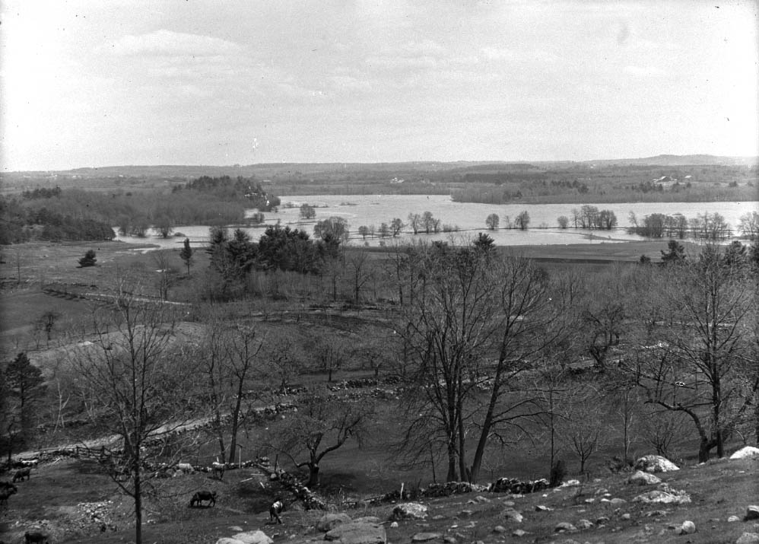
Notes:
Open meadows were a component of our landscape for hundreds and hundreds of years.
Plants, insects and other animals evolved with this landscape.
This dynamic history yielded great biodiversity. *was primarily driven by humans* Humans part of the ecological system.
Photo from hill in Concord over Great Meadow during a flood.

Slide 4
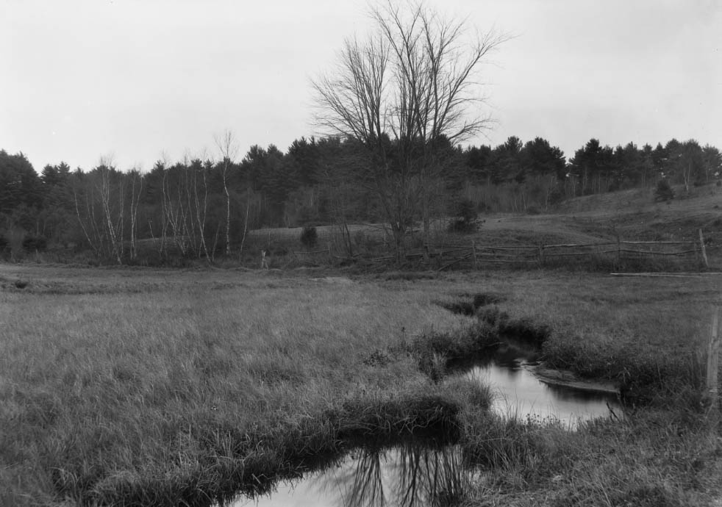
Notes:
Wetlands were channelized and drained; flooded in winter to fertilize.
Nut Meadow – now a forested swamp

Slide 5
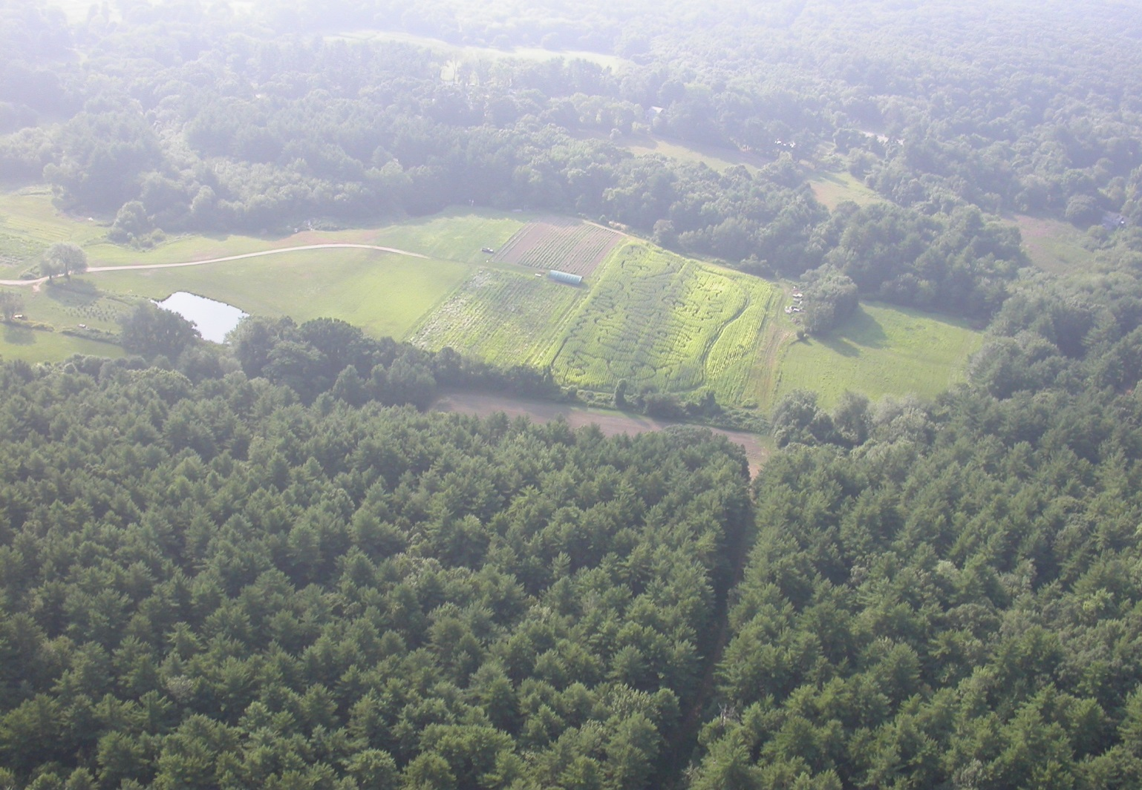
Landscape Level
Loss of habitats and associated species
Notes:
Current theory and practice of Conservation Biology emphasized maximizing biodiversity at a landscape scale (not necessarily at site level – which can reduce overall biodiversity).
Grassland and wet meadow habitat is imperiled today due to agricultural abandonment, development (and – interpretation of -wetland regulations).
ll diversity). Goal is to maintain as many viable populations of species as possible.

Slide 6
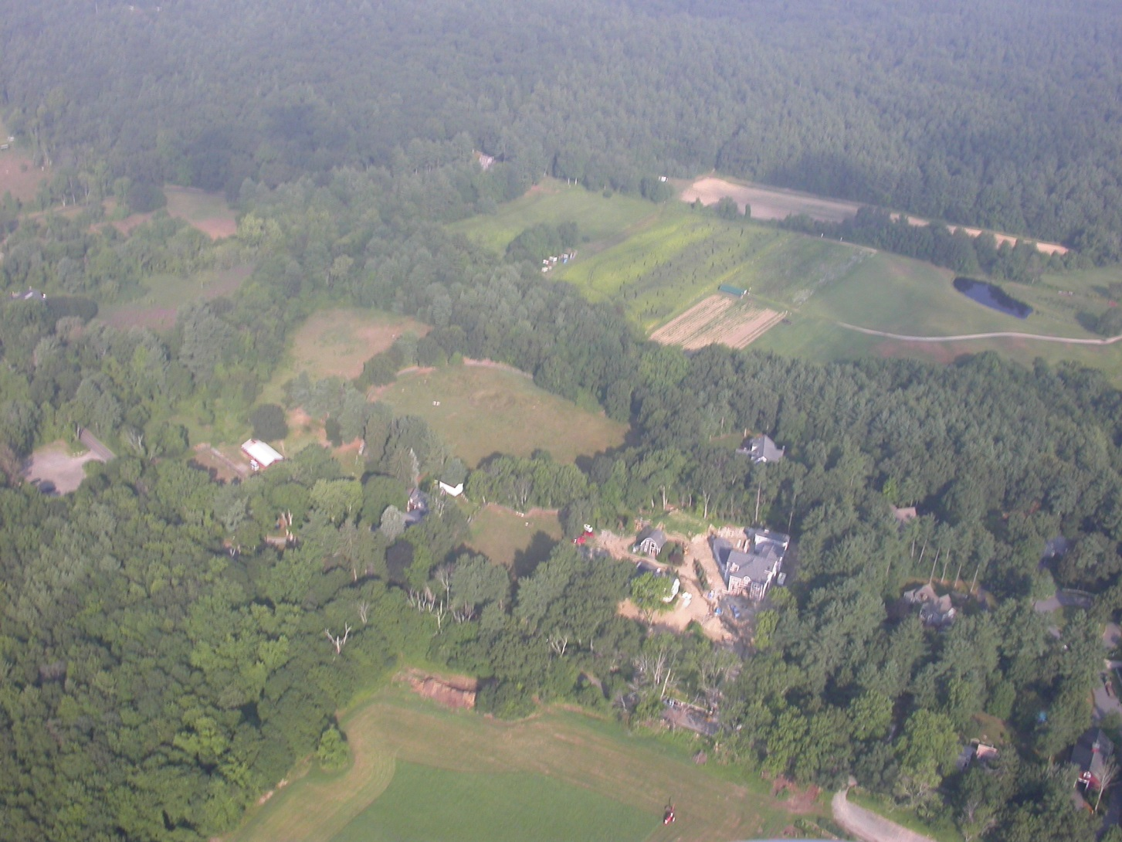
Conservation Planning at the Landscape Level
Notes:
Evaluate landscape level first to determine appropriate site level management goal. Don’t confuse the two!

Slide 7
Conservation Planning at the Landscape Level
Look for areas with other open areas nearby
Field nesting birds have minimum area requirements
Birds-Eye View - all open areas are attractive
Insects and plants do not have known area limitations
Consult with MassWildlife and MNHESP

Slide 8
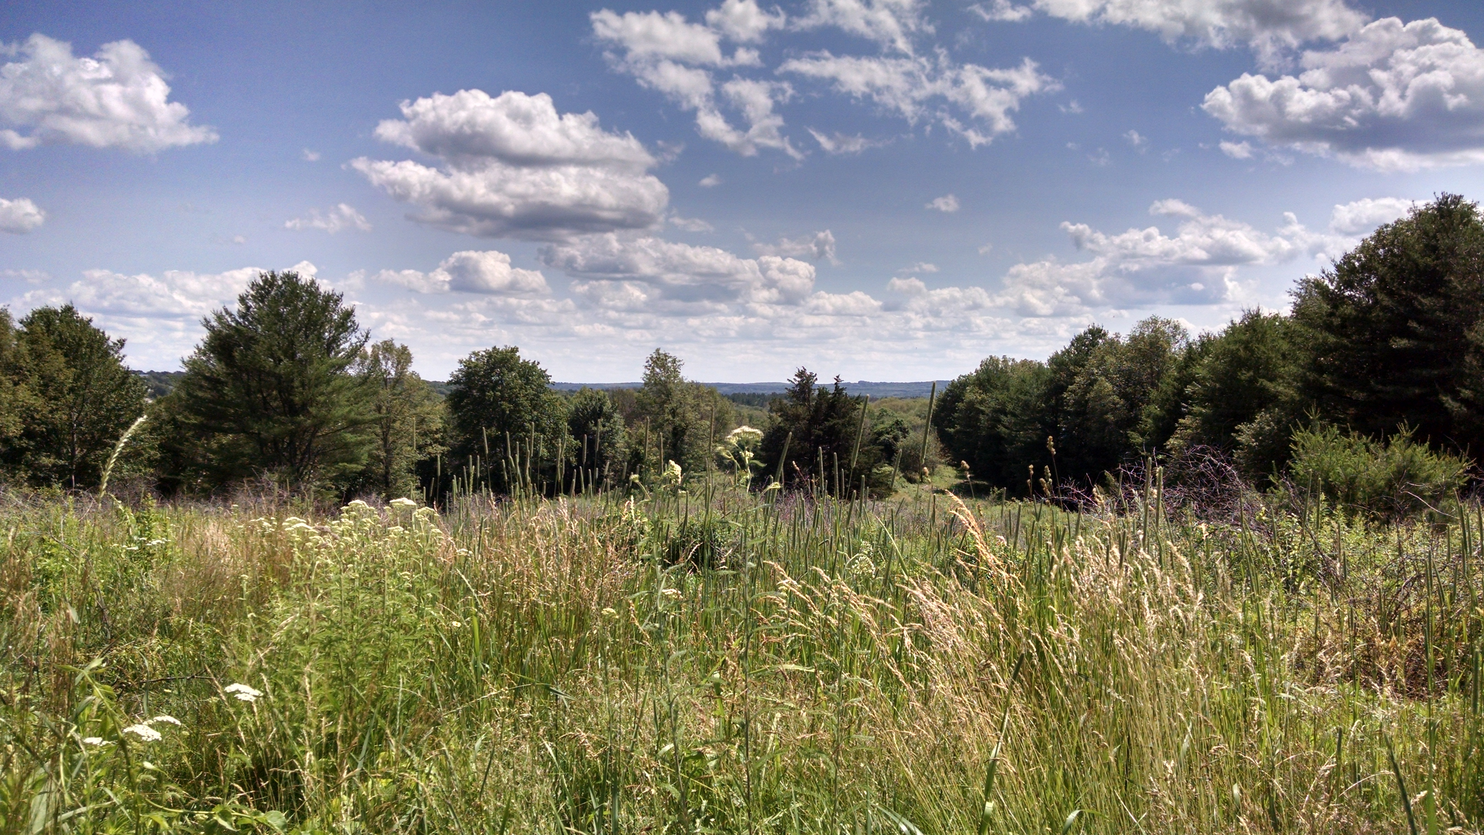
Identify Conservation Targets
Identify Threats
Consider Management Options and Plan Accordingly
Considerations
No field can be all things to all grassland species
Landscape, Context, Size, Environmental Conditions, Land Use
Wildlife
Notes:
There are many aspects to consider when planning field management. One is landscape context. Where does your field situate in the surrounding landscape. An adjacent grassland may inform you to manage your field as a grassland, to get more acreage. A field surrounded by forests adds diversity to the landscape. With fields, size matters. For fields over 10 acres, you can consider habitat for different grassland nesting birds. Think about what environmental conditions you are starting with. Are there wetlands nearby? How present are invasive species? What is the land use? Is it an old overgrown field, or is it an active hayfield? Finally, what wildlife are presently using the field? Or are they any species you are hoping to manage for?

Slide 9
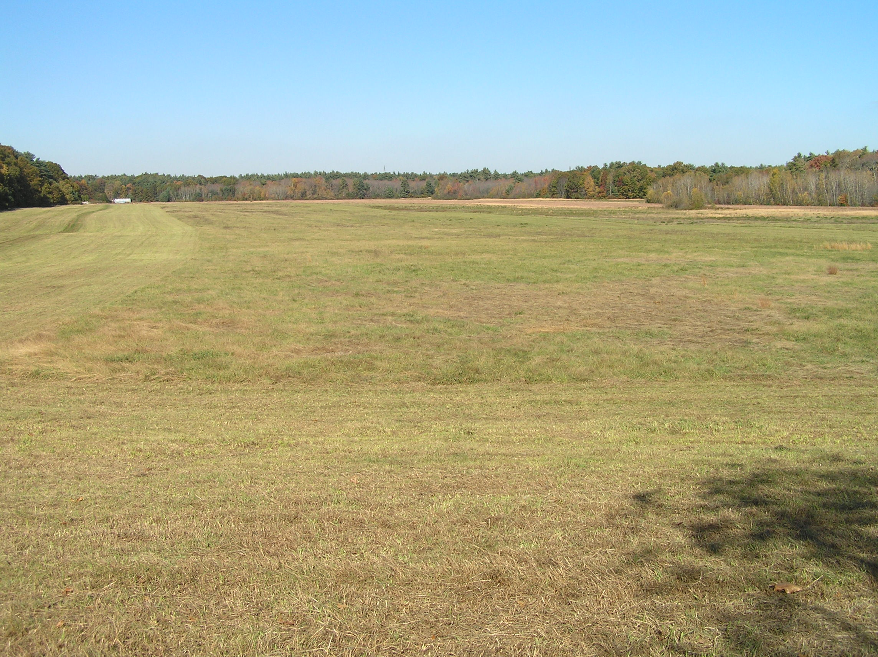
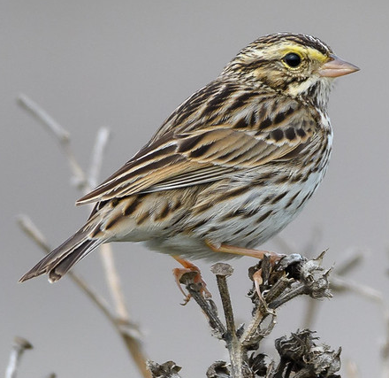

Big Patches

Slide 10
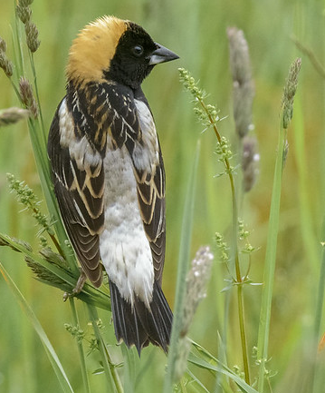
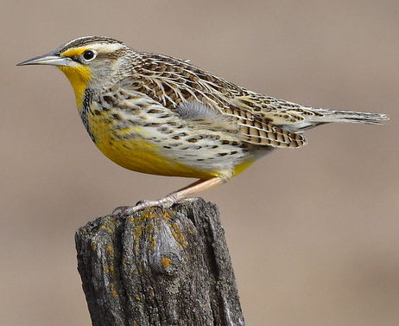
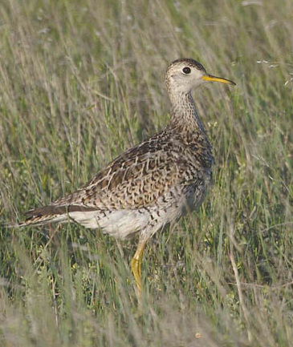
Grassland Nesting Birds
Species | Area Required | Vegetation Needed
Bobolink | 10+ ac. | Grass taller than 3 ft.
Eastern meadowlark | 15+ ac. | Grass and forbs taller than 3 ft.
Savannah sparrow | 20+ ac. | Areas of short and tall vegetation
Grasshopper sparrow | 30+ ac. | Short and sparse grass
Northern harrier | 30+ ac. | Wet meadows
Upland sandpiper | 100+ ac. | Short and sparse grass
Steven Kersting,
Creative Commons
John Carrel,
Creative Commons
Becky Matsubara,
Creative Commons
Gregory Smith,
Creative Commons
Do not mow between April 15th and August 1st
Notes:
If you have a field of at least 10 acres, you have the opportunity to manage habitat for grassland nesting birds. Many of which are rare in Massachusetts because large grasslands are rare. These birds are area sensitive, meaning they will not typically nest in areas less than a certain acreage. For example, bobolinks typically need at least 10 ac. while upland sandpipers need at least 100. Each species has its own requirements for vegetation too. Bobolinks and eastern meadowlarks prefer tall vegetation. A couple more notes is to avoid disturbing the nesting habitat between April 15th and August 1st.

Slide 11
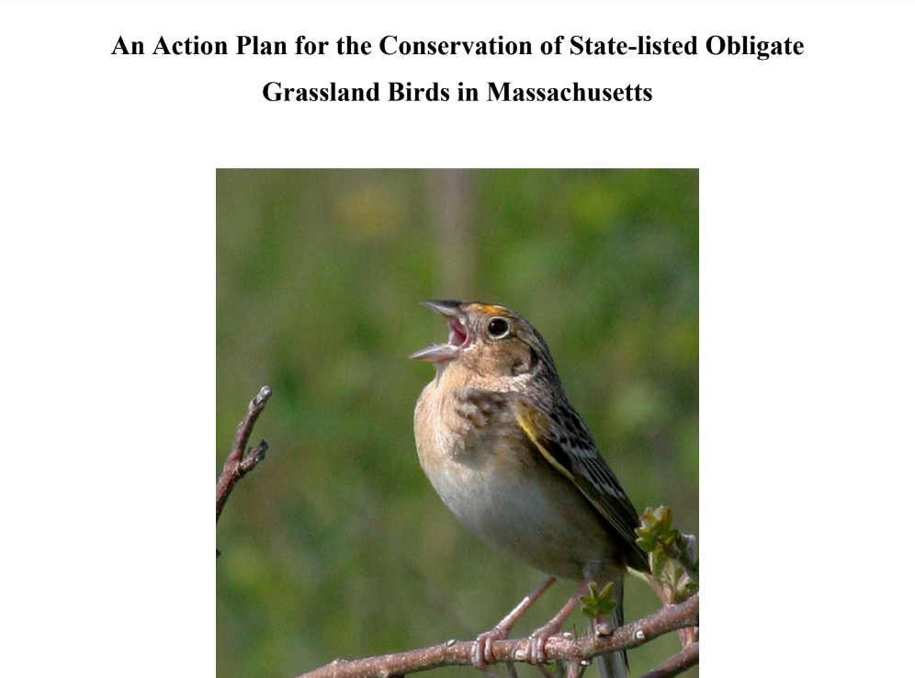
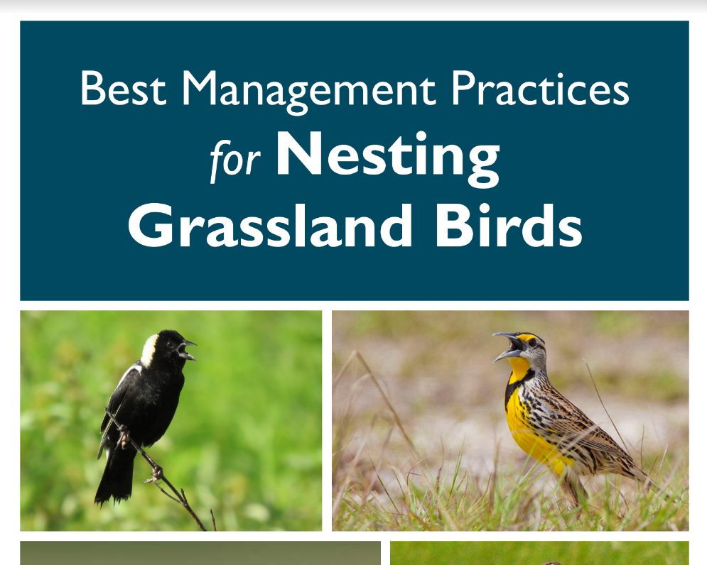
Notes:
These are a couple resources to read more about managing for grassland nesting birds. One is from Mass Audubon and the other is a collaborative work from multiple groups in the state. We’ll share both of these following the presentation.

Slide 12
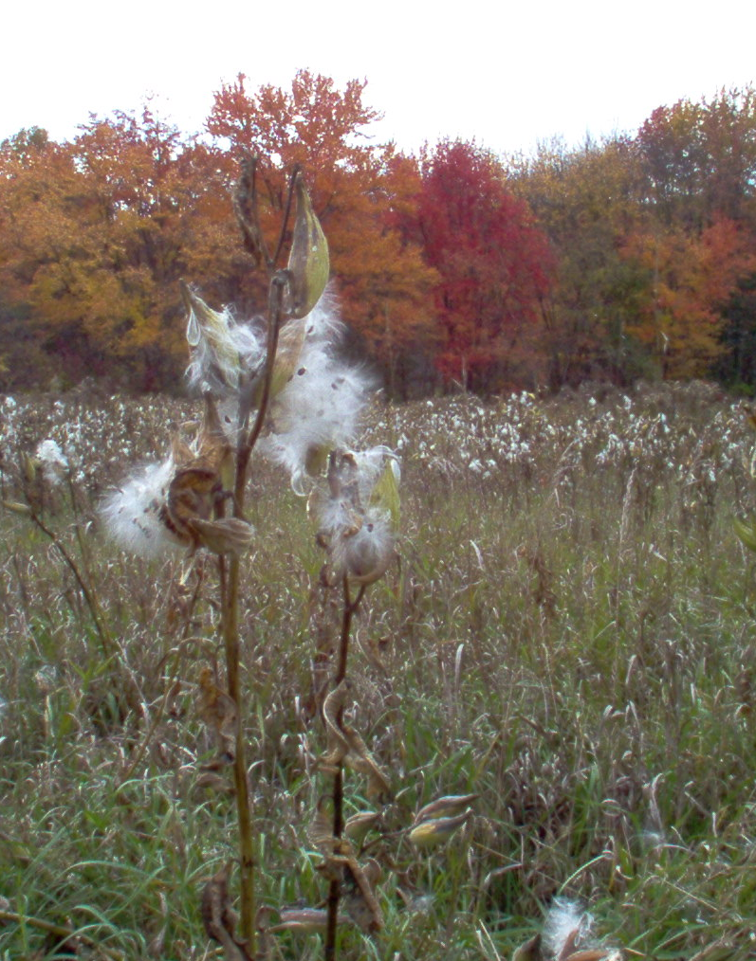
Benefits of Small Fields
Too small for grassland nesting birds
Small mammals
  and their predators
Nesting turtles
Stopover site for migrating birds
Rare plants
Pollinators and other insects
Notes:
Not every field is large enough for grassland nesting birds, but small fields still provide many other ecological benefits. Other wildlife such as meadow voles or meadow jumping mice use these areas. Their predators, snakes, raptors, foxes, and others also benefit from the field too. Some turtle species nest upland from a nearby wetland. A small field can act as a stopover site for grassland nesting birds, as migrating birds often stop in places similar to their nesting habitat. The field could also be a site for rare plants.
A field has the opportunity to be habitat for pollinators and other insects.

Slide 13
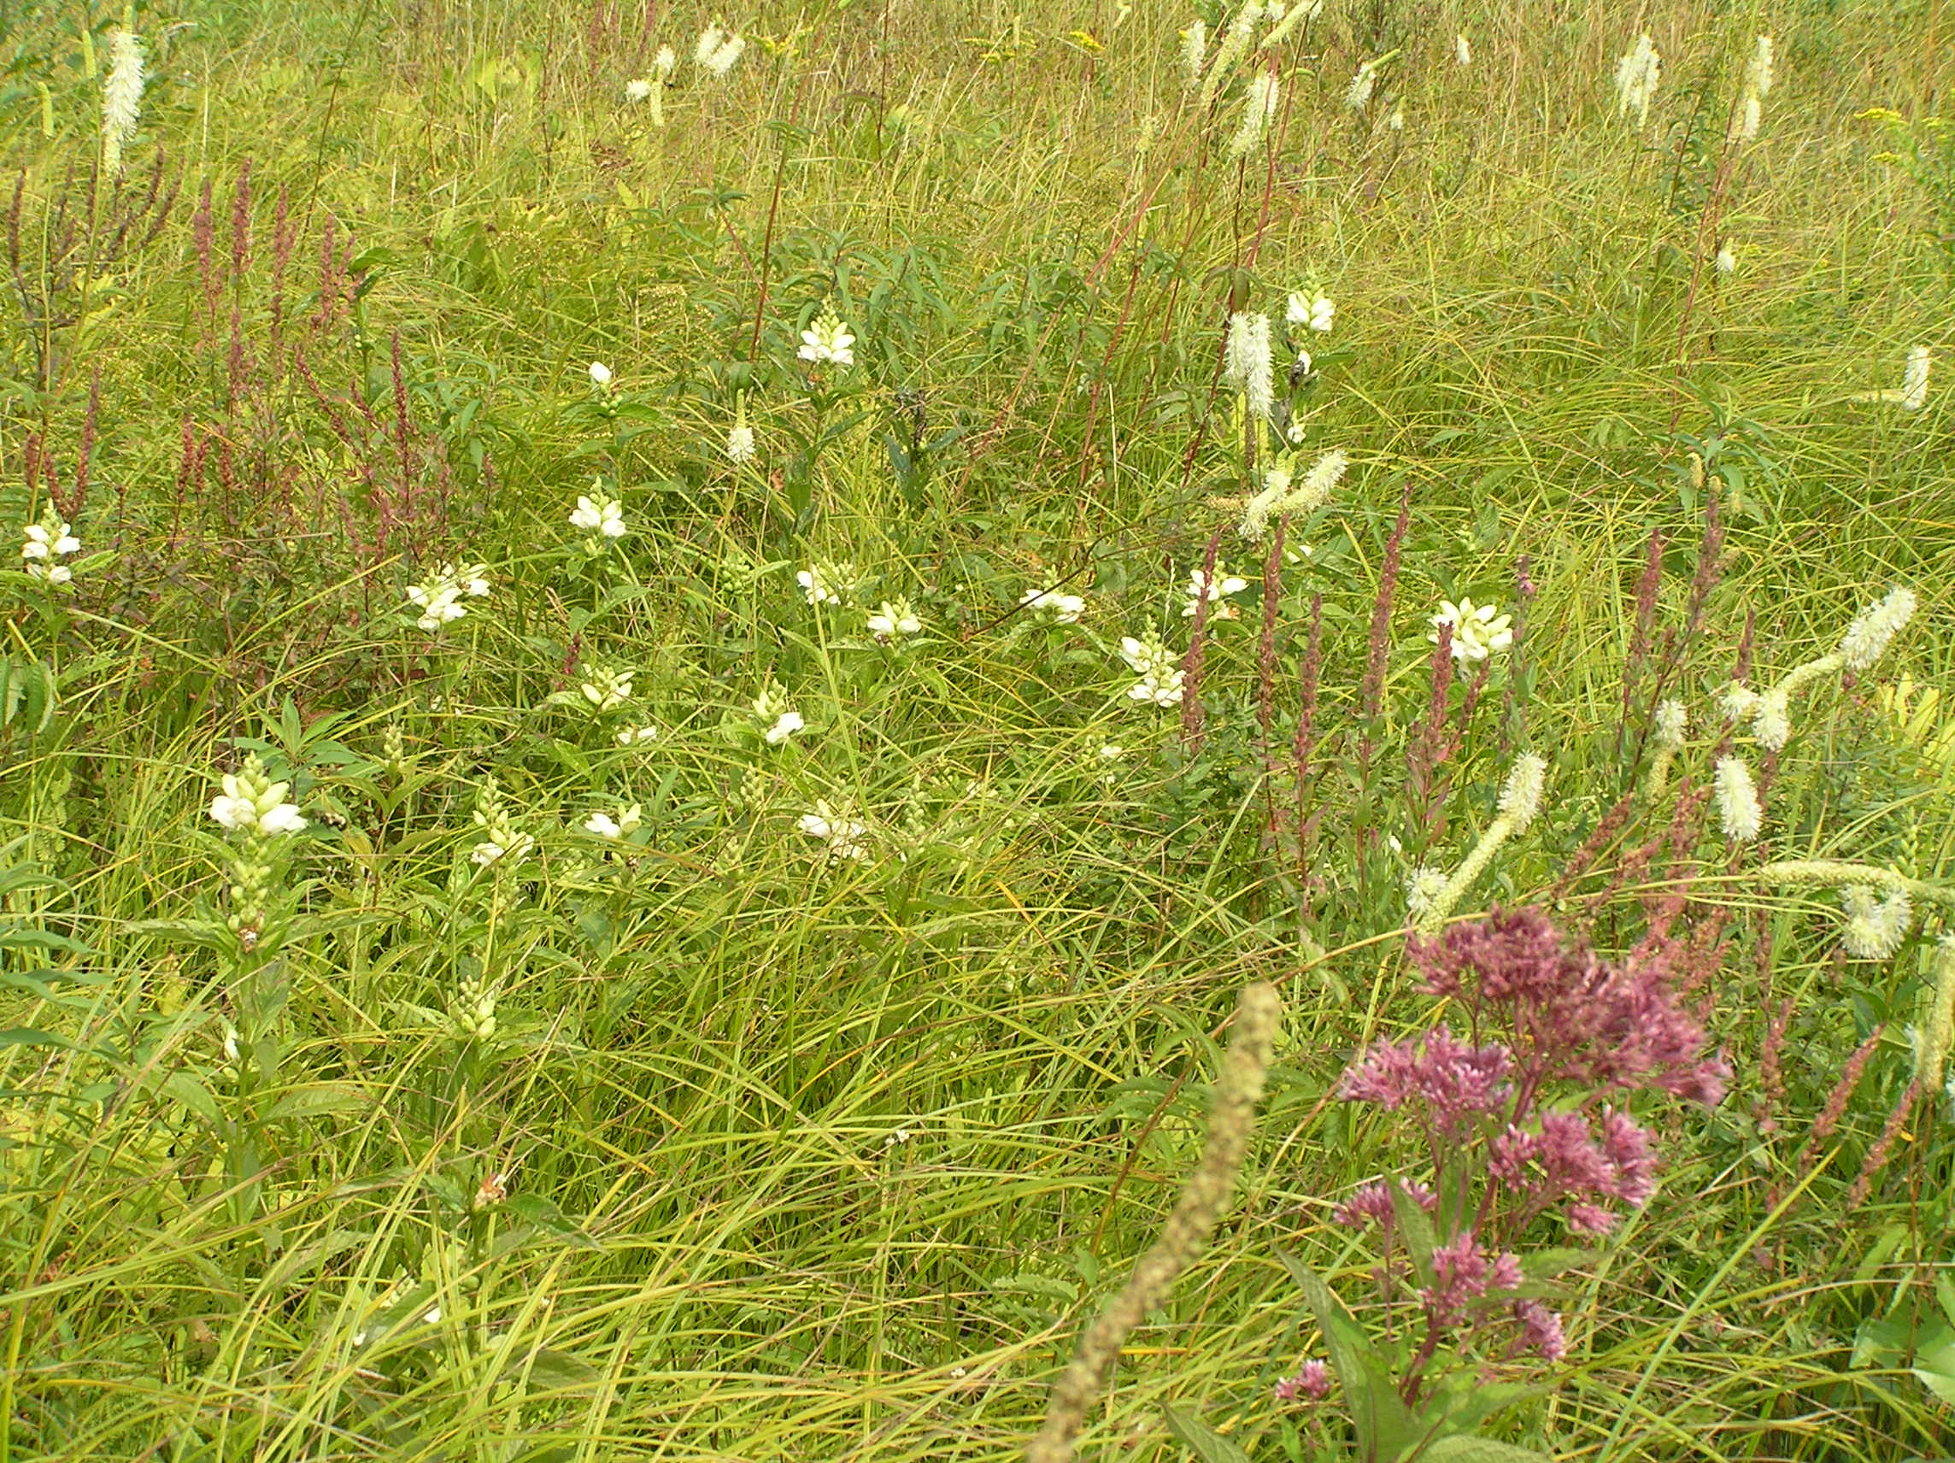
Wet Meadows
Notes:
Value of wet meadows habitat to add diversity

Slide 14
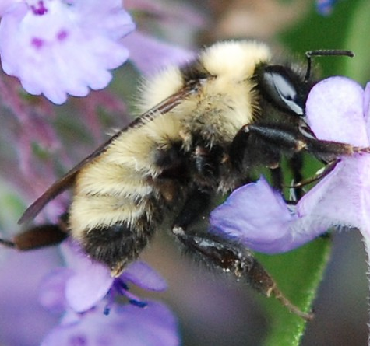
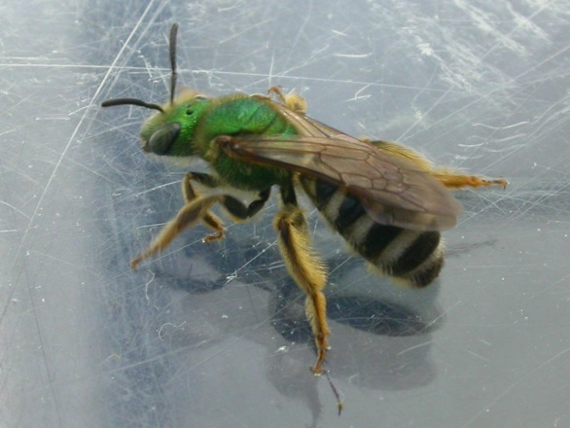
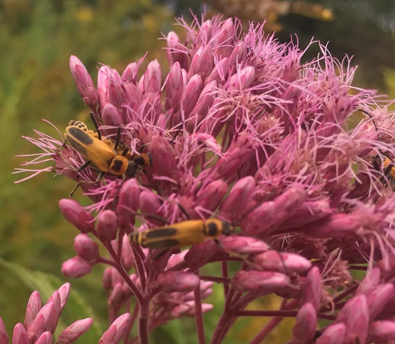
Pollinators
Over 75% of flowering plants need animals for pollination
The role of pollinating wild plants falls on native pollinators
Many pollinators are in decline, some at higher rates than others
John Baker,
Creative Commons
Notes:
Pollinators are an excellent group of critters to manage for, as their services are vital for ecological health. Pollination sustains most of an ecosystems plants, which provide food and shelter for wildlife. There’s a lot of buzz around the word pollinator, so I just want to take a moment to discuss which critters I’m talking about. The role of pollinating wild plants of the environment falls on native pollinators, which includes species of bumblebees, sweat bees, butterflies, beetles, and more. This does not include honeybees, which are vital in large scale agriculture, but not for New England’s environment. Many pollinators are in decline, so managing a field as pollinator habitat is a worthy cause. However, not all pollinators are declining at the same rate, creating habitat for more at-risk species will help preserve biodiversity than native pollinators that are not as threatened.

Slide 15
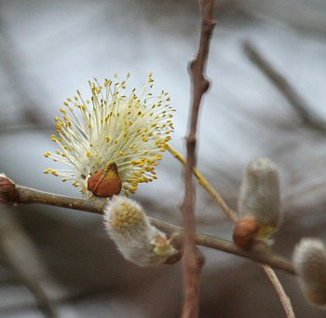
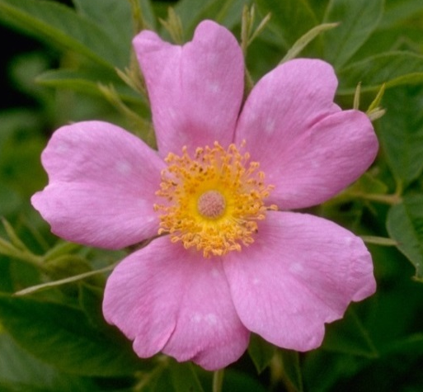
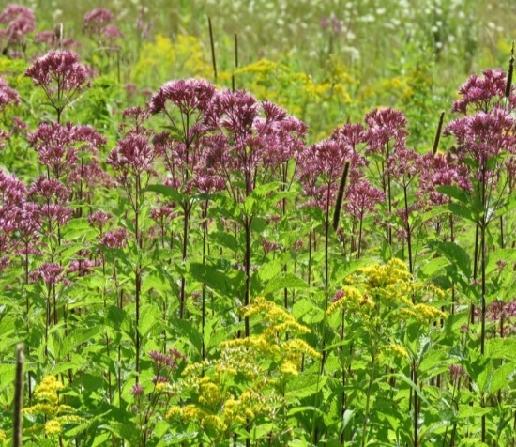
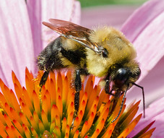
Habitat for At-risk Pollinators
Plant specifically for them
  Provide sources of nectar and pollen
  Bloom throughout the season
    Early and late season blooms are especially important
Craig Smith
Freddie Gillespie
Christa R.,
Creative Commons
John Baker,
Creative Commons
Notes:
If you are thinking about pollinator habitat. Think of species that are more at-risk. For example, MA has twelve species of bumblebees. In eastern MA, there are two species that have declined more than others, B. fervidus and B. vagans. You can help these species by planting the plants they need. This includes flowers that provide nectar and pollen, and collectively bloom from March to October. Having those early and late season plants is helpful for queens coming out and going back into winter hibernation. We’ll also share a plant list following the presentation based on research happening in MA.
Also, creating habitat for these at-risk pollinators also helps others pollinators too.

Slide 16
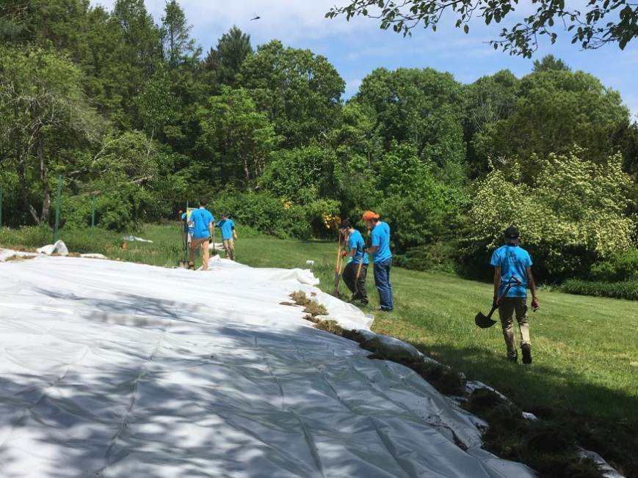
Solarization
Create a blank canvas for planting
Lay clear plastic for at least 6 weeks in full sun during summer
Notes:
A great way to prepare a site for planting is solarization. This process involves laying clear plastic in full sun during summer, and leaving it for at least six weeks. The plastic traps in heat from the sun to kill the existing vegetation, creating a blank canvas for any planting.

Slide 17
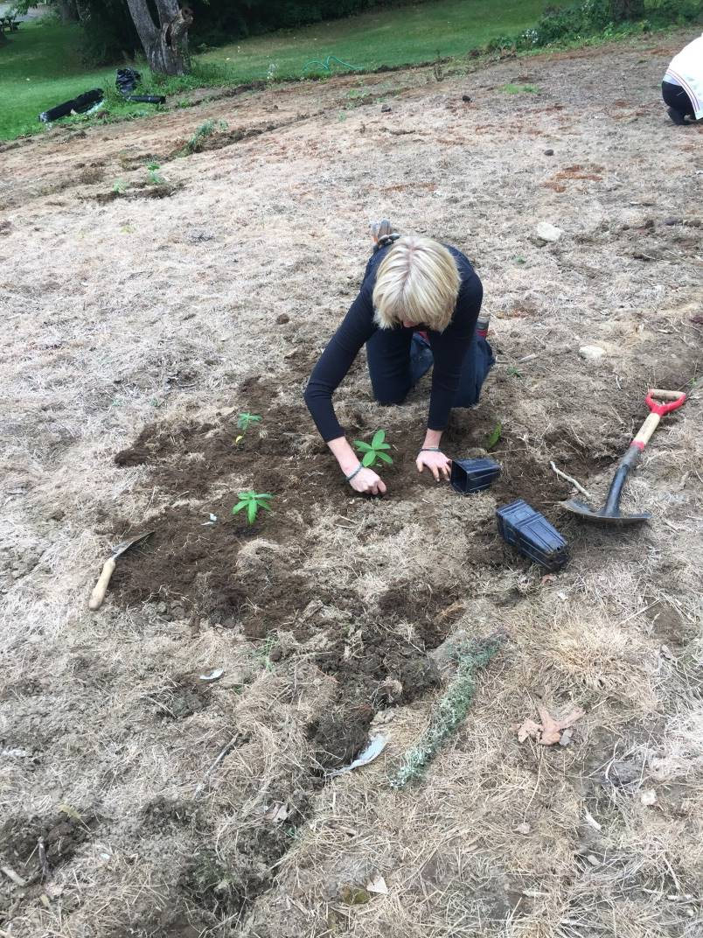
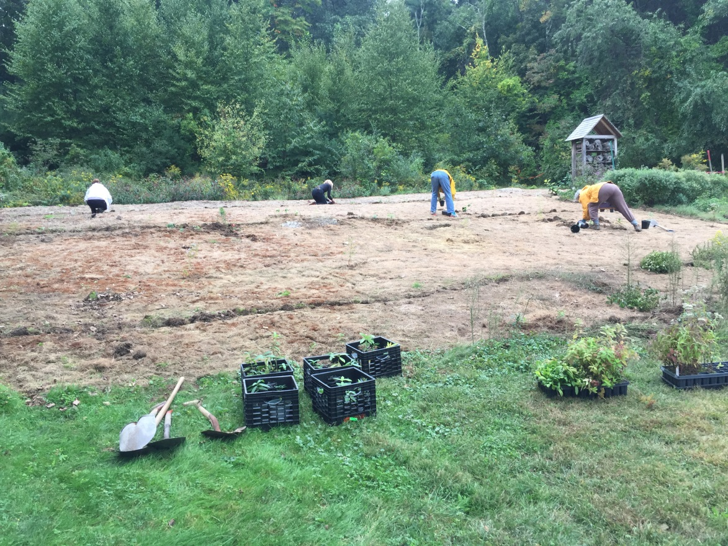
Planting
Install plugs and lay seed
Notes:
It’s important to plant soon after removing the solarizing sheets, before any invasive or unwanted plants establish. A native seed mix is a cost effective way to grow a pollinator area, but it may not include the plants needed for at-risk pollinators. Purchasing plugs (or small plants) of what you are missing is a way to fill the gaps.

Slide 18
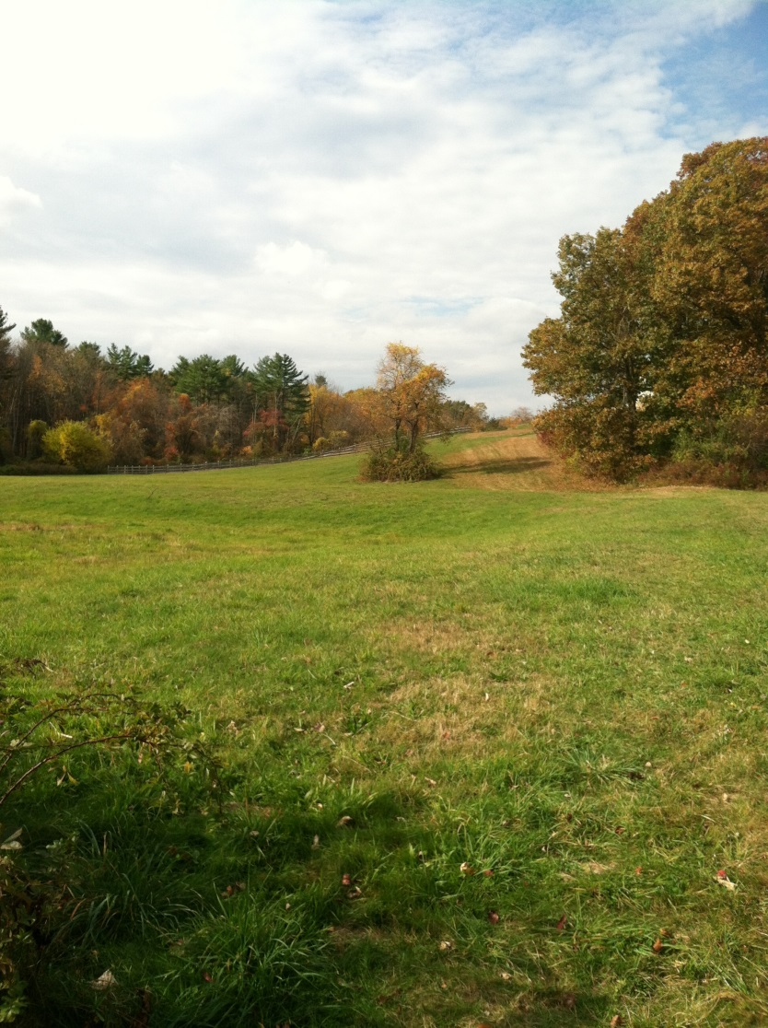
Tips for Managing Small Fields with Limited Resources
Use rotational mowing cycle
Reduce speed to at most 8mph
Don’t mow outward-in
Adding a flush bar to mower
Mower height to at least 8 in.
Mow in late fall to promote late season forbs like asters and goldenrods
Notes:
You may not have the resources for a full field restoration project. Here are some practices you can follow if all you have is a mower. Avoid mowing the whole field at once. That creates a large disturbance for critters using the field. Instead, leave some area to be mowed later. This could either be field edges or a whole section.

Slide 19
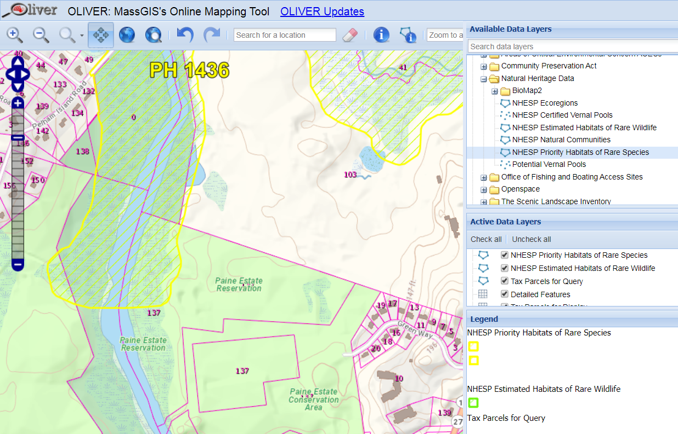
Find Habitats of Rare Wildlife
Notes:
One way to prioritize is to see if any rare species occur in or near your field. You can search online on OLIVER and select the Natural Heritage layers. This is a field that SVT manages, with some priority habitat between it and a river. To find out exactly what species an area is denoting, send an email to Natural Heritage with the PH number and prove that you the landowner looking to improve habitat.
Just because priority is not mapped, does not mean it’s not there. Ask a local botanist or naturalist to for a survey.

Slide 20

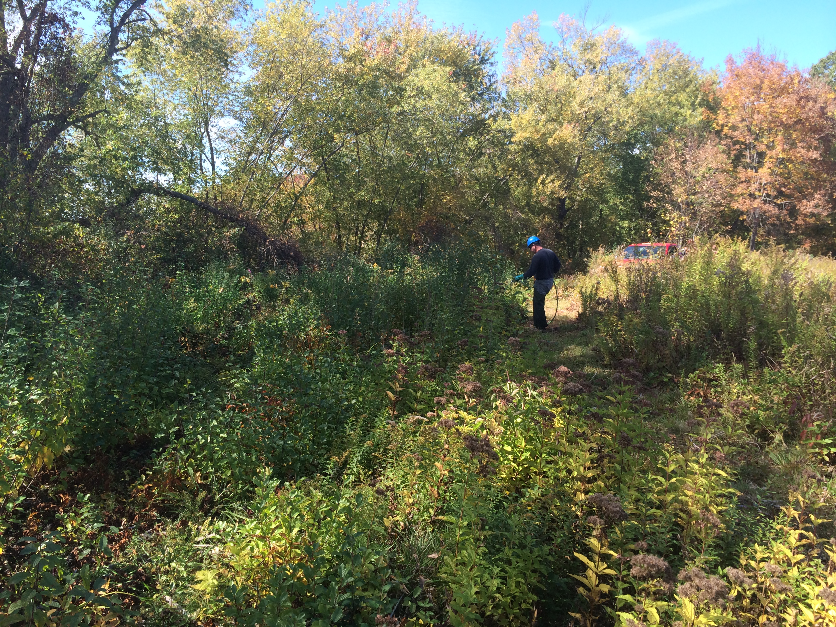
Treatment of Invasive Plants in Field Habitat Management
Control Strategies
Suggested Techniques
Required Licenses
Case study
Restoration & Shifting Plant Communities

Slide 21
Control Strategy
1. Goals for project
2. Methods
3. Resources
4. Survey, Mapping, Documentation (Year 1)
5. Flag sensitive areas and rare species
6. Control Methods and Implementation (Years 1-2)
  7. Follow up Control and Monitoring (long-term)
  8. Restoration
Notes:
Staff roles; volunteer roles

Slide 22
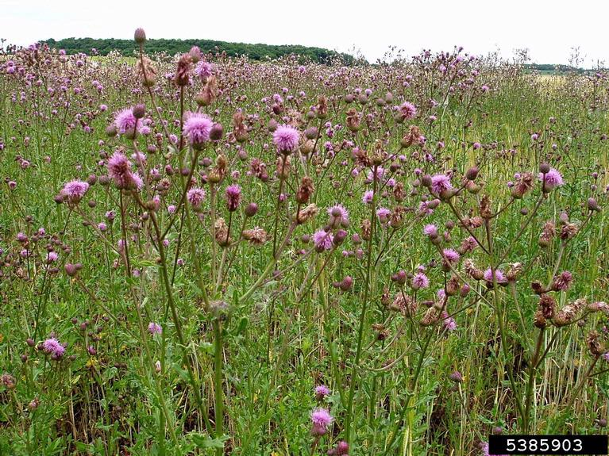
↑ Land use history = ↑ Invasive species abundance
Notes:
field habitats usually have an abundance of invasive species which 9 out of 10 times can be attributed to land use history. The longer a parcel is disturbed manipulated and planted the greater chance there is for invasion and establishment of these species.

Slide 23
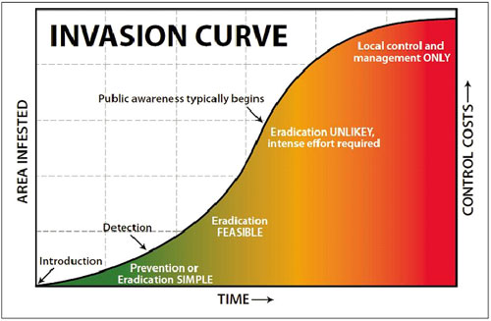
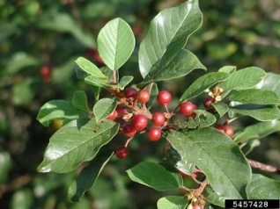
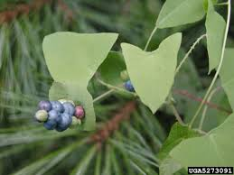
Control: Sequence
Notes:
SET a REALISTIC GOAL
Size of infestation influences feasibility of success and amount of $$ required for control
Prevention is the cheapest and easiest (prevention may not be an option in a field, where invasives are common)
Control of EDRR of is also in expensive and is relatively easy, requires
Define EDRR and some of the challenges.

Slide 24
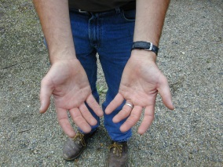
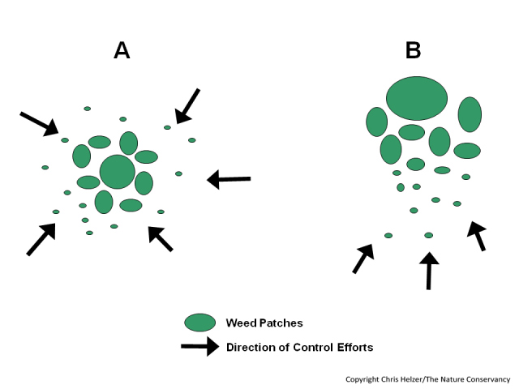
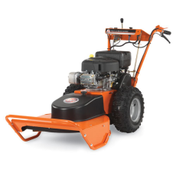
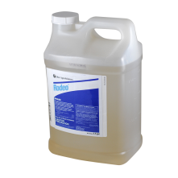
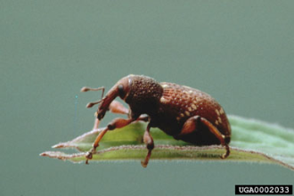
Control Strategies
Manual
Mechanical
Chemical
Biological
$$$$
Large Patch Small Patch
IPM
$
Notes:
Different approaches are appropriate for different sized infestations. It’s generally unrealistic to hand pull several acres of knapweed just as it’s unrealistic to release Galerucella beetles for a very small isolated patch of purple loosestrife. Select the right strategy for the right size patch.
Generally several strategies are needed for effective control (IMP).
Implement by working from the area of “least” infestation to the greatest while trying to reduce/stop seed production.

Slide 25

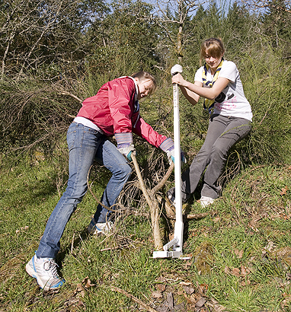
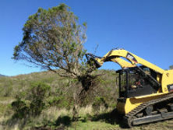
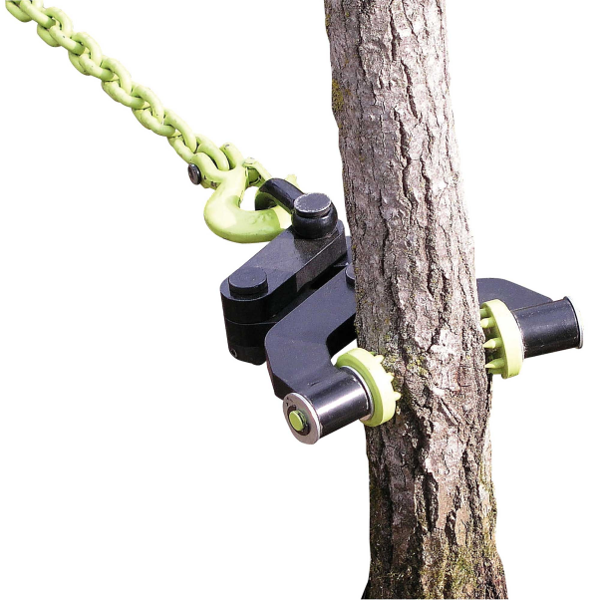
Control Techniques
Puller Bear
  SPRING – EARLY SUMMER
    Remove small-medium woodies or herbaceous plants
      Hand pulling or wrenching
        Volunteers!
      Mechanical uprooting
      Mound mulch/cover herbs.
Machine attachments
Brush Grubber
Notes:
Friends of Assabet; SVT volunteers.
NPT team of 20 =1/2 acre of fairly dense understory shrubs in 2-3 hrs. Ground is moist, weather is not hot, manual pulling can be done anytime of year. Species dependent—longer root species are not as easy for manual pulling—Asian bittersweet has long roots, Mugwort and Japanese knotweed have rhizomes that make it difficult to control by manual pull-On the other hand, Japanese Stiltgrass and Japanese barberry have shallow roots that make them easier to pull manually
Cost?
Touch on brush disposal

Slide 26
Mechanical Control Summary
PROS
Can be very cost effective
Requires little permitting and is very resource efficient
Introduces no chemicals into the environment
Volunteers can help initially
CONS
Labor intensive
Sometimes difficult to maintain volunteer enthusiasm
Time intensive
Not feasible for large scale infestations in most cases
Disturbance of soil

Slide 27
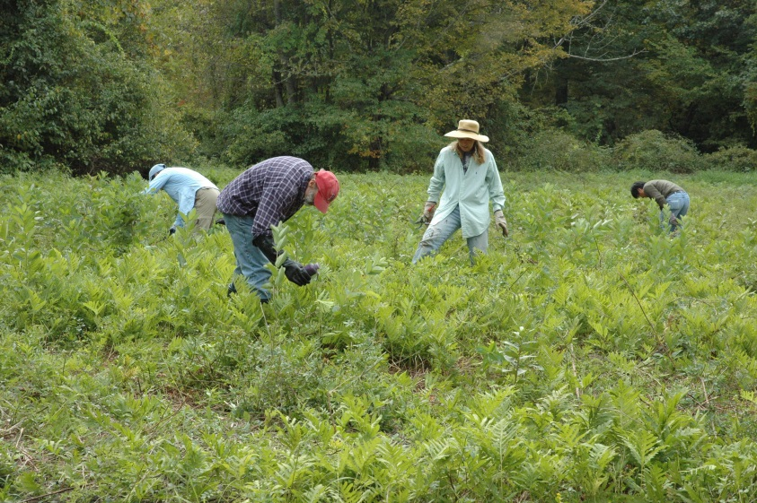
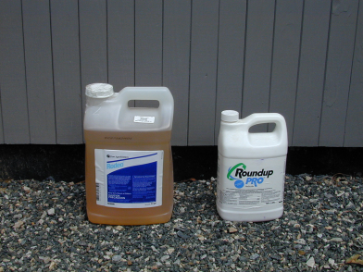
Chemical Treatments
One of the more effective and resource efficient ways to treat invasive species infestations
Most invasive plants can be treated using either glyphosate (Round-up and Rodeo) or triclopyr (Brush-B-Gone and Garlon)

Slide 28
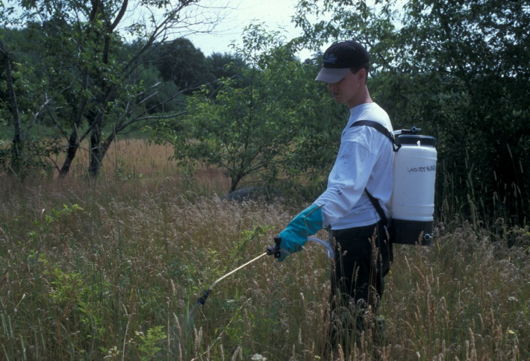
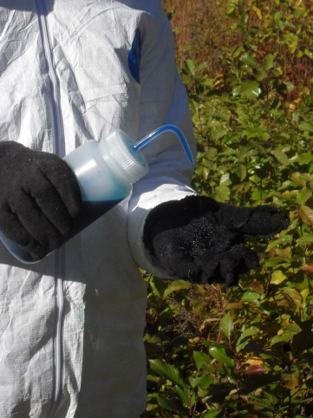
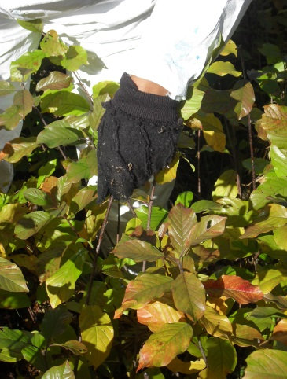
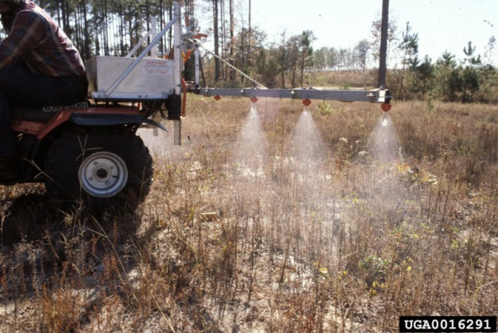
Control Techniques
  MID SUMMER – LATER FALL
    Treat woodies and herbs, < 5 ft.
      Foliar triclopyr - height of summer
      Foliar application of glyphosate late summer - fall
      Mechanical mowing, cutting or uprooting
Notes:
Foliar= less chemical and over 90%-100% effective, cut stump only 60% effective.
2-3 % solutions applied selectively by applicator, some collateral but spray can be targeted and veg. can be mowed earlier in the year to keep it low to the ground.
If favoring grass species in areas of dense invasives, selective herbicide (triclopyr) can be used and in some cases using an atv mounted boom sprayer is more effective and efficient.
Sensitive areas around rare plant species or habitats- swipe application- just as effective but very time consuming and

Slide 29




Control Techniques
  LATE FALL - WINTER
    Remove large woodies
      Cut-paint or hack glyphosate treatments
      Basal bark and dormant stem triclopyr treatments
      Mechanical
Notes:
Winter work= less non-target impact of herbs.
Glyphosate used on a 25-50% solution for C.P. Can be purchased in aquatic safe formulas for sensitive sites, very low toxicity. Brush must be cut or hacked. Brush handling can be costly and difficult.
Basal bark 20-30% solution in 100% oil for larger stems, dormant stem 2% solution plus 2-3 gallons oil in water for small stems. Only for upland site.
Oils = petroleum on non-petroleum based, non petroleum = Arborchem’s NPD- not to be sprayed into water.
Mechanical. Only suppresses vegetation, great for prepping for future foliar applications, improving access, and suppressing seed production.
Balance between disturbance and 100% control. Bush hogging can create a dense littler layer that prevents seed germination and limits open ground for wildlife

Slide 30
Required Licenses
  To apply “general use” herbicides you need, at a minimum, a Commercial Applicators License (sometimes called the CORE license)
  To apply “restricted use” herbicides you need a Commercial Applicators License PLUS a Commercial Certification

Slide 31
Chemical Control Summary
PROS
Can be very effective with cut-paint and foliar spray
Typically less labor and time intensive
Less earth disturbance
CONS
License required
Permitting is sometimes required
Work with potentially hazardous chemicals

Slide 32

Notes:
Cow Pasture before

Slide 33

Notes:
After treatment

Slide 34
Wetlands Permitting
Check with your local Conservation Agent regarding local bylaws
Contact DEP specialist

Slide 35


Rare species habitat Management
in a wet meadow habitat
Notes:
Native Plant Trust has been involved for a while on a rare plant species habitat management project in Concord, MA

Slide 36

Viola brittoniana management-Wet meadow
● 10 acres of floodplain and 9 acres of river open meadow
● Largest known population in NE for the rare Viola brittoniana
● Occupies approximately 2.5 acres of the overall site and presently contains approximately 2,666 plants
● Site is annually mowed, keeping the area in early succession
● Threats include succession and Invasive plants such as Frangula alnus (glossy buckthorn)
● Funding from the Town, via the state for Threatened and Endangered plants of MA
● Goal is to restore habitat and increase V. brittoniana population
Notes:
Native Plant Trust was contracted by the town to conduct management for the benefit of a rare violet, Viola brittoniana. This population of Viola brittoniana is threatened by the continued presence and spread of glossy buckthorn. This is by far the largest population of this rare species currently known in New England, with considerably more individuals than any other site. Its loss or dramatic decline would cause a major reduction in the total number of Viola brittoniana plants in the region, and may have genetic consequences. We have a good understanding of the ecology and habitat requirements of this species in our area resulting from Dr. Zielinski’s two decades of study and our own observations of its growth in cultivation at the New England Garden of Rare and Endangered Plants at Garden in the Woods, in addition to experience managing other populations-

Slide 37




Viola brittoniana -Species profile
Habitat: found mostly between the upper part of the annually flooded zone and the 100-year flood line of freshwater rivers-in wet meadows, and can occur in drier mowed areas and along woodland trails
Notes:
This rare violet has distinctive leaves with narrow lobes and deep sinuses- Fields, meadows, trail edges, and forest clearings adjacent to rivers and coastal marshes, also peaty river shores

Slide 38


Viola brittoniana management-Pre-management in 2009
Notes:
Management for this species has been going on since 2010-This photos shows pre-management-tons of buckthorn in much of the area around the open meadow-The shrub border surrounding the mowed portion of Calf Pasture contained many large fruit producing buckthorn Frangula individuals. The simple removal of Frangula from the pasture itself meant little in the long term without the removal of the source infestation. The removal of the Frangula would benefit the Viola by preventing further colonization of the open pasture habitat and reduce the competition for light, space, and nutrients.

Slide 39


Viola brittoniana management-Site preparation
Notes:
So, in 2010, NEWFS was contracted by the town/MA Natural Heritage to conduct management to restore populations of V. brittoniana. Monitoring of violets in measured plots had been conducted by Dr. Sally Zielinski, who has been monitoring V. brittoniana populations since 1990-to get a count of violets before management was conducted. The treatments started in Area 3, but expanded to Area 1, Area 4, and eventually Area 5, where new subpopulations of V. brittoniana were found. In Area 1, treatment of glossy buckthorn, multiflora rose, burning bush, etc. was conducted at subpopulations of V. brittoniana population along the creek side trail (within 2 meters of the trail), using hand-swipe and cut and paint methods of applying glyphosate. Hand pulling of invasive plants in this area was also conducted when feasible. A small population of V. brittoniana has been found in this area. Despite progress here, there is still a good amount of buckthorn, and other invasive plants that remain in this area.
Triclopyr was used to treat Asian bittersweet, and other invasive plants in Areas 2 and 4. The area was sprayed with Triclopyr in summer of 2017 in order to eliminate the encroachment of bittersweet and other invasive plants into the areas where V. brittoniana occur. Triclopyr (3, 5, 6-Trichloro-2-pyridinyloxyacetic acid) is an organic compound used as a systemic, foliar herbicide and fungicide. It was applied with a backpack sprayer in areas where no violets were present, and using the hand-wicking technique where contact with violets was possible via herbicide drift (Figure 3). Through this treatment, a significant amount of potential habitat will be opened up and a future and current serious issue will hopefully be addressed. Onoclea sensibilis (sensitive fern), a native plant with aggressive tendencies, was also treated within Area 2.
Area 3 has been treated with glyphosate multiple times in the past few years, and in 2017, hand-swipe method of treatment was applied to glossy false buckthorn and Asian bittersweet in order to 'maintain' and 'clean up' the area. V. brittoniana is abundant in this area. This area was treated for several hours. However, the amount of glossy false buckthorn saplings in this area is still abundant, and will require more treatment in 2018. It is possible that mowing in Area 3 annually in autumn can greatly increase the glossy false buckthorn saplings that will need to be treated.
Area 5 had a heavy, mainly low-growing buckthorn infestation and required the most hours of treatment with glyphosate. The hand-swipe method was used for smaller invasive plants, and the cut and paint methods for larger shrubs. Only a fraction of the work needed was completed in this area in 2017, so a large amount of work will be needed in 2018.

Slide 40

Viola brittoniana management-Methods
Annual monitoring of Viola brittoniana in long-term established plots
Invasive plant control of glossy buckthorn and other invasive plants in wet meadow, and forested floodplain
Treated with rodeo by cut-paint and hand-swipe methods
Treated Asian bittersweet with triclopyr spray method
Notes:
The cut-and-paint treatments started in Area 3, but expanded to Area 1, Area 4, and eventually Area 5, where new subpopulations of V. brittoniana were found. In Area 1, treatment of glossy buckthorn, multiflora rose, burning bush, etc. was conducted at subpopulations of V. brittoniana population along the creek side trail (within 2 meters of the trail), using hand-swipe and cut and paint methods of applying glyphosate. Hand pulling of invasive plants in this area was also conducted when feasible. A small population of V. brittoniana has been found in this area. Despite progress here, there is still a good amount of buckthorn, and other invasive plants that remain in this area.
Triclopyr was used to treat Asian bittersweet, and other invasive plants in Areas 2 and 4. The area was sprayed with Triclopyr in summer of 2017 in order to eliminate the encroachment of bittersweet and other invasive plants into the areas where V. brittoniana occur. Triclopyr (3, 5, 6-Trichloro-2-pyridinyloxyacetic acid) is an organic compound used as a systemic, foliar herbicide and fungicide. It was applied with a backpack sprayer in areas where no violets were present, and using the hand-wicking technique where contact with violets was possible via herbicide drift (Figure 3). Through this treatment, a significant amount of potential habitat will be opened up and a future and current serious issue will hopefully be addressed. Onoclea sensibilis (sensitive fern), a native plant with aggressive tendencies, was also treated within Area 2.
Area 3 has been treated with glyphosate multiple times in the past few years, and in 2017, hand-swipe method of treatment was applied to glossy false buckthorn and Asian bittersweet in order to 'maintain' and 'clean up' the area. V. brittoniana is abundant in this area. Area 5 had a heavy, mainly low-growing buckthorn infestation and required the most hours of treatment with glyphosate. The hand-swipe method was used for smaller invasive plants, and the cut and paint methods for larger shrubs.

Slide 41

Viola brittoniana management-challenges
Control of glossy false buckthorn has proved to be challenging, since this species resprouts vigorously in response to herbicide and mowing
Resprouts of buckthorn have been visually observed after mowing and cut-painting individuals
Manual pulling is not feasible due to the proximity of violets next to buckthorn
Recruitment of source of buckthorn has not yet been eradicated--dispersal

Slide 42
Viola brittoniana management--2019-2020 management objectives
Native Plant Trust (NPT) set up three 10 m X 10 m plots in 2019
NPT conducted counts of V. brittoniana individuals and hybrids, and also counted Frangula alnus (glossy buckthorn) stems within each plot
Later, in summer of 2019, NPT conducted hand-swipe of buckthorn within the three plots
Goal is to evaluate the effectiveness of the hand-swiping of buckthorn within each plot, determine survivorship of buckthorn, and monitor for changes of V. brittoniana numbers
In 2020, NPT will count V. brittoniana and buckthorn stems again in the three plots in order to gather data to determine if hand-swiping method is an effective tool in controlling buckthorn

Slide 43



Slide 44

Shifting Plant Communities
Notes:
Remove sod (non-native species, i.e. fescues)
Timed mowing, herbicide, fire, or raking
Majority “ag.” field grasses are non-native and many are mat forming (fescues) whih prevents native plant germination
Management tools can be used to shift plant communities to some degree, general approach is
- late season mowing- suppresses woodies, favors perennial herbs
Spring mow suppresses woodies, favors grasses
Mid-season mow can target species like golden rod. Time to hit plants at flower, before fruit.
Herbicide can be used to create openings while limiting disturbance
Fire, acts similarly to mowing but removes thatch (which prevents germination of some species)
Raking can be combined with mowing in replace of fire

Slide 45

Case Study
Greenways Conservation Area Wayland
Notes:
Overview of landscape context – see many fields nearby and some across river and within same complex that are supporting breeding bobolinks.
Target species: bobolink plus other insects/plants that might use this habitat.

Slide 46

Case Study
Greenways Conservation Area, Wayland

Slide 47

Case Study
Greenways: SVT North Field (2007)
Notes:
Plan to remove edges. Commission balked at section “C” because it contained a decent proportion of native wetlands shrubs.
However – this defeats the purpose. The goal is to create open meadow habitat; not protect wetland shrubs/trees.

Slide 48




Mowing invasive shrub perimeters
Funded by MassWildlife

Slide 49


Fecon Bull Hog Mounted on a Skid Steer
Brush Hog Maintenance mowing

Slide 50


Treatment of
Shrub Wetland/Field Edges

Slide 51

Persistent Buckthorn and Others
Funded by National Fish & Wildlife Foundation
& NYANZA Mitigation Funds

Slide 52


3 years of treatments+
Notes:
Cut and paint larger buckthorn shrubs around edges and in the wetter corner of the field.
Selectively spray buckthorn in field interiror (after mowing earlier in the season).

Slide 53

After first year

Slide 54


Planting Natives
Choose Plot locations and kill existing plants

Slide 55


Rototilled Plot – Much easier!
(Success was similar)

Slide 56


Weeding and Watering

Slide 57



Success!!

Slide 58


Pollinators

Slide 59


But…. 2 years later

Slide 60



3 Years Later

Slide 61
Funding Grassland
Habitat Management
USDA Natural Resources Conservation Service (EQIP) – DCR Liaison
MassWildlife Habitat Management Program
DCR Forest Stewardship Program
Local CPA
Work with partners to increase funding potential

Slide 62

Q & A Discussion

