Slide 1
”Eyes in the Sky”
Wellesley Conservation Council
Pete Jones, Michael Tobin, and Kevin Hanron

Slide 2
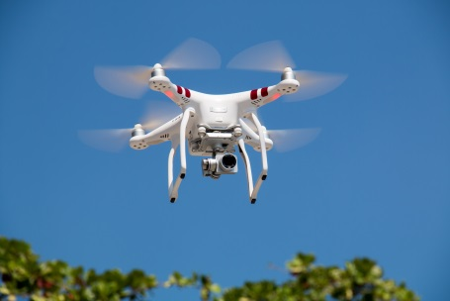
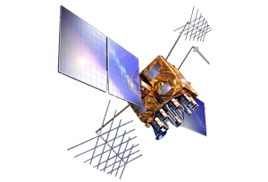
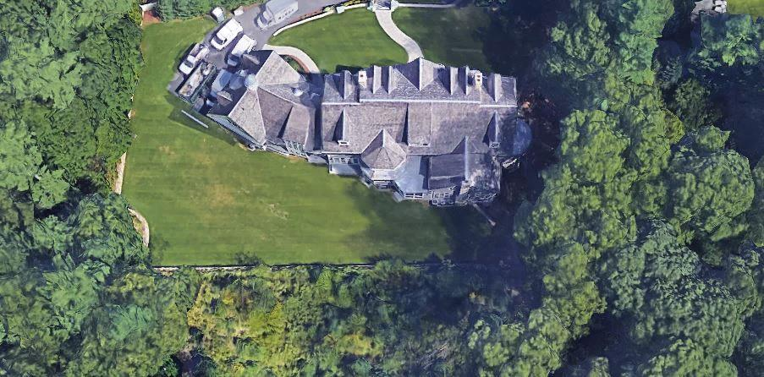
“Eyes in the sky” monitoring tools, techniques, and methods to protect your conservation resources

Slide 3
Todays Presentation
How using new technology can protect your conservation lands from encroachment
How technology can increase your staff or volunteers’ productivity managing your land trusts
How technology helps you identify your property borders as well as giving you detailed tree sizing and location information for remediation

Slide 4
It’s Complicated
New technology like drones can identify encroachment areas
Parcel research and GIS analysis can help educate your land trust and provide accurate background information
In the event that encroachment offenders refuse to cooperate, seek pro bono legal assistance immediately

Slide 5
How a Land Trust can Use Quadcopters (drones): Our “Eyes in the sky”

Slide 6
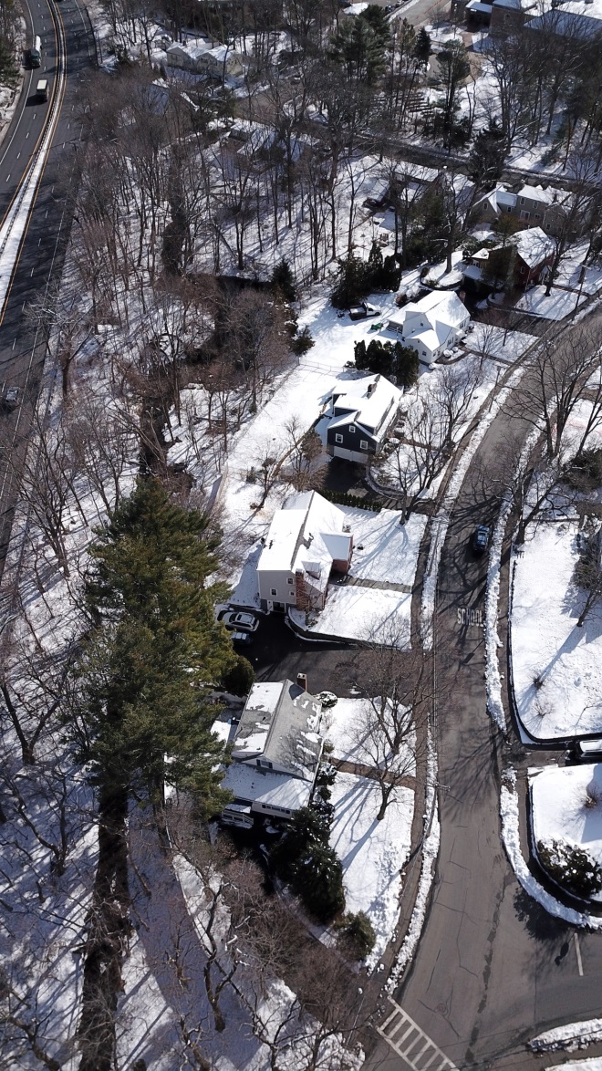
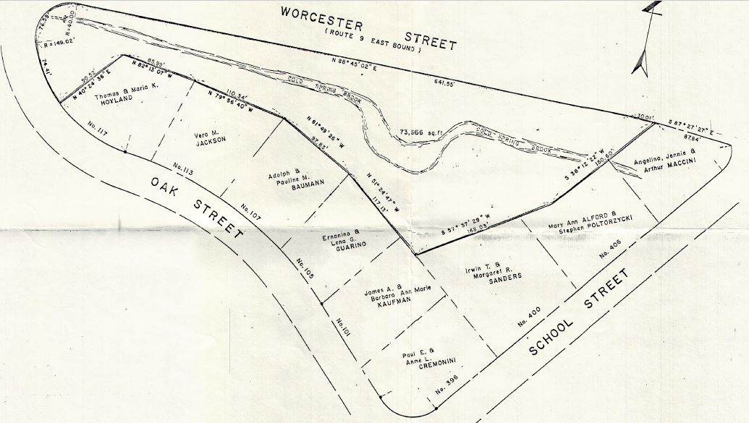
Cold Spring Brook Sanctuary
A two-acre green buffer between Worcester St (State Route 9) and a school neighborhood
Acquired by the Council in 1982

Slide 7
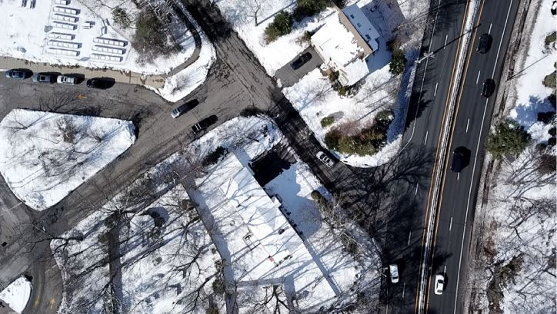
Let’s Go Flying!
Attend Workshop 3D Room B110 2:30 - 3:55pm
to see Fly Over technology solutions

Slide 8
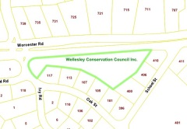
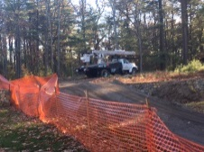
The First Warnings and Responses
Ongoing monitoring reveals encroachment, or concerned neighbors call about destruction or construction
Research property details
Visit easement property and ask owners permission to investigate

Slide 9
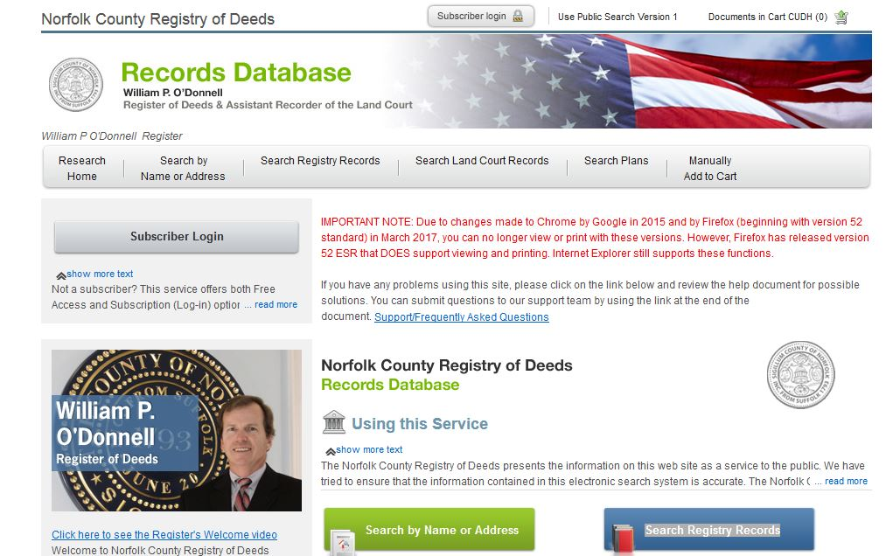
Research Properties – County Registry of Deeds

Slide 10
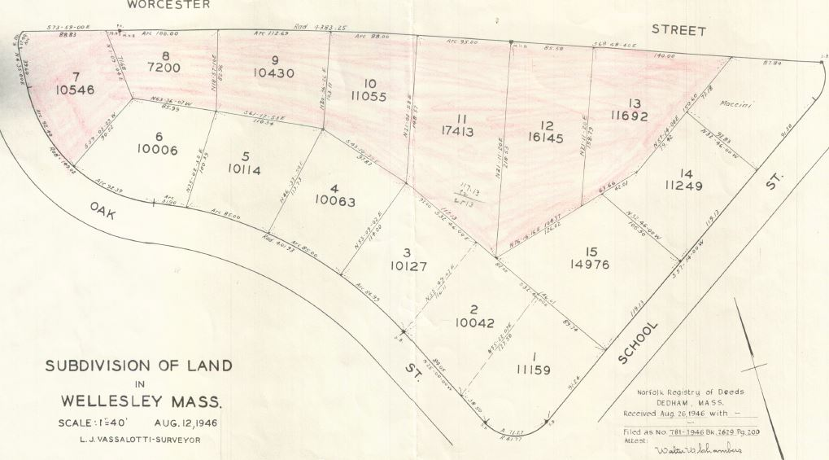
Research Properties – 1946 Tax Maps

Slide 11
Research Properties – 1991 Tax Maps

Slide 12
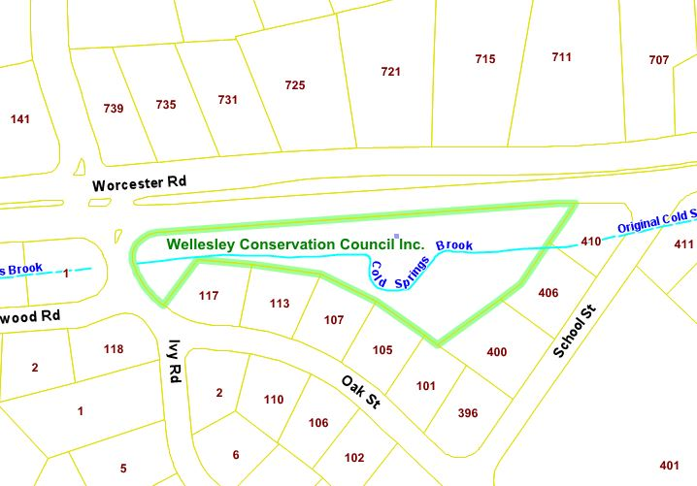
Research Properties – Parcel Maps

Slide 13
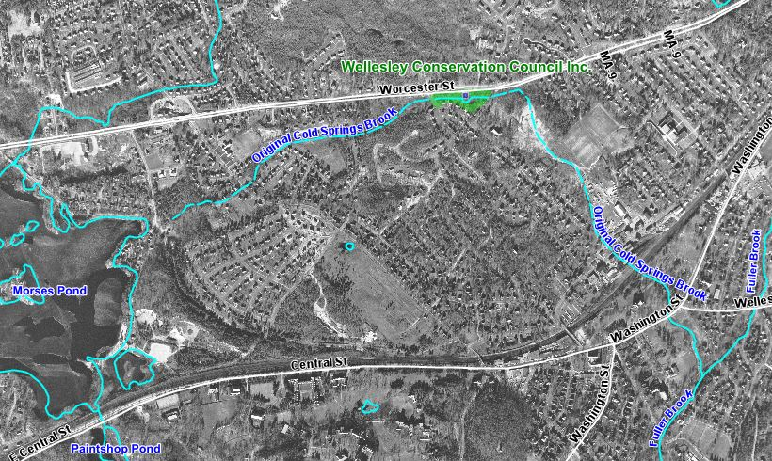
Cold Springs Brook - 1955

Slide 14
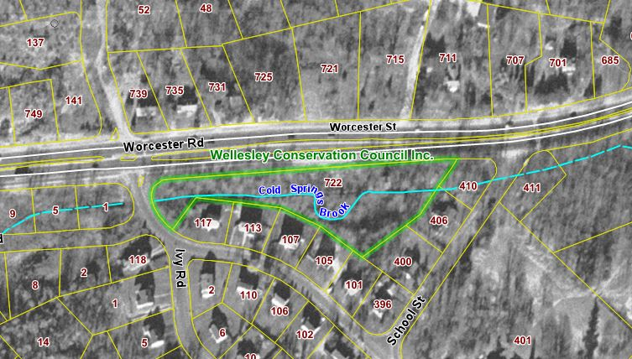
Cold Springs Sanctuary - 1955

Slide 15
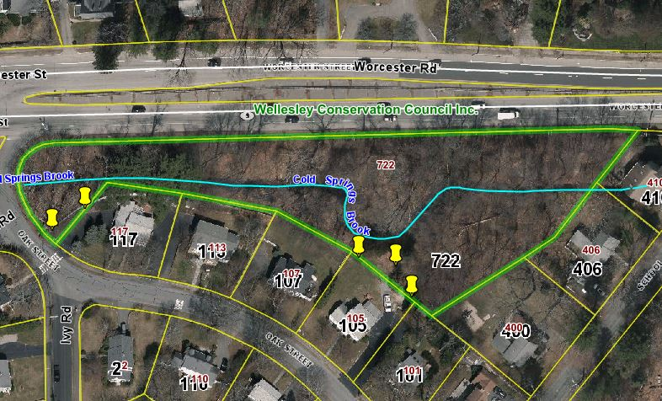
Cold Springs Sanctuary - 2017

Slide 16
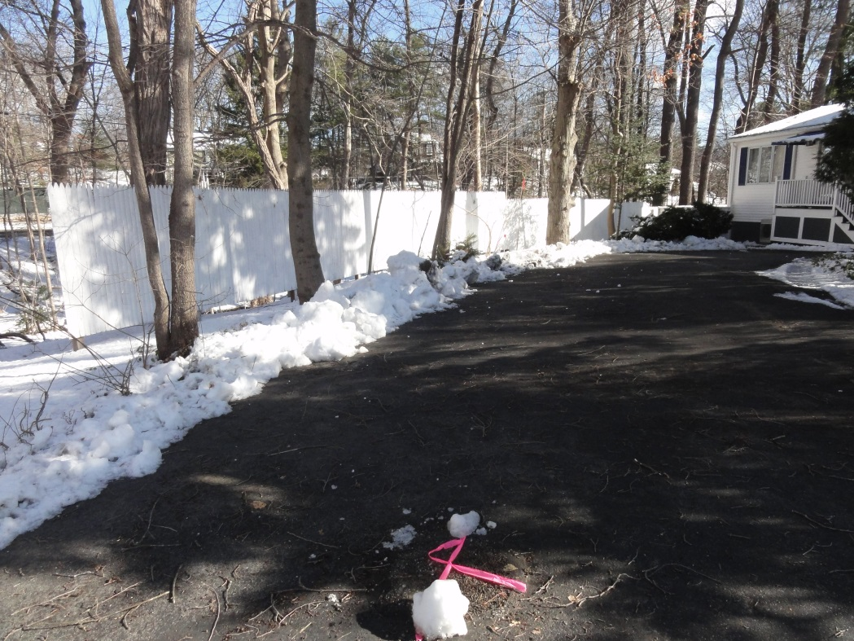
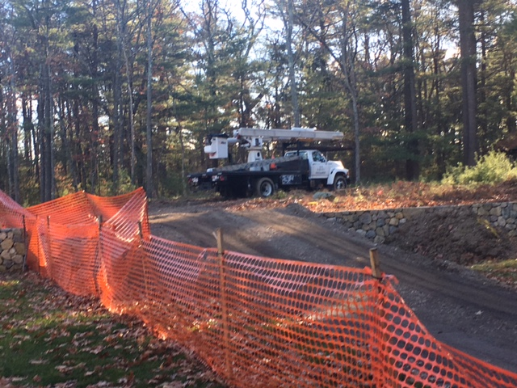
Visit Your Conservation Properties
… From the Ground

Slide 17
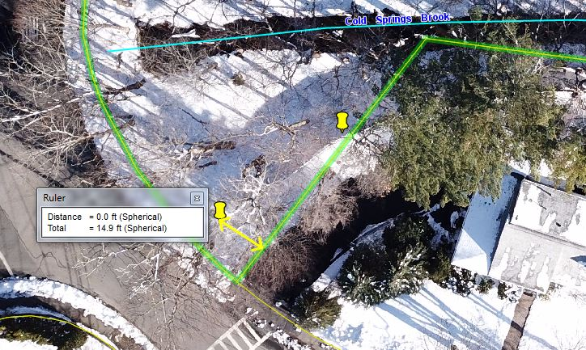
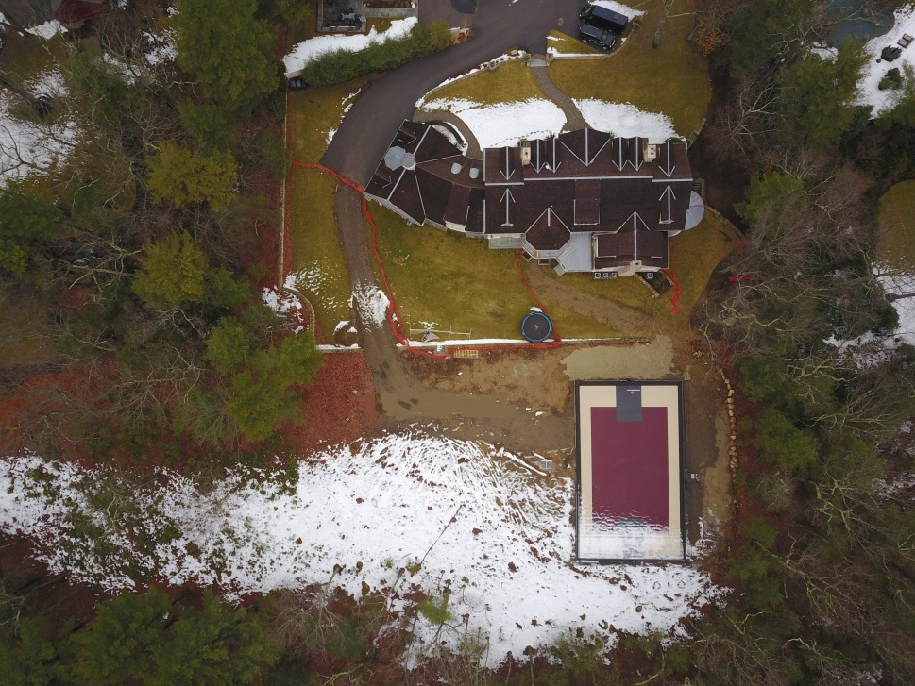
And Visit Your Conservation Properties
From the Air
2018 Drone Photo
2017 Drone Photo
Integrated into GIS for Analysis

Slide 18
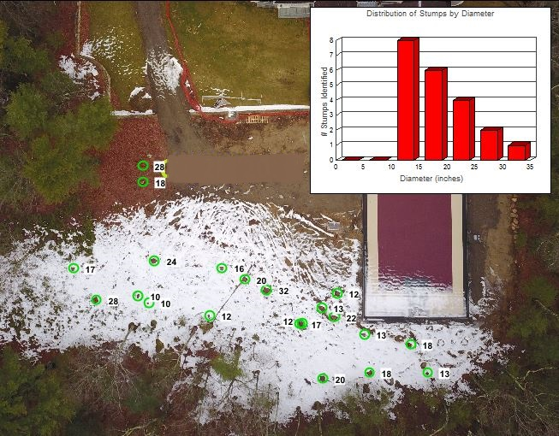
Using GIS and Drone Photos to Quantify Enroachment Damage

Slide 19
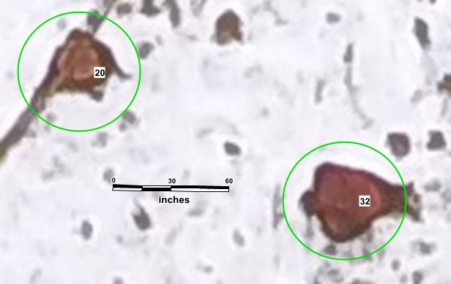
“Zoom In” And Measure Tree Stump Diameters
Using GIS Ruler Tool

Slide 20
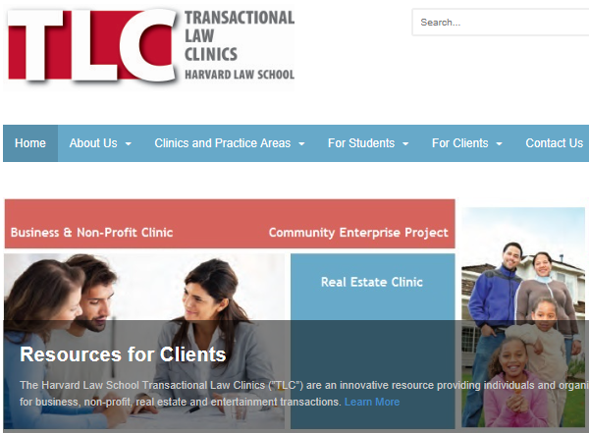
If a Friendly Resolution Cannot be Found,
Find out Whether you Should Find a Lawyer

Slide 21
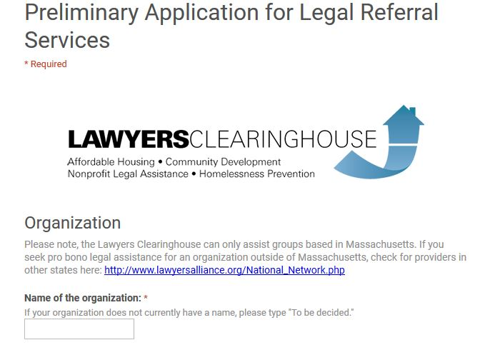
If Litigation is Recommended,
You Need to Find a Lawyer You Can Afford!

Slide 22
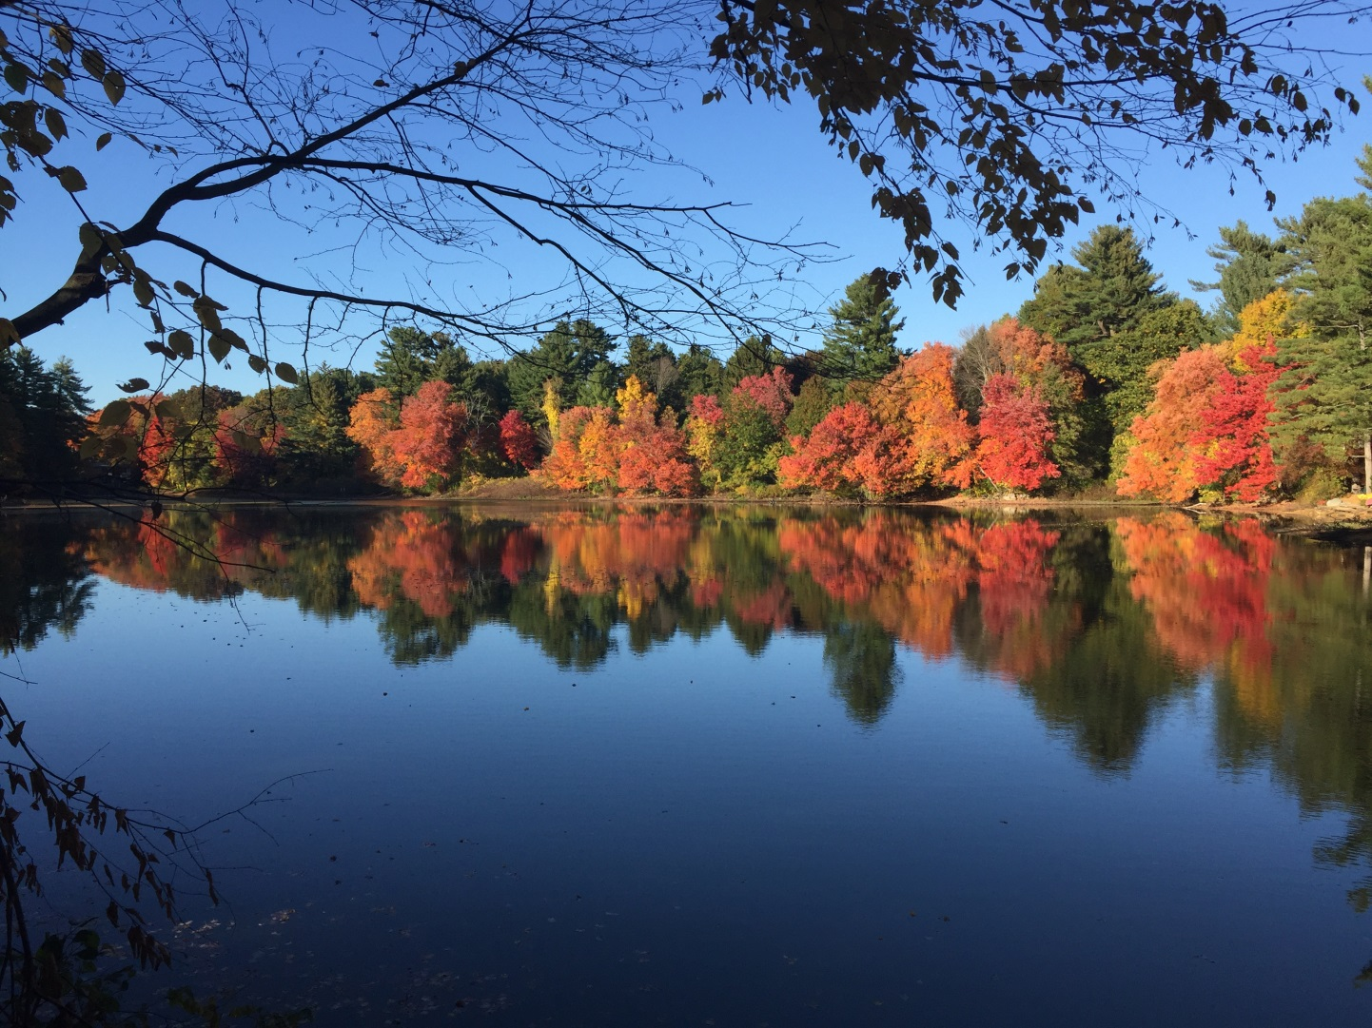
One Last Flight
Guernsey Sanctuary (Lake Sabrina)
Attend Workshop 3D Room B110 2:30 - 3:55pm
to see Fly Over Technology Solutions

Slide 23
It’s Complicated,
But You Can Do It Too
Monitor your properties against your baseline data on a regular basis, aerial photography is best done in late fall or early spring
Respond quickly to encroachment activities
Use effective technologies to assess activity, and in the rare event that offenders refuse to cooperate seek pro bono legal assistance
Questions?

