Slide 1
Planning and Executing a Grassroots Campaign

Slide 2
Choose and clarify your goal
Criteria/Possible Campaign: | Get Sen. Spilka To report out PLPA | Stop the Loss of Public Land in our town | Get our city council to pass a resolution supporting solar net metering limits | ??
Is it winnable in a timely way?
Will it build our group’s strength, increase our visibility to power-holders?
Do we have allies in this? Who?
Does it result in a concrete change?
Will it set us up for a next win or next step in our longer campaign?

Slide 3
The 50:50 Rule
50% of your group’s time should go to capacity-building…
50% to achieving your goals/waging your campaign

Slide 4
Plan Your Campaign (1)
Purpose of this Planning Step:
To set concrete steps in and phases of your campaign
To identify who you will work with, who will help you reach the goal
To identify who are your main targets, who has the power to make the change

Slide 5
Plan your Campaign (2)
Impact Goal | Organizational Goal | Constituents, Allies and Opponents | Decision-maker and Target(s) | Peaks in the Campaign | Tactics

Slide 6
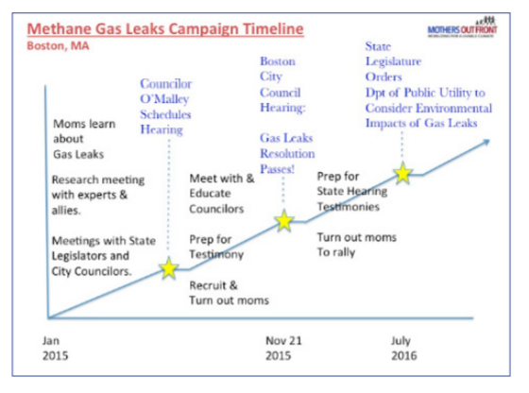
Set Your Timeline

